Slide 1
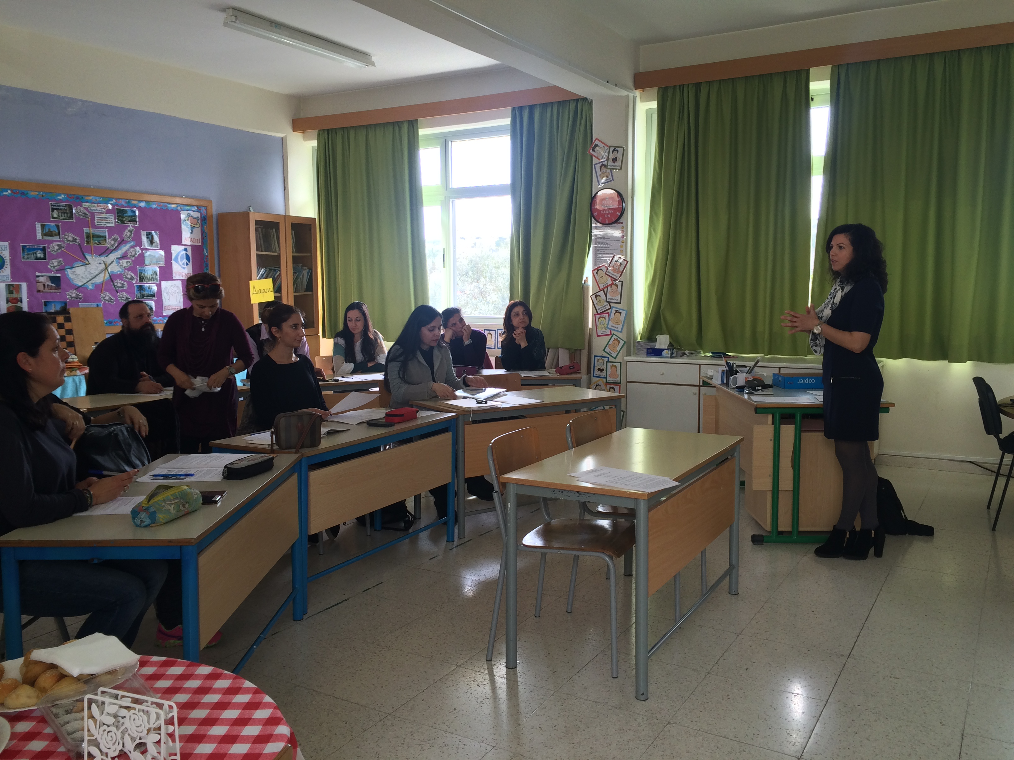
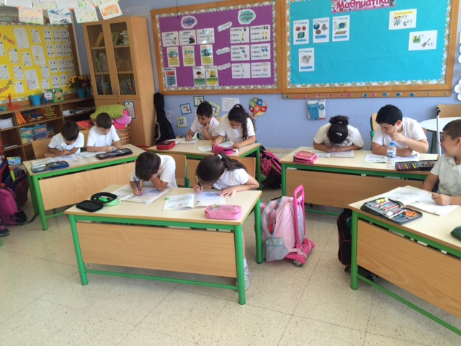
Alambra Primary School, Nicosia, Cyprus
School-Based Teachers’ Professional Learning
Kalomira Ioannou
Raising Achievement Project Advisory Group member, National Co-ordinator Cyprus, Headteacher
Notes:
Alambra Primary School, Nicosia, Cyprus
School-Based Teachers’ Professional Learning
Kalomira Ioannou
Raising Achievement Project Advisory Group member, National Co-ordinator Cyprus, Headteacher

Slide 2
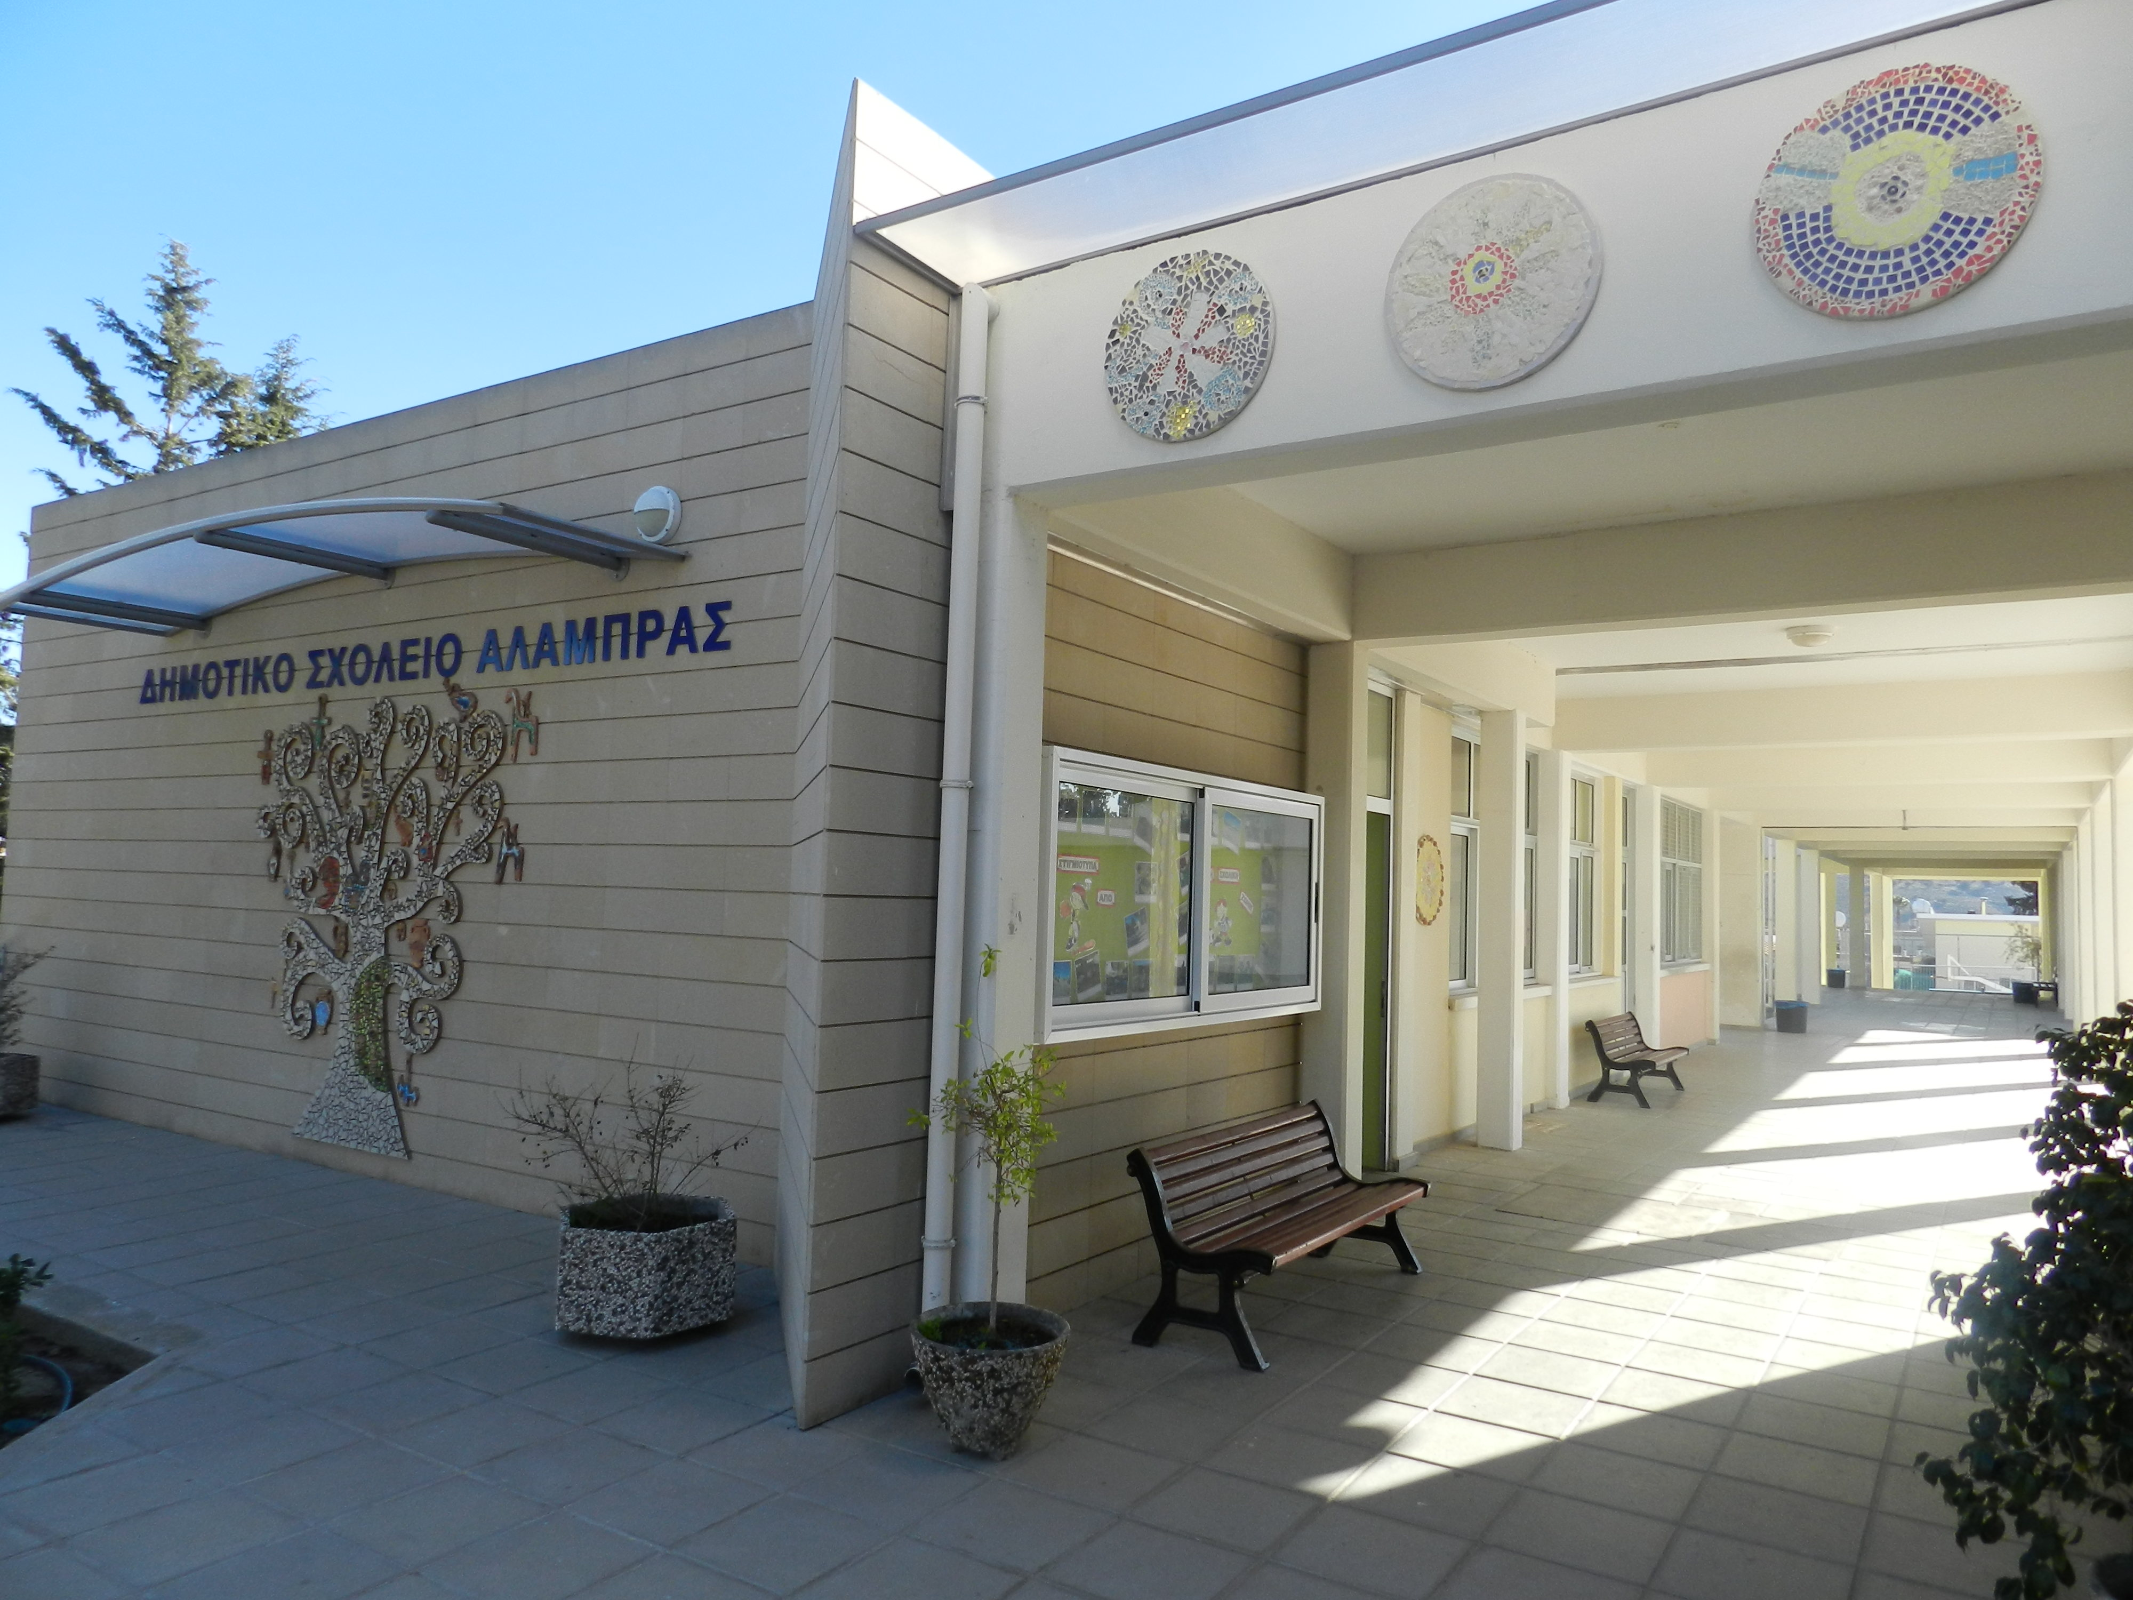
Professional Learning Programme Focus: Raising the Achievement of All
About the school
Rural school, near the capital (Nicosia)
93 pupils
10 teachers
1 headteacher
1 special needs teacher
1 speech therapist
Difficulties in reading, comprehending, low achievement
The programme was developed by the school with the support and guidance from the Pedagogical Institute of Cyprus
Notes:
Professional Learning Programme Focus: Raising the Achievement of All
About the school
Rural school, near the capital (Nicosia)
93 pupils
10 teachers
1 headteacher
1 special needs teacher
1 speech therapist
Difficulties in reading, comprehending, low achievement
The programme was developed by the school with the support and guidance from the Pedagogical Institute of Cyprus

Slide 3
Stages
Investigation of pupils’ needs in learning
Investigation of parents’ needs in their child’s learning
Investigation of the teachers’ needs in their teaching practice to meet the needs of the pupils and parents and to raise achievement of all
Setting priorities- Basic Needs – Common vision
Action plan
Implementation of action plan
Assessment
Redefinition of goals and actions
Notes:
Stages
Investigation of pupils’ needs in learning
Investigation of parents’ needs in their child’s learning
Investigation of the teachers’ needs in their teaching practice to meet the needs of the pupils and parents and to raise achievement of all
Setting priorities- Basic Needs – Common vision
Action plan
Implementation of action plan
Assessment
Redefinition of goals and actions

Slide 4
Investigation of needs
Pupils
Teachers
Differentiation
Less homework
More use of games and technology in the lesson
Difficulties to achieve well
Encouragement
Pupils do not do their homework
Very slow learners
Low achievement
Difficulties in reading and
comprehending which affects all lessons
Parents
How to help their children at home
Notes:
Investigation of needs
Teachers
Pupils do not do their homework
Very slow learners
Low achievement
Difficulties in reading and comprehending which affects all lessons
Parents
How to help their children at home
Pupils
Differentiation
Less homework
More use of games and technology in the lesson
Difficulties to achieve well
Encouragement

Slide 5
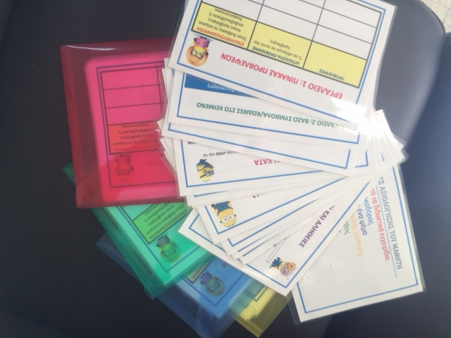
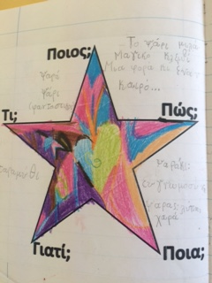
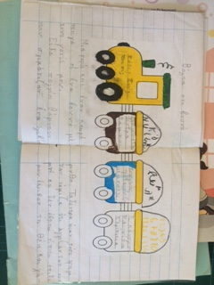
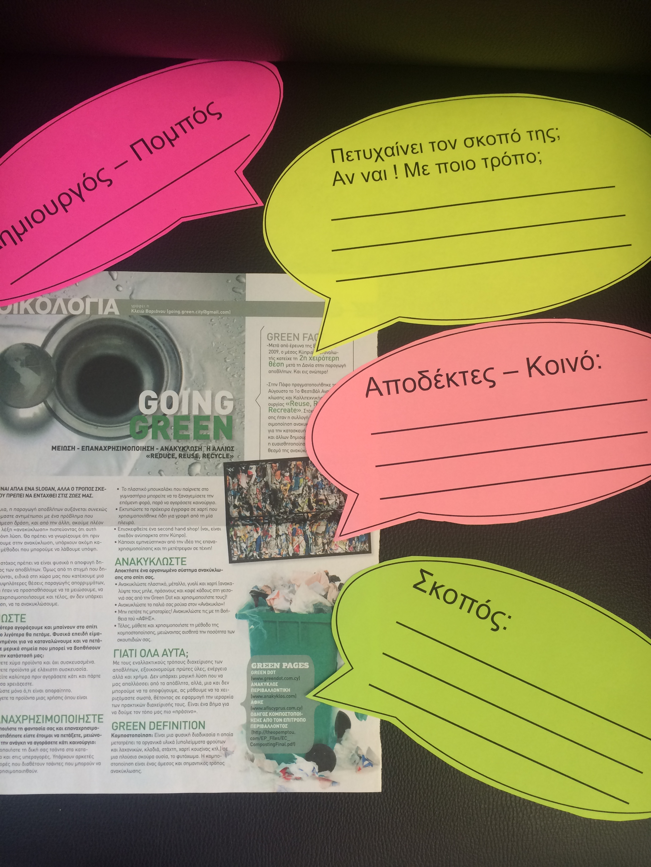
Setting goals
Effective teaching in order to raise achievement of all learners
Helping pupils with reading and comprehension
Helping parents help their children
Notes:
Setting goals
Effective teaching in order to raise achievement of all learners
Helping pupils with reading and comprehension
Helping parents help their children

Slide 6
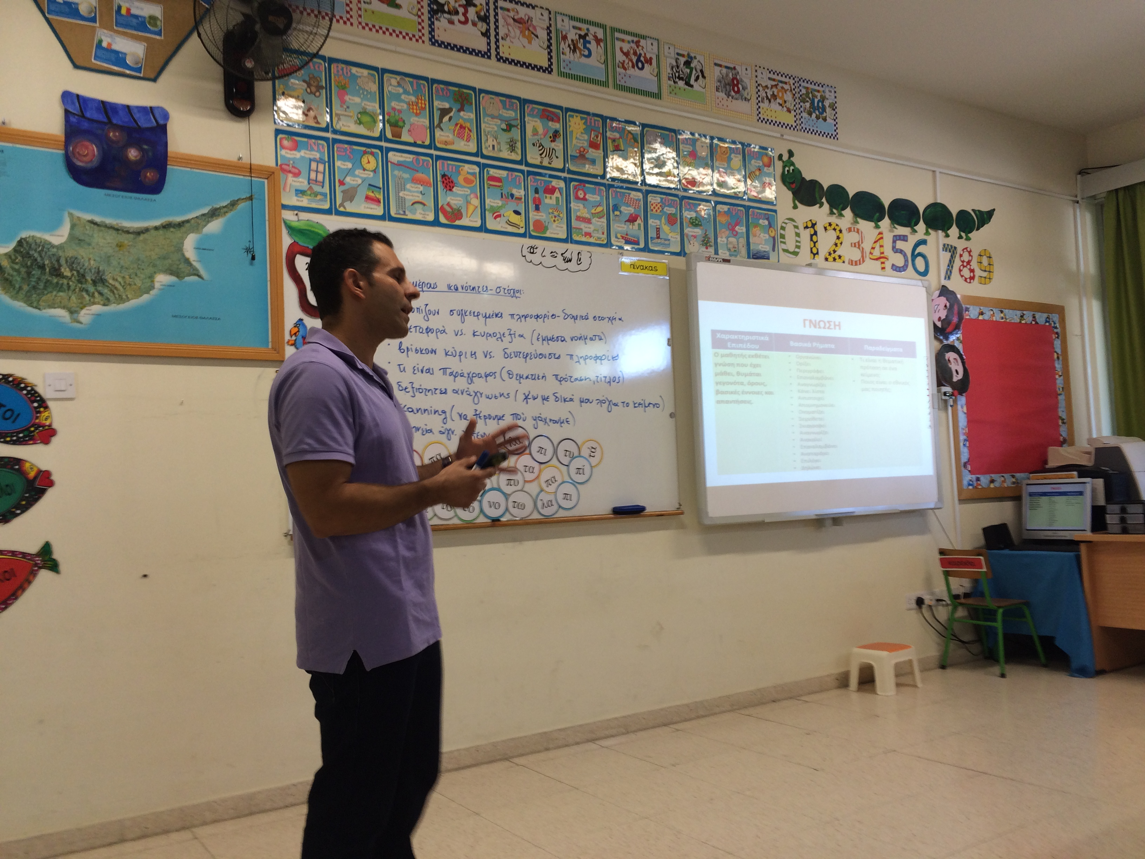
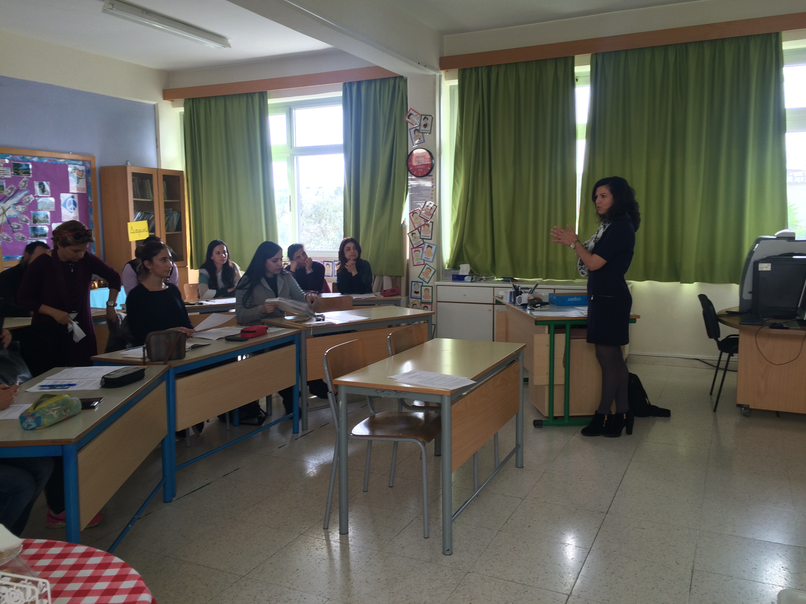
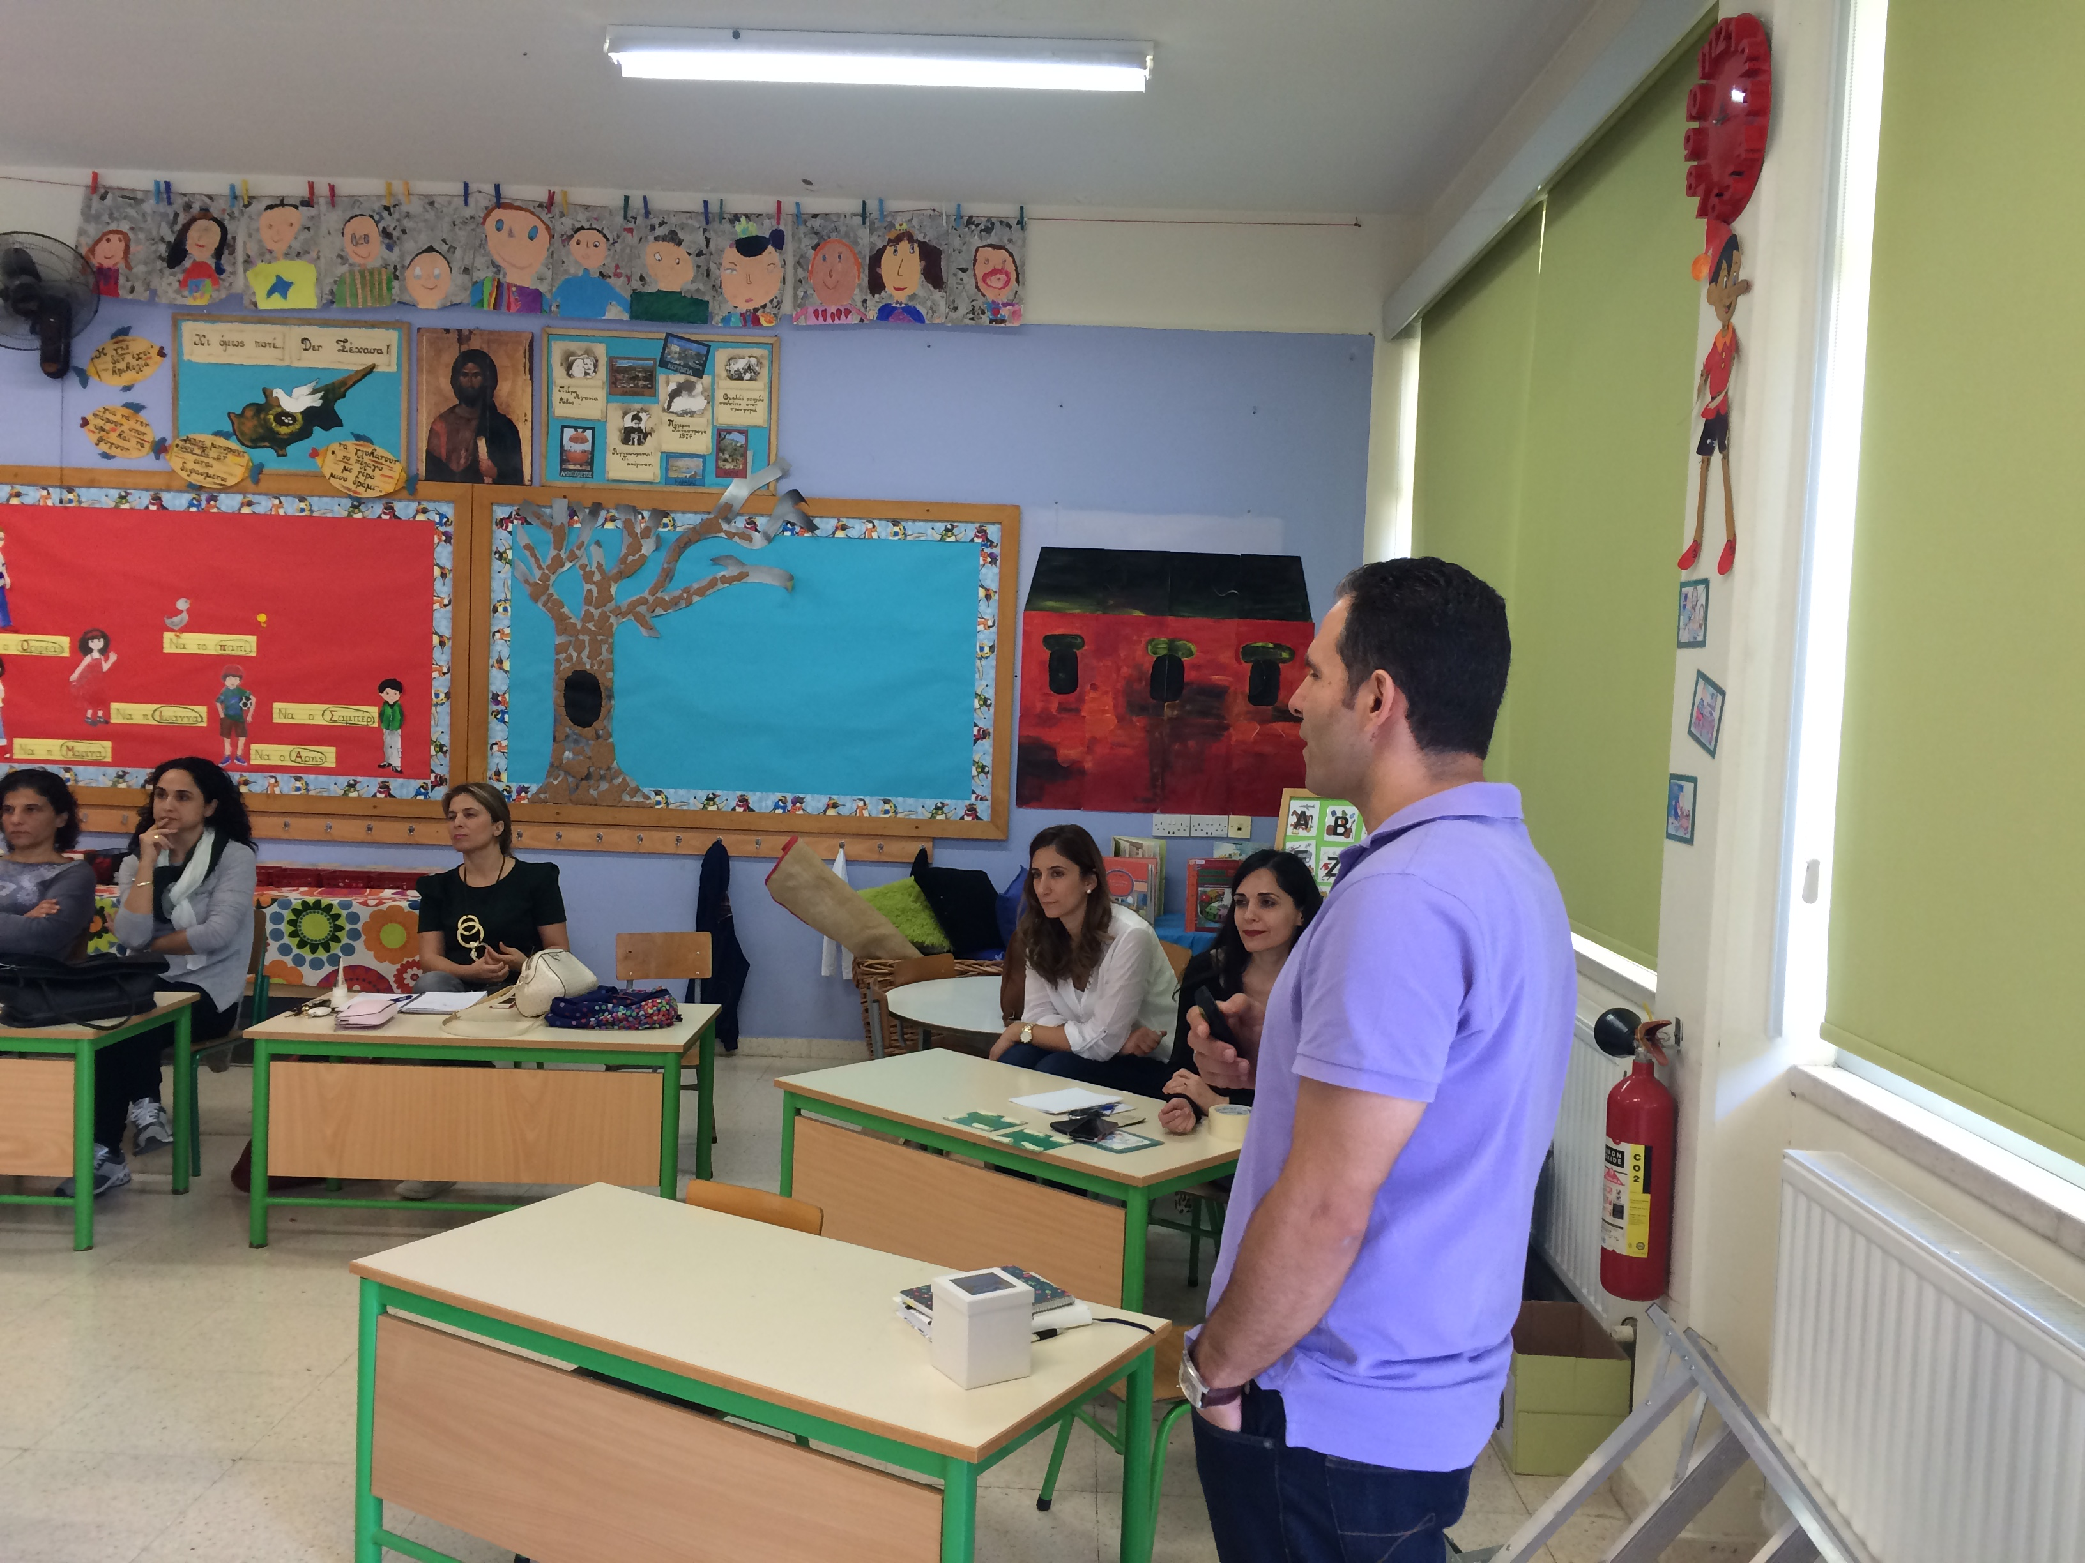
Action plan
Teaching strategies for effectiveness in class
Goals for each class and pupil
In-service training for teachers on effective teaching and meeting the needs of all pupils (educators from the Pedagogical Institute of Cyprus)
In-service training on improving reading and comprehension skills (professors from the University of Cyprus)
Assessment for raising achievement
Observation in classroom (teachers)
Co-teaching
Pedagogical meetings
Teacher-Parent meetings
Self-evaluation
Notes:
Action plan
Teaching strategies for effectiveness in class
Goals for each class and pupil
In-service training for teachers on effective teaching and meeting the needs of all pupils (educators from the Pedagogical Institute of Cyprus)
In-service training on improving reading and comprehension skills (professors from the University of Cyprus)
Assessment for raising achievement
Observation in classroom (teachers)
Co-teaching
Pedagogical meetings
Teacher-Parent meetings
Self-evaluation

Slide 7
Outcomes
Pupils were happier and took part in the lessons, they enjoyed lessons, were more active in class, could understand more
Teachers were more satisfied with their teaching and with their pupils achievement
Parents were happy to see their children improve and found it easier to help them at home
All could see themselves improve
Raising achievement was evident through assessment
Raising achievement
raising teaching quality/pedagogy
school leadership
collaboration
Notes:
Outcomes
Pupils were happier and took part in the lessons, they enjoyed lessons, were more active in class, could understand more
Teachers were more satisfied with their teaching and with their pupils achievement
Parents were happy to see their children improve and found it easier to help them at home
All could see themselves improve
Raising achievement was evident through assessment
Raising achievement
raising teaching quality/pedagogy
school leadership
collaboration

