Slide 1
M-DECREE: MOTOR, MOTIVATION AND POSSIBILITIES IN PROFESSIONAL LEARNING COMMUNITIES
WILSSENS, M., MEIRSSCHAUT, M., MICHELS, S., OUAHAB, A., DE SMET, V.
Artevelde University College, Ghent, Belgium, Pedagogical Counselling Service Catholic Education Flanders, East-Flanders area, Pedagogical Counselling Service of the City of Ghent
www.arteveldehogeschool.be/en/en
MALTA, 6th of April 2017
Notes:
M-DECREE: MOTOR, MOTIVATION AND POSSIBILITIES IN PROFESSIONAL LEARNING COMMUNITIES
WILSSENS, M., MEIRSSCHAUT, M., MICHELS, S., OUAHAB, A., DE SMET, V.
Artevelde University College, Ghent, Belgium, Pedagogical Counselling Service Catholic Education Flanders, East-Flanders area, Pedagogical Counselling Service of the City of Ghent
www.arteveldehogeschool.be/en/en
MALTA, 6th of April 2017

Slide 2
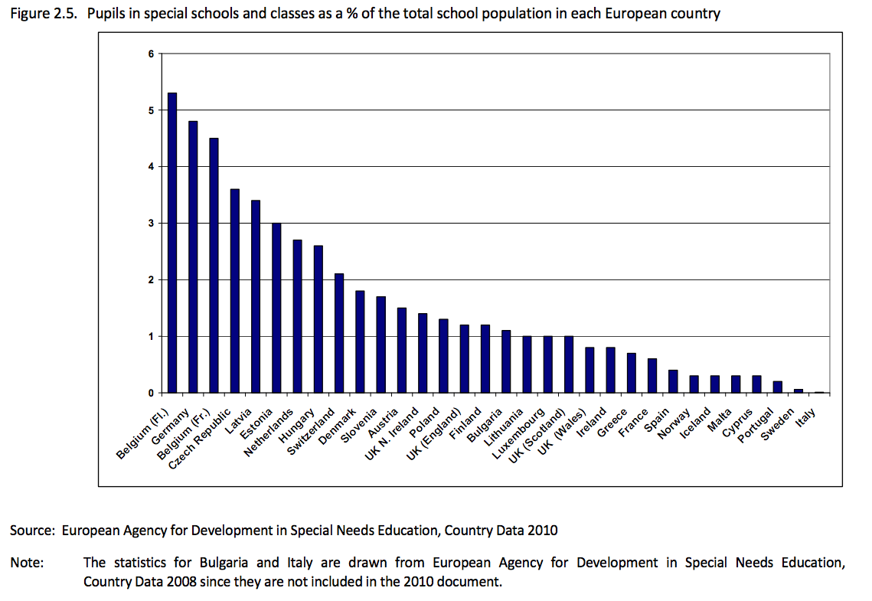
1. Policy framework
Belgium: relatively large number of students with SEN located in special schools (NESSE, 2012)
Over the last decade: increase of pupils assessed with SEN of 12%
Educational system
grade retention,
diagnostic labelling
referral: expert model
(Crevits, 2014)
Notes:
1. Policy framework
Belgium: relatively large number of students with SEN located in special schools (NESSE, 2012)
Over the last decade: increase of pupils assessed with SEN of 12%
Educational system
grade retention,
diagnostic labelling
referral: expert model
(Crevits, 2014)
Graph showing Pupils in special schools and classes as a % of the total school population in each European country.
Belgium (Flemish community) has the highest percentage (approximately 5.2%), followed in descending order by Germany, Belgium (French community), Czech Republic, Latvia, Estonia, Netherlands, Hungary, Switzerland, Denmark, Slovenia, Austria, UK (Northern Ireland), Poland, UK (England), Finland, Bulgaria, Lithuania, Luxembourg, UK (Scotland), UK (Wales), Ireland, Greece, France, Spain, Norway, Iceland, Malta, Cyprus, Portugal, Sweden and Italy.
Source: European Agency for Development in Special Needs Education, Country Data 2010.
Note: The statistics for Bulgaria and Italy are drawn from the European Agency for Development in Special Needs Education, Country Data 2008 since they are not included in the 2010 document.

Slide 3
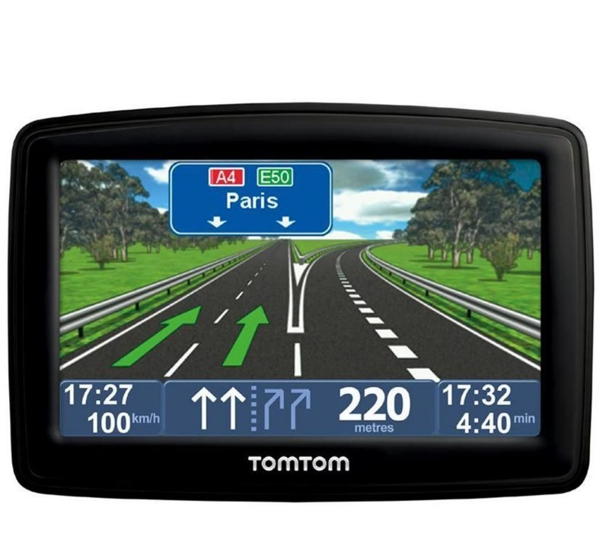
2. New legislation Belgium Flemish community: M-decree (2014)
Inclusive education as the first option
The right to reasonable accommodations
The right for enrolment in a regular school
Modernising the structure & role of special schools
Continuum of supports & clear procedures for assessment, external support and individually adapted curricula
Supporting teachers in regular schools
Towards more inclusive education
M- DECREE
Notes:
2. New legislation Belgium Flemish community: M-decree (2014)
Inclusive education as the first option
The right to reasonable accommodations
The right for enrolment in a regular school
Modernising the structure & role of special schools
Continuum of supports & clear procedures for assessment, external support and individually adapted curricula
Supporting teachers in regular schools
Towards more inclusive education

Slide 4
Professional development programmes
Department of Education finances
PDPs within 5 learning networks
Artevelde University College Network
Initial teacher education
Advanced bachelor Special Ed. + School Development
Pedagogical Counselling Service Catholic Education Flanders, East-Flanders area
Pedagogical Counselling Service City of Ghent
Professional learning communities:
30 schools in 2015-16, 30 in 2016-17, 30 in 2017-18
Notes:
Professional development programmes
Department of Education finances
PDPs within 5 learning networks
Artevelde University College Network
Initial teacher education
Advanced bachelor Special Ed. + School Development
Pedagogical Counselling Service Catholic Education Flanders, East-Flanders area
Pedagogical Counselling Service City of Ghent
Professional learning communities:
30 schools in 2015-16, 30 in 2016-17, 30 in 2017-18

Slide 5
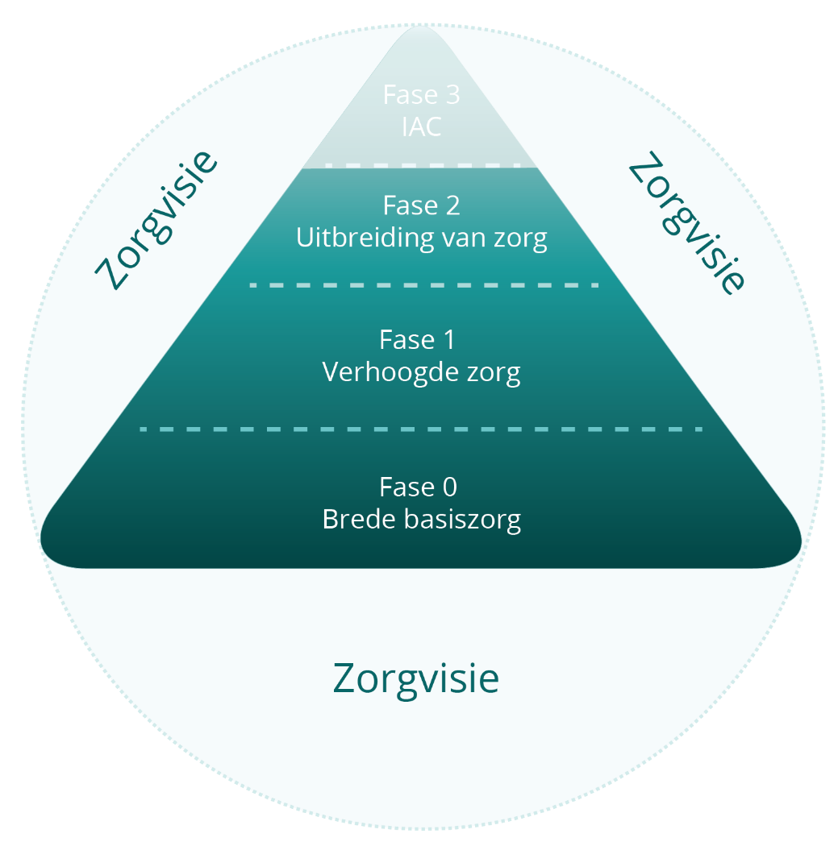
What support should every school provide since September 2015?
Pupil guidance centre: needs based, action oriented assessment and/or statement giving access to an individually adapted curriculum (IAC)
Needs for external support
Pedagogical counselling services supporting a broad support for all children & more inclusion
www.prodiagnostiek.be
Notes:
What support should every school provide since September 2015?
Pupil guidance centre: needs based, action oriented assessment and/or statement giving access to an individually adapted curriculum (IAC)
Pedagogical counselling services supporting a broad support for all children & more inclusion
A triangle shows four phases of support needs.
Vision for support:
Phase 0: Broad basic support, is at the base of the triangle, followed by Phase 1: Increased support and Phase 2: Extended support, with Phase 3: Individual Supported Curriculum at the tip of the triangle.
In phases 0 and 1, Pedagogical counselling services support a broad support for all children and more inclusion.
In phases 2 and 3, Pupil guidance centre: needs-based, action-oriented assessment and/or statement giving access to an individually adapted curriculum (IAC).
www.prodiagnostiek.be

Slide 6
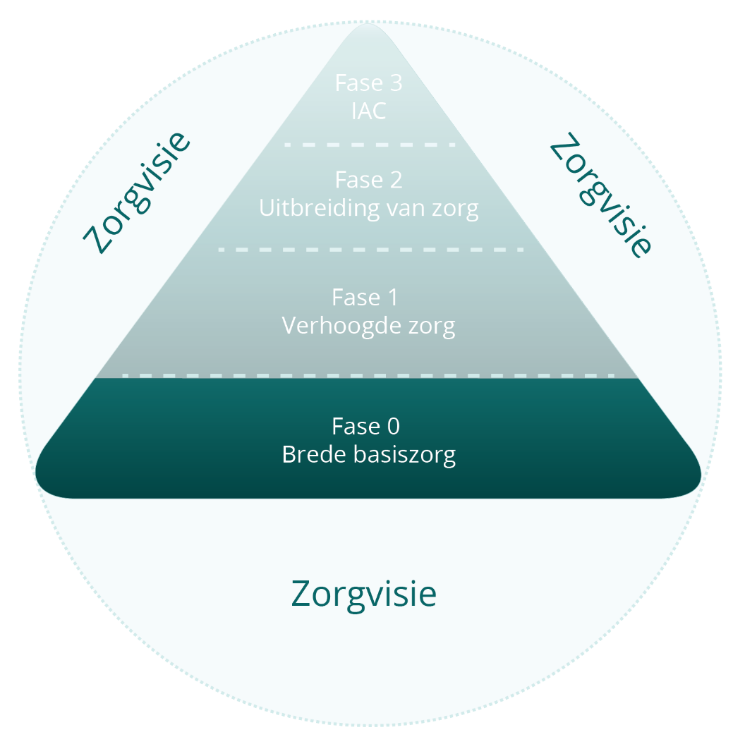
Goal: raising achievement for all learners
Universal Design for learning
www.arteveldehogeschool.be/universeelontwerp
Notes:
Goal: raising achievement for all learners
Universal Design for learning
A triangle shows four phases of support needs.
Vision for support:
Phase 0: Broad basic support, is at the base of the triangle, followed by Phase 1: Increased support and Phase 2: Extended support, with Phase 3: Individual Supported Curriculum at the tip of the triangle.
www.arteveldehogeschool.be/universeelontwerp

Slide 7
Professional learning communities project M: Motor, Motivation, Possibilities – why?
Teachers learn to see the M-decree as a motor for a more inclusive school and see themselves as ‘fuel’ for realising it
Teachers feel motivated to deal with questions and worries by communicating and collaborating with their colleagues.
Teachers discover concrete possibilities and options for addressing the needs of all learners and raising achievement
Notes:
Professional learning communities project M: Motor, Motivation, Possibilities – why?
Teachers learn to see the M-decree as a motor for a more inclusive school and see themselves as ‘fuel’ for realising it
Teachers feel motivated to deal with questions and worries by communicating and collaborating with their colleagues.
Teachers discover concrete possibilities and options for addressing the needs of all learners and raising achievement

Slide 8
Project M: Motor, Motivation, Possibilities: how to promote school development?
Core group:
Principal
Special educational needs coordinator
Teachers
Critical friend, e.g. school psychologist of the CLB, pedagogical counsellor,
teacher from special ed…
Notes:
Project M: Motor, Motivation, Possibilities: how to promote school development?
Core group:
Principal
Special educational needs coordinator
Teachers
Critical friend, e.g. school psychologist of the CLB, pedagogical counsellor,
teacher from special ed…

Slide 9
Sessions project M: Motor, Motivation, Possibilities: what?
8 sessions | Knowledge base: different frameworks | Pedagogical and didactical translation | Becoming more inclusion-oriented as a teacher | School policy | Consolidating partnerships
Intake | x |  | x | x | x
Team meeting | X |  | x |  | x
Inspiration day | X | x | x |  | x
Coaching 1 | v | X | X |  | x
Coaching 2 | v | X | X |  | x
Exchange day | v | v | v | x | X
Coaching 3 | v | v | v | X | X
Overview/ synthesis in policy | v | v | v | X | X
Notes:
Sessions project M: Motor, Motivation, Possibilities: what?
Project M has eight sessions and the table shows their elements as follows:
The sessions are: Intake, Team meeting, Inspiration day, Coaching 1, Coaching 2, Exchange day, Coaching 3, Overview/synthesis in policy.
The following elements apply to all eight sessions: Knowledge base: different frameworks; Becoming more inclusion-oriented as a teacher; Consolidating partnerships.
The Pedagogical and didactical translation element applies to the Inspiration day, Coaching 1, 2 and 3, Exchange day and Overview/synthesis in policy sessions.
The School policy element applies to the Intake, Exchange day, Coaching 3 and Overview/synthesis in policy sessions.

Slide 10
3. Experiences so far…
Common themes
During the training path, schools asked for extra support on following subjects:
Communication with parents
Reflect which children
Pupil participation
Team teaching
Differentiated instruction
Graduating
Partnerships
Student tracking system
Notes:
3. Experiences so far…
Common themes
During the training path, schools asked for extra support on following subjects:
Communication with parents
Reflect which children
Pupil participation
Team teaching
Differentiated instruction
Graduating
Partnerships
Student tracking system

