Slide 1
Łajski School – The Art of Following Each Learner
Virginia Stafiej, Deputy Headteacher of Schools in Łajski, Poland, and Project Expert
Elżbieta Kot, English teacher
Lidia Kazberuk, Office Manager
Notes:
Łajski School – The Art of Following Each Learner
Virginia Stafiej, Deputy Headteacher of Schools in Łajski, Poland, and Project Expert
Elżbieta Kot, English teacher
Lidia Kazberuk, Office Manager

Slide 2
Łajski School video presentation
Watch the video that presents images from Łajski School
Notes:
Łajski School video presentation
Watch the video that presents images from Łajski School (https://youtu.be/dIDiJlDT5Y0)

Slide 3
Overview of presentation
Our school: an introduction
Leadership
Pedagogy
Collaboration
The school as good practice
Notes:
Overview of presentation
Our school: an introduction
Leadership
Pedagogy
Collaboration
The school as good practice

Slide 4
Leadership
Notes:
Leadership

Slide 5
Visionary school management
School is the place where:
external and
internal expectations
gather, so there is constant need to focus on challenges and to continue activities which are already completed.
Notes:
1. Visionary school management
School is the place where:
external and
internal expectations
gather, so there is constant need to focus on challenges and to continue activities which are already completed.

Slide 6
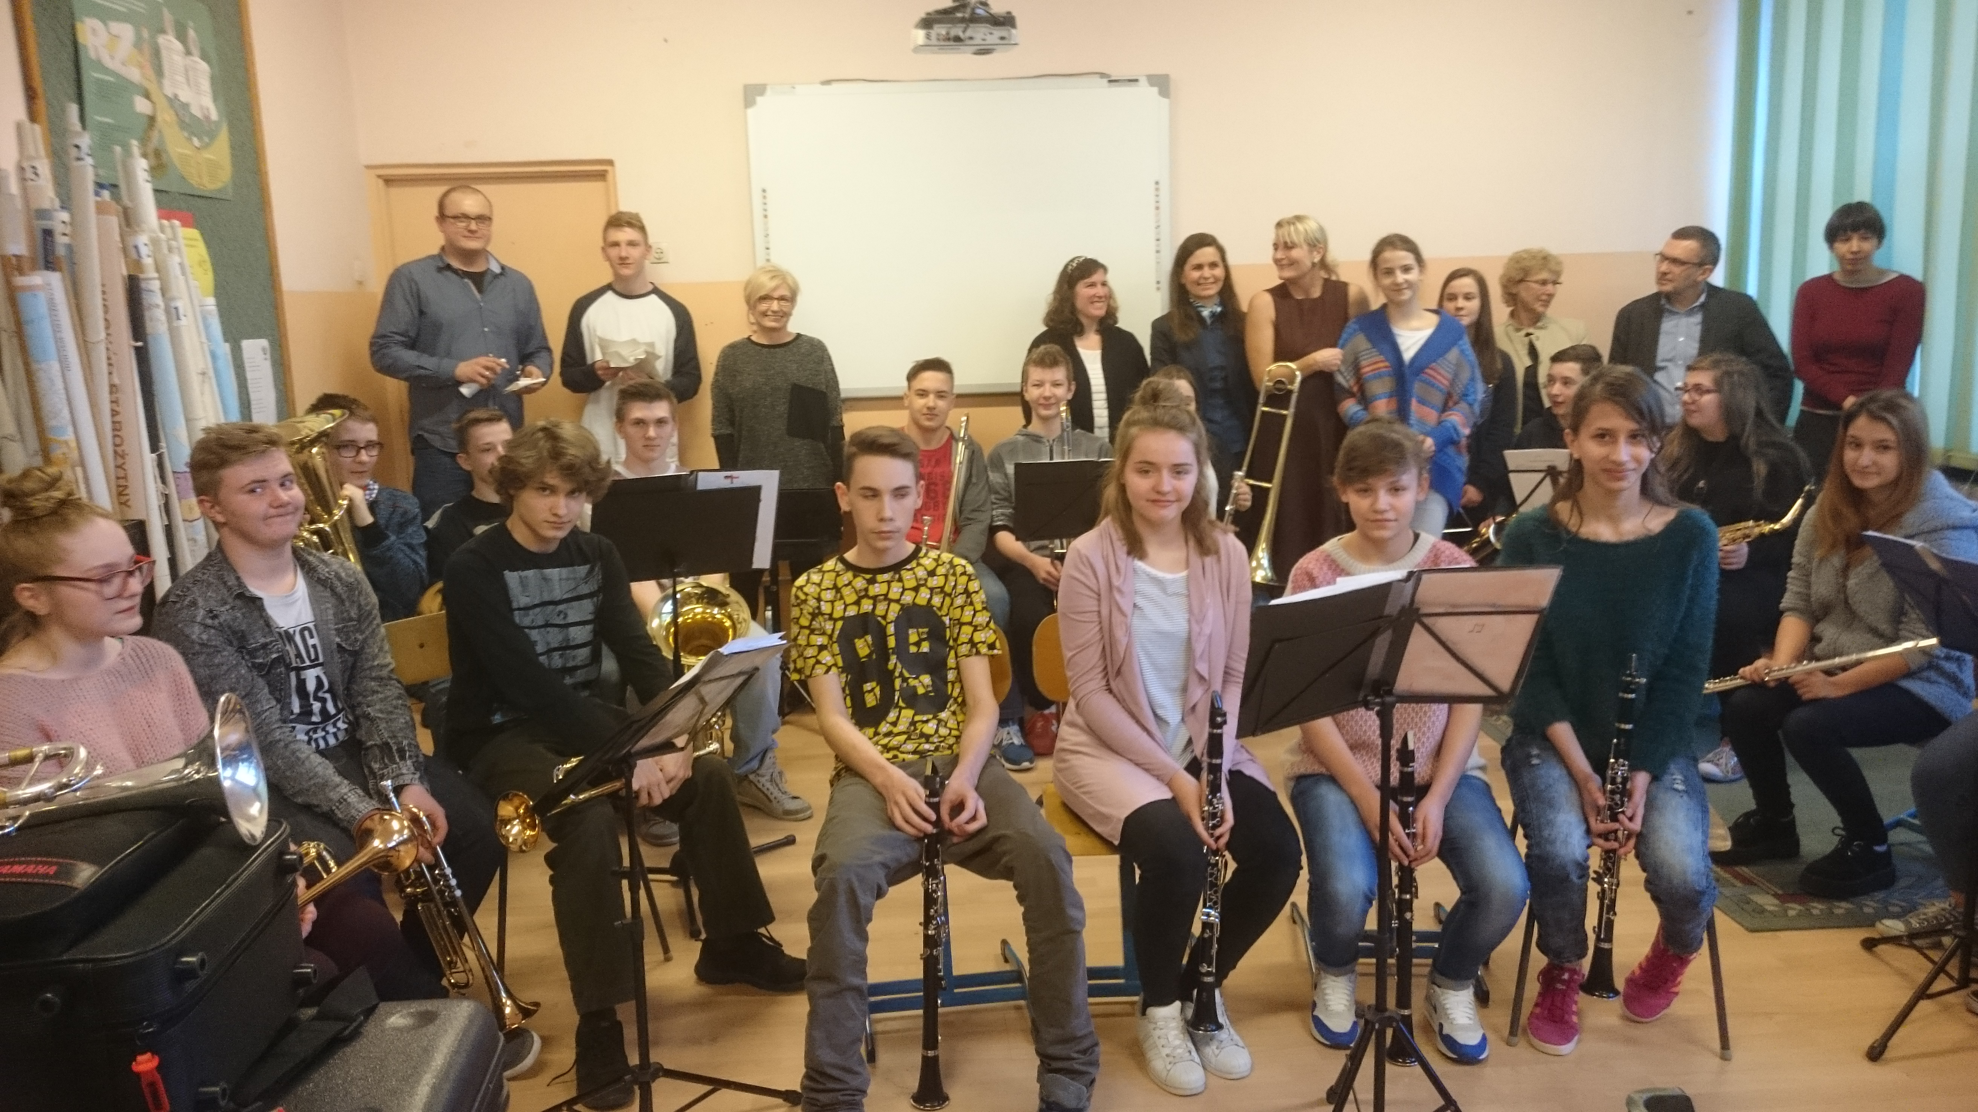
School orchestra photo
Notes:
School orchestra photo

Slide 7
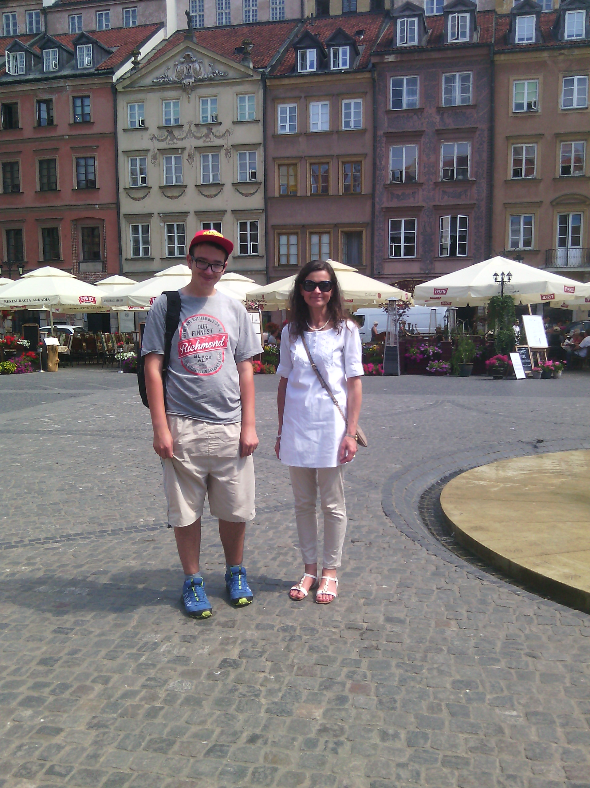
Needs analysis (1)
The school headteacher should cover wide aspects of proper leadership:
social environment
technical/place conditions
students’ educational and therapeutical needs
staff’s strengths, motivation and professional development
friendly and kind atmosphere
Notes:
2. Needs analysis (1)
The school headteacher should cover wide aspects of proper leadership:
social environment
technical/place conditions
students’ educational and therapeutical needs
staff’s strengths, motivation and professional development
friendly and kind atmosphere

Slide 8
Needs analysis (2)
Students as the inclusive society:
clear rules, clear values and culture of behaviour
individualisation of education – finding abilities, strengths and gifts
learning by teaching others
freedom for self-realisation
help and support among peers
Notes:
2. Needs analysis (2)
Students as the inclusive society:
clear rules, clear values and culture of behaviour
individualisation of education – finding abilities, strengths and gifts
learning by teaching others
freedom for self-realisation
help and support among peers

Slide 9
Headteacher as the leader
Headteacher/leader/visionary plans school vision and mission at least 5 years ahead, including:
culture of organisation
ethos promoting education
openness and accountability for co-operation:
learner–teacher/assistant–parents
Notes:
3. Headteacher as the leader
Headteacher/leader/visionary plans school vision and mission at least 5 years ahead, including:
culture of organisation
ethos promoting education
openness and accountability for co-operation:
learner–teacher/assistant–parents

Slide 10
Pedagogy
Notes:
Pedagogy

Slide 11
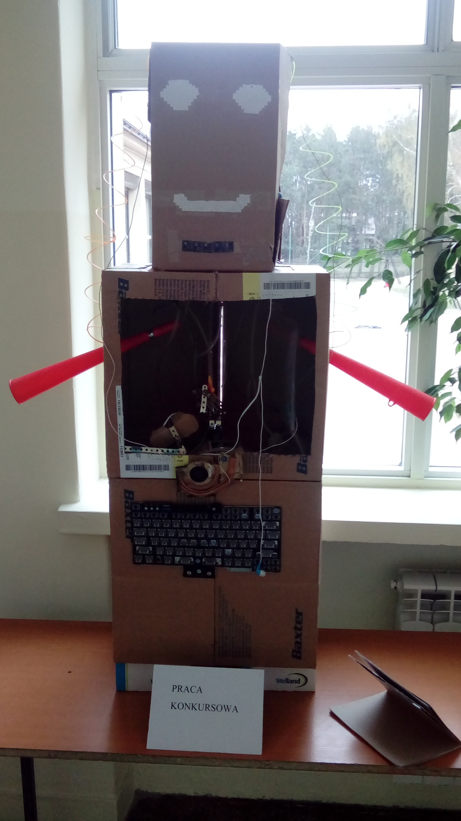
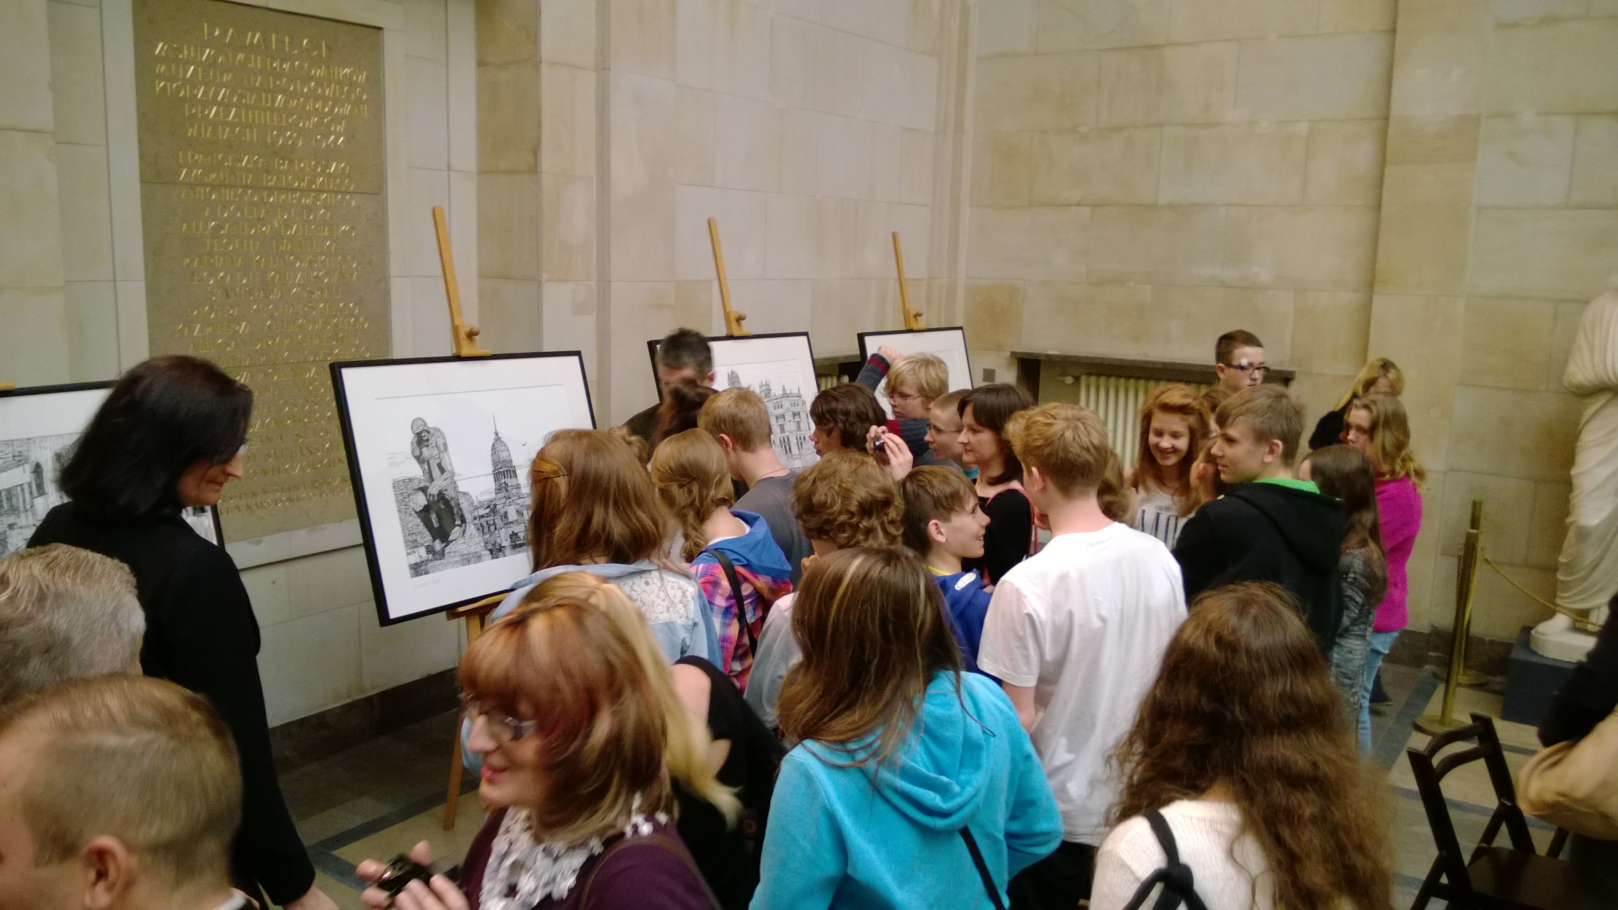
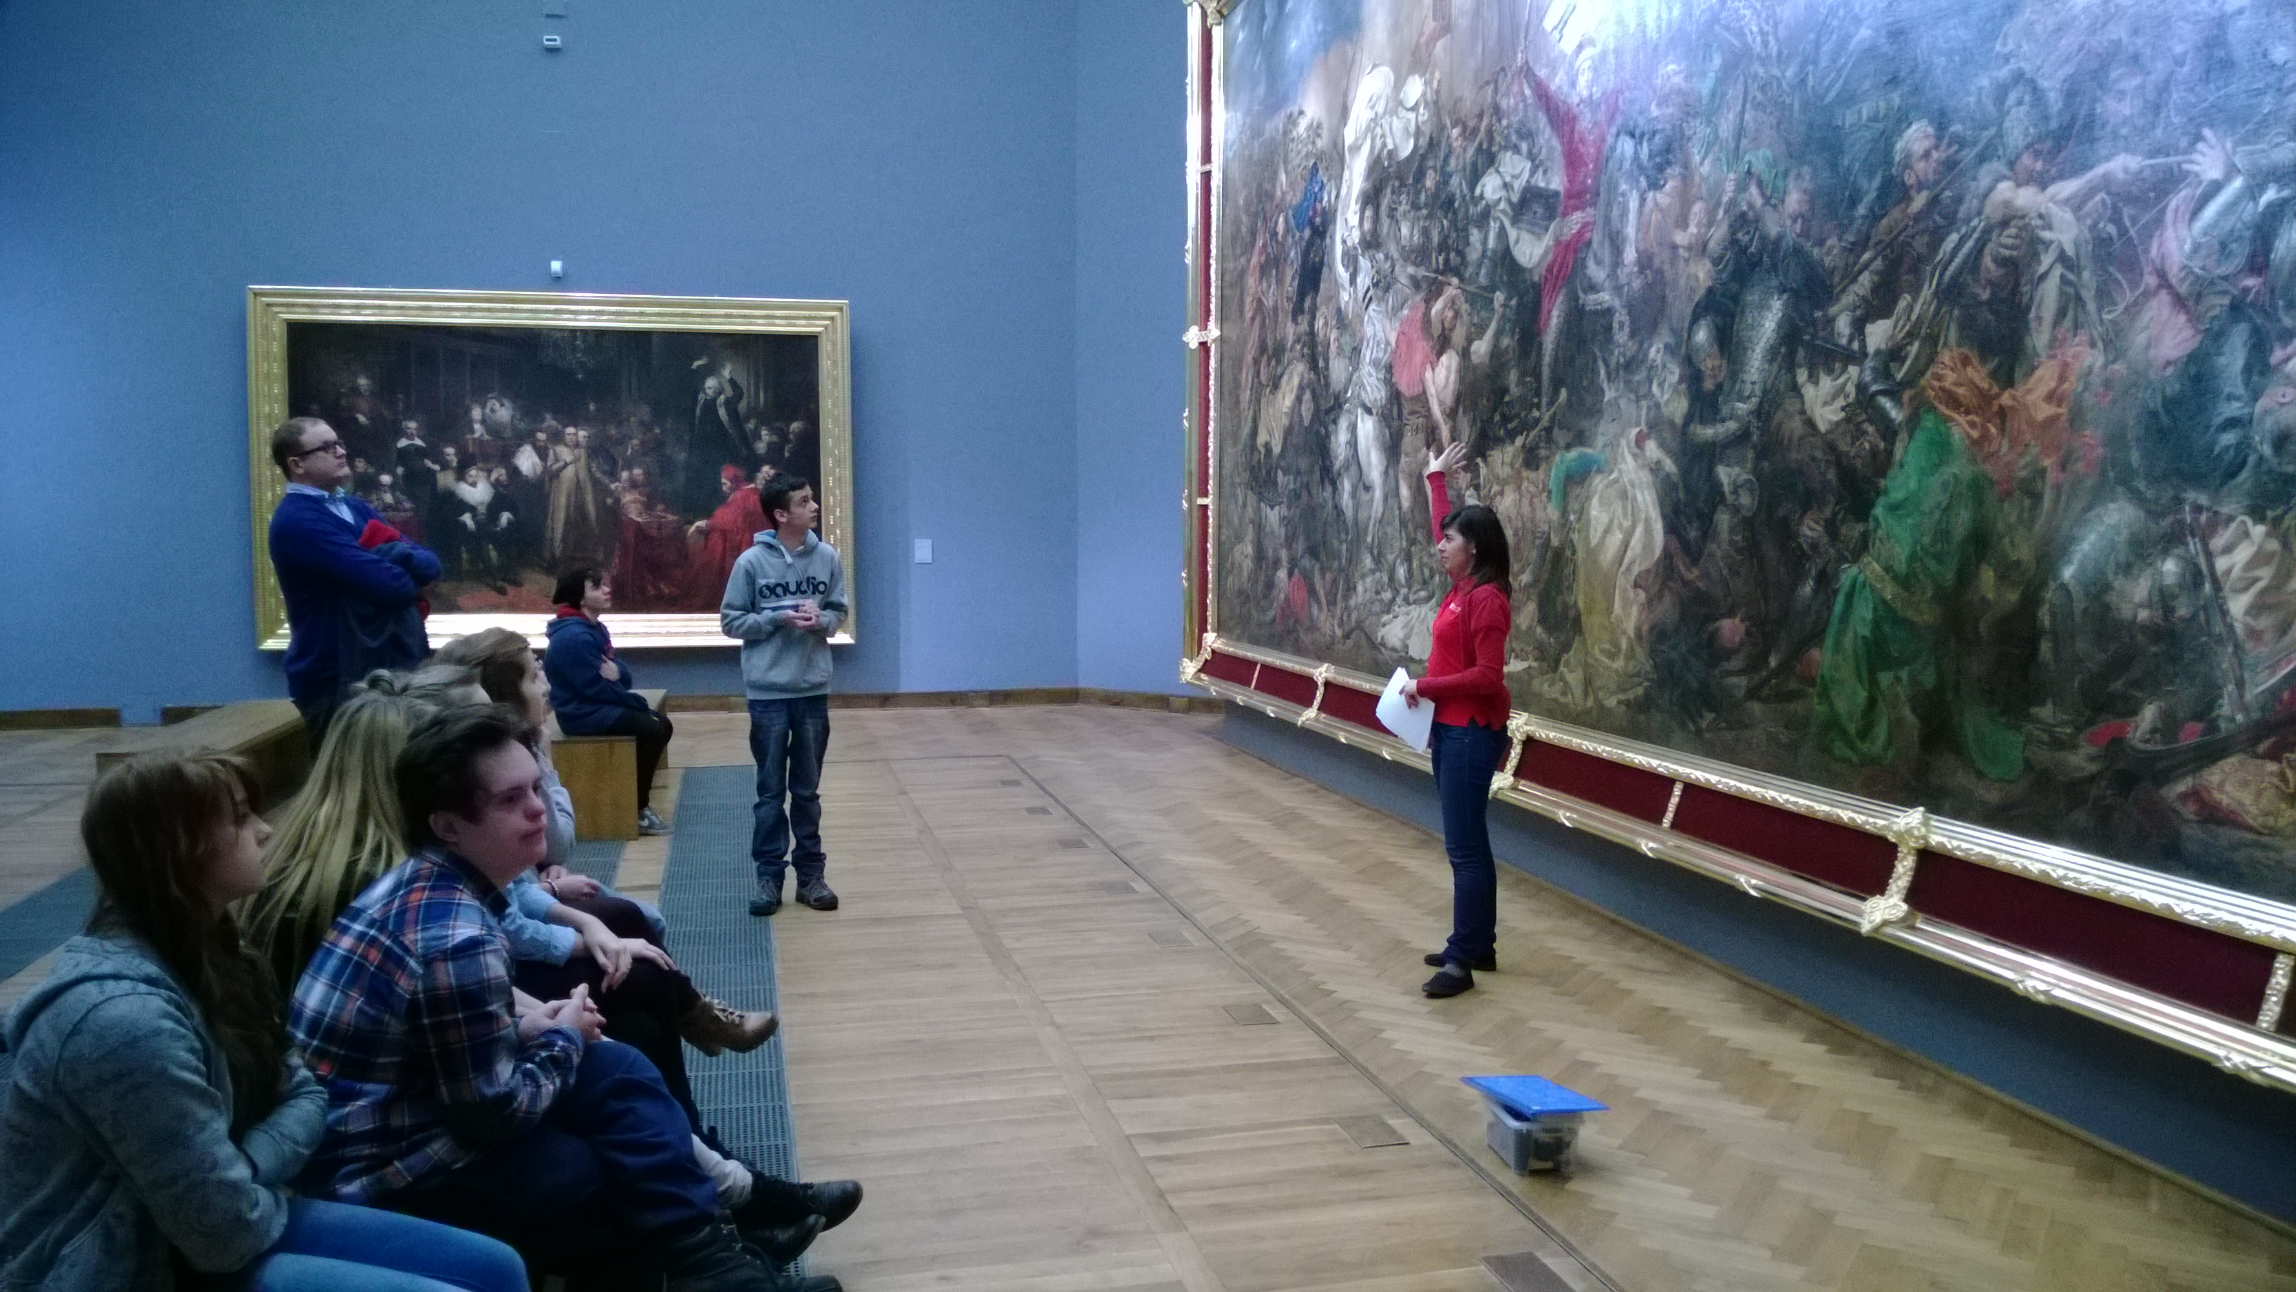
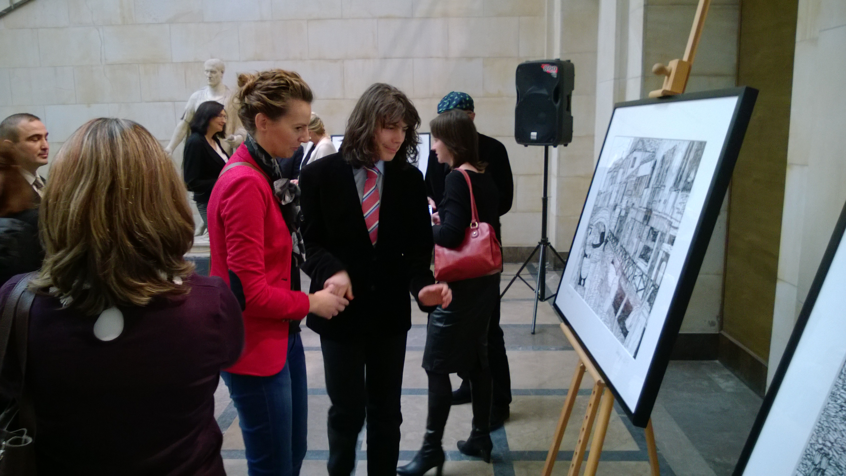
Pedagogy – Education through the arts
Notes:
Pedagogy – Education through the arts

Slide 12
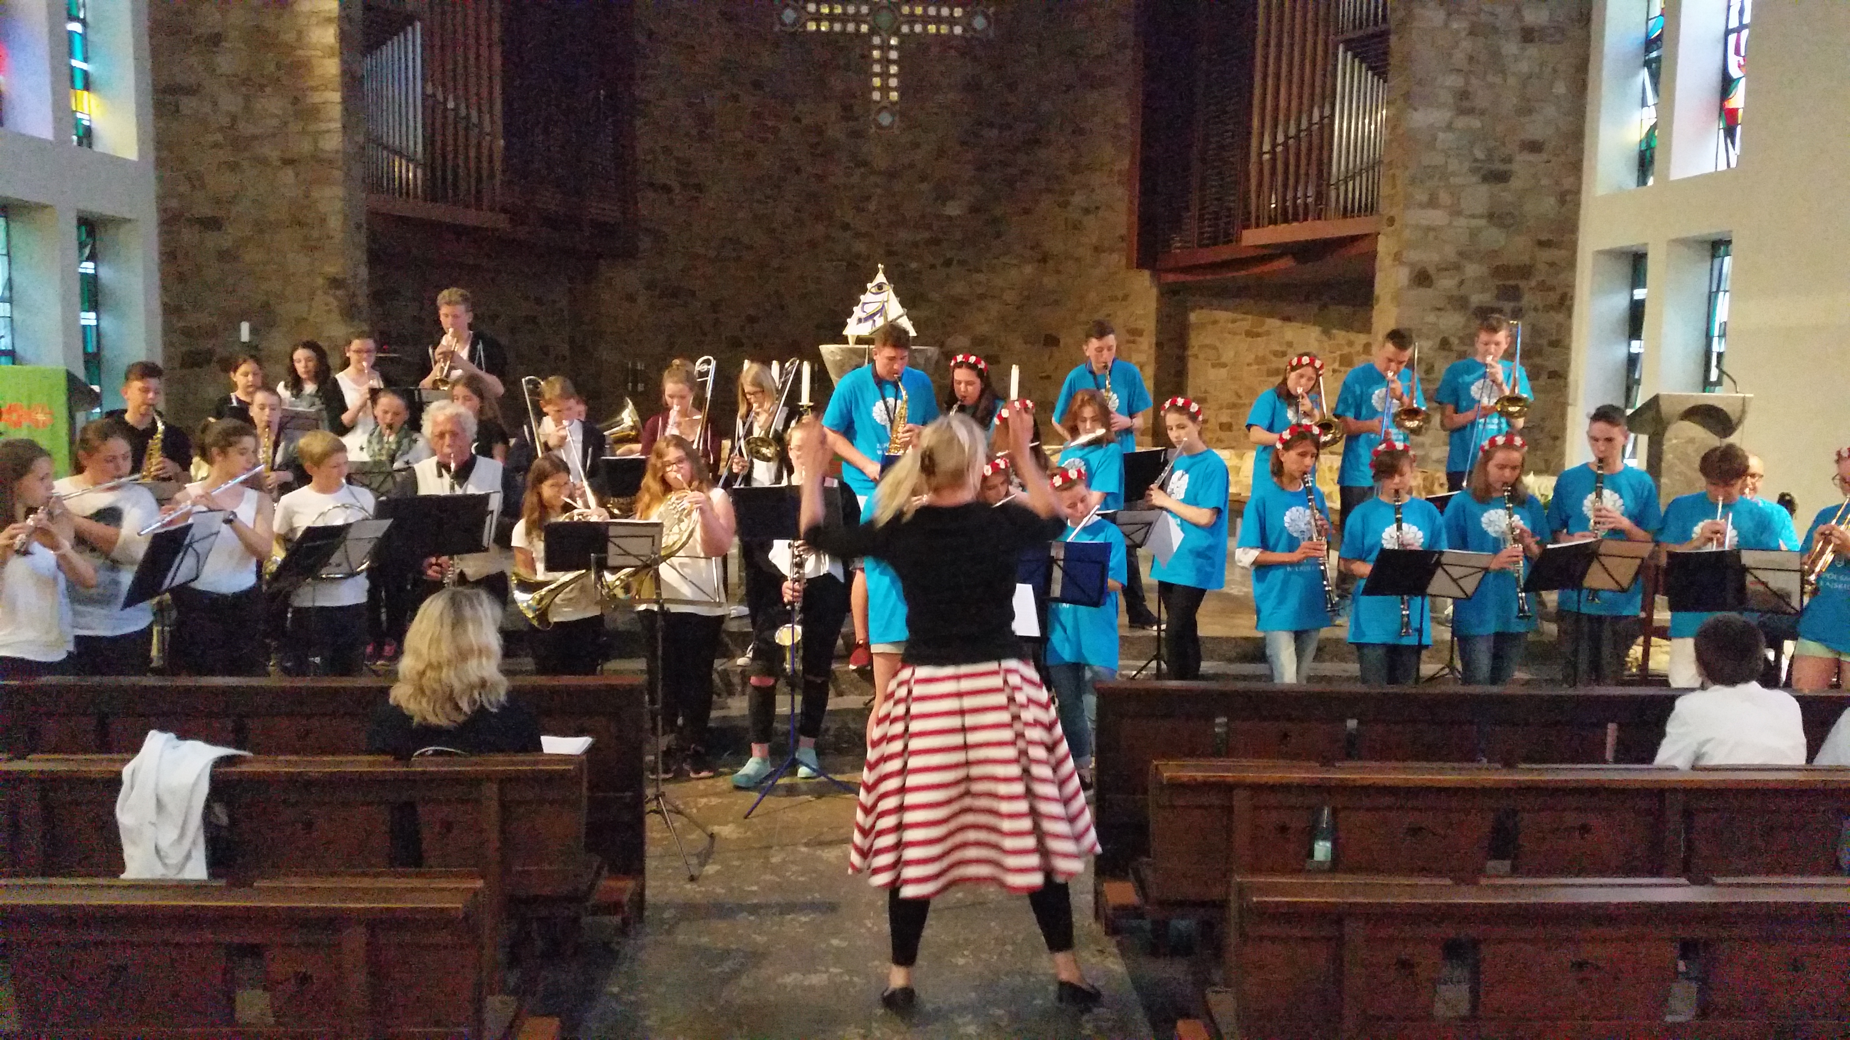
School brass orchestra
A wonderful idea by our music teacher Justyna Niegierysz – the conductor.
An instrument for everyone. All students play and have fun!
Concerts at important events.
Meeting a German school orchestra to play together annually.
Notes:
School brass orchestra
A wonderful idea by our music teacher Justyna Niegierysz – the conductor.
There is an instrument for everyone. All students play and have fun!
They also give concerts at important events.
They meet with a German school orchestra to play together annually.

Slide 13
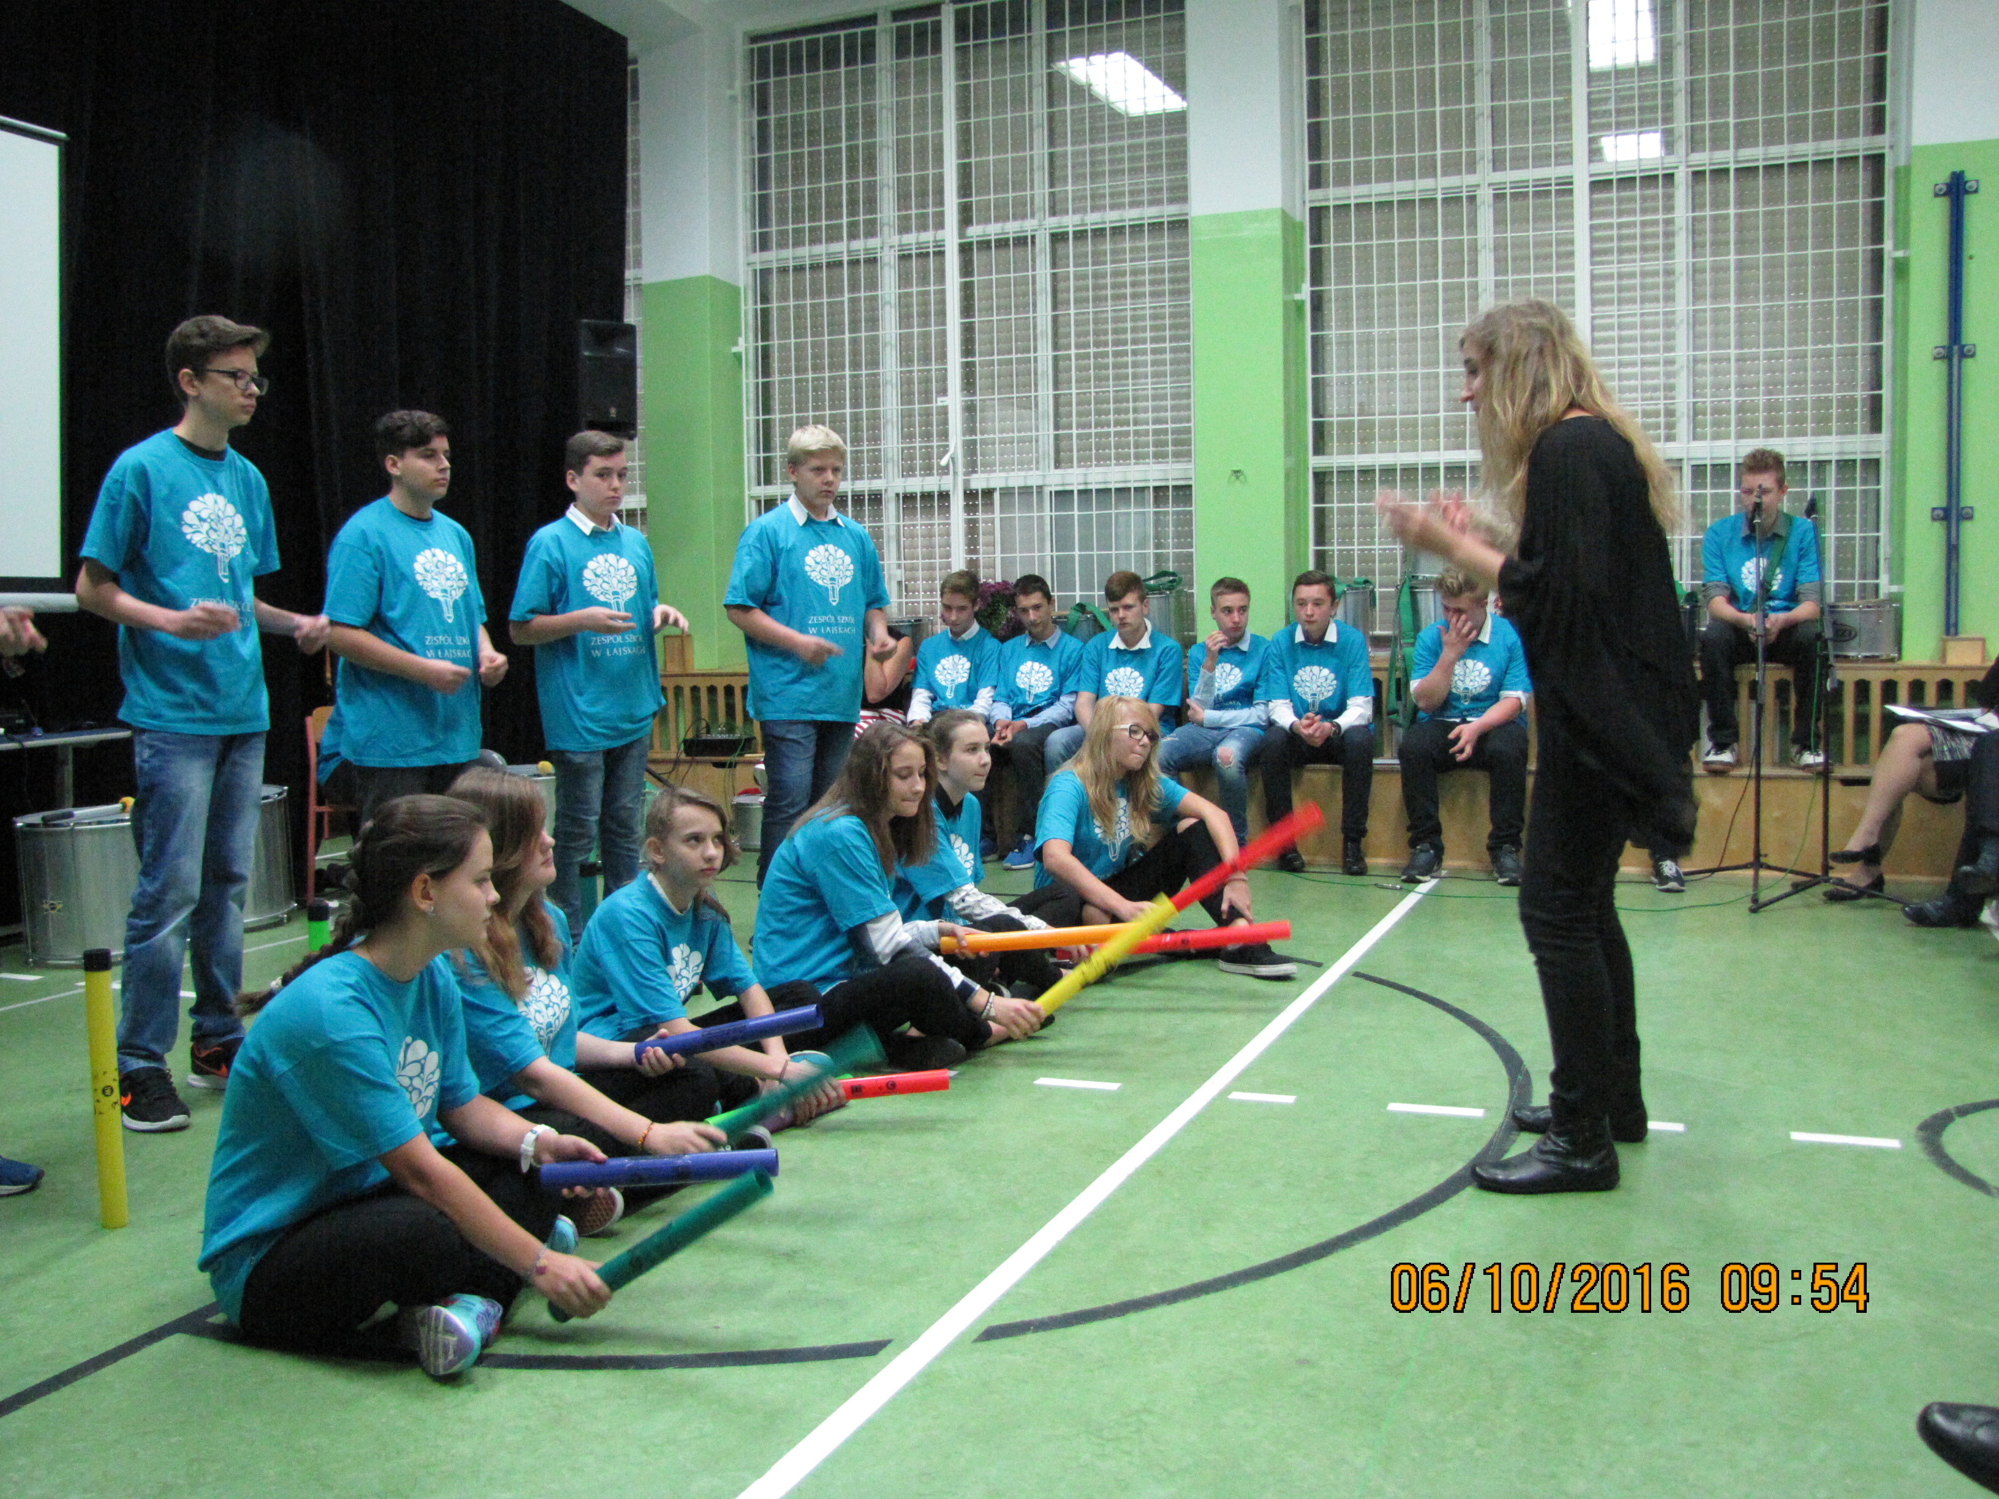
‘Batucada’ drums orchestra
An answer to a need – the alternative for students who cannot deal with brass instruments
Brass instruments / pipes playing / body percussion
Notes:
‘Batucada’ drums orchestra (1)
An answer to a need – the alternative for those students who cannot deal with brass instruments
Brass instruments / pipes playing / body percussion
Conducted by Marta Maślanka – our music teacher, a musician in ‘Des Orient’ band (playing instruments from every corner of the globe)

Slide 14
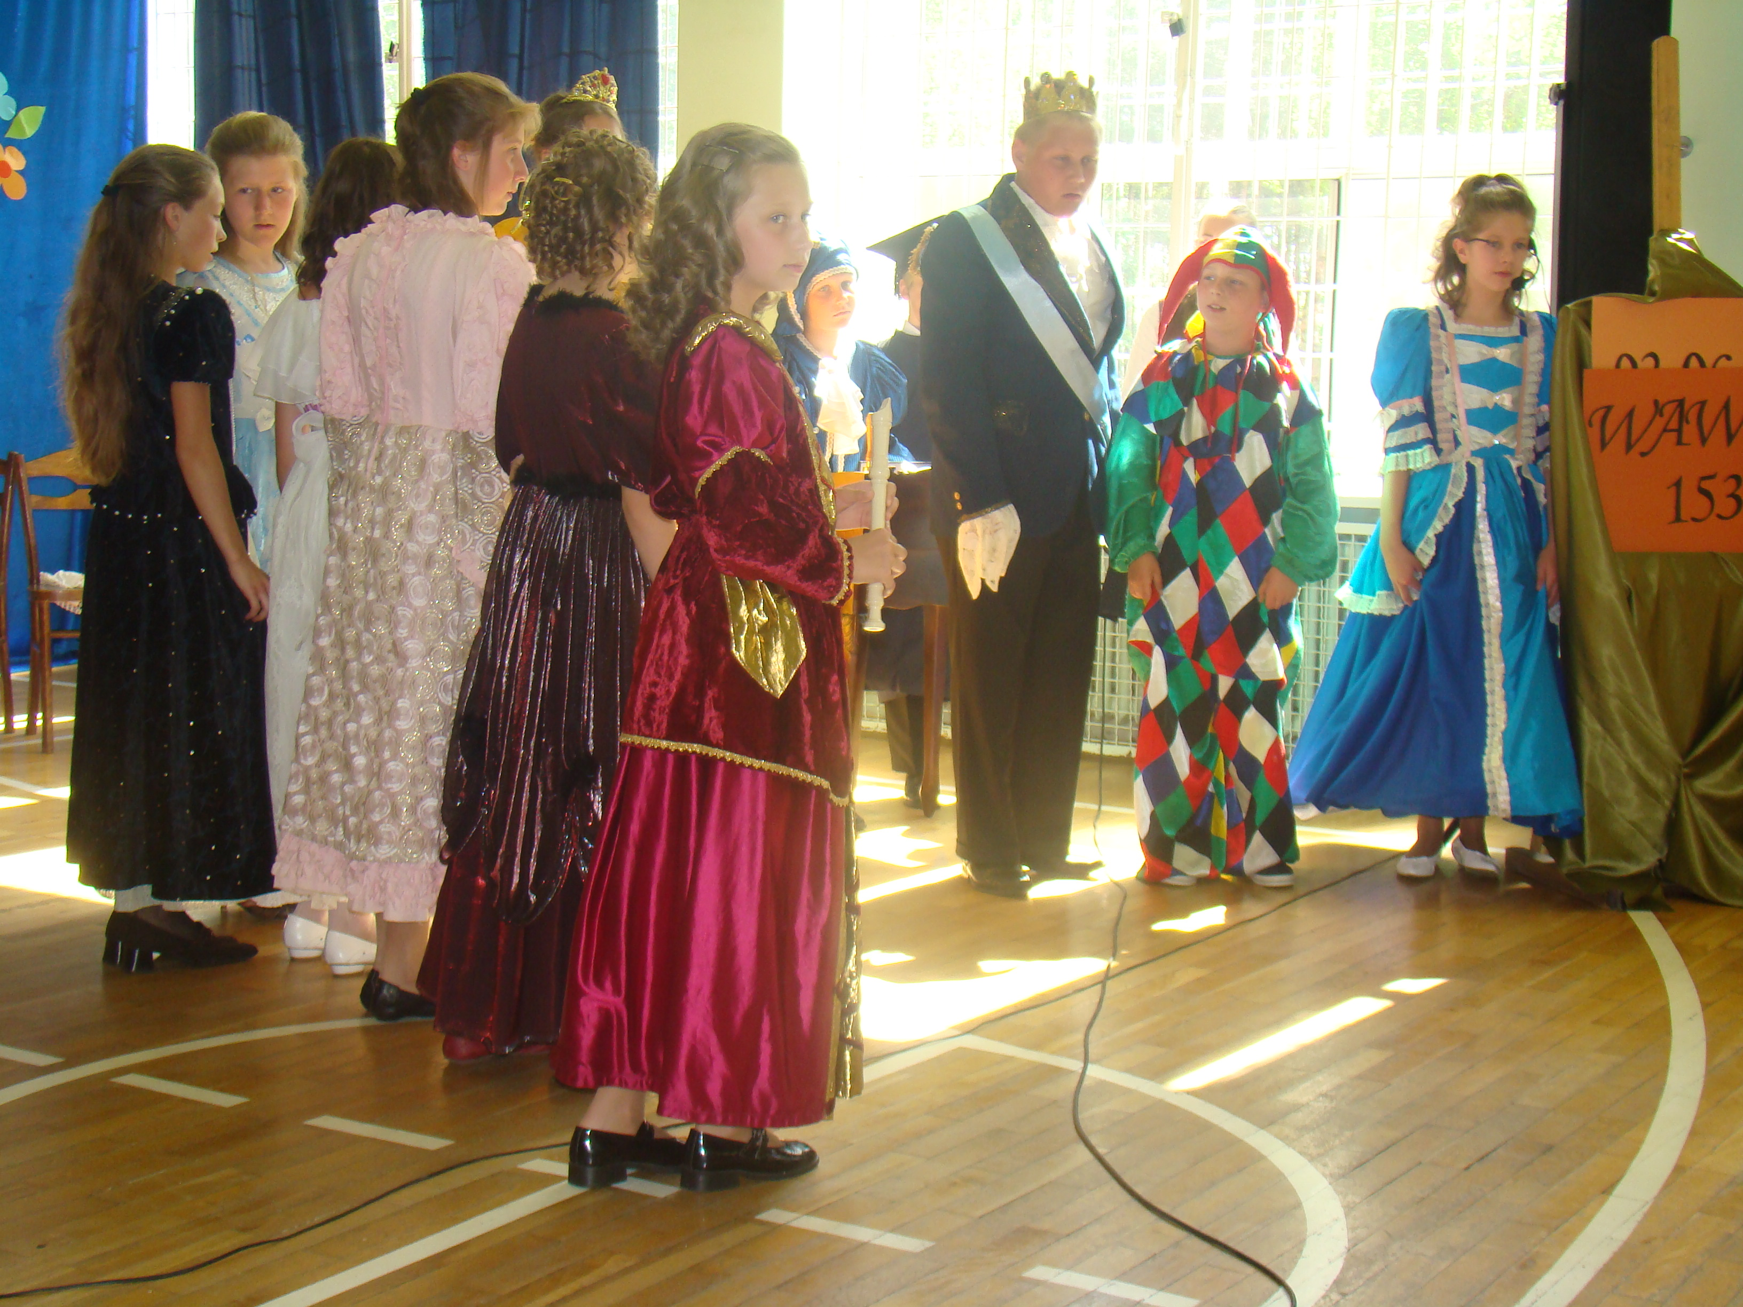
Art and drama
Many artistic evenings are organised with different artists and performances. All students and staff are welcome, as well as their whole families.
Activities are also run by the school drama club (e.g. acting out novels, writing plays).
Notes:
Art and drama
Many artistic evenings are organised with different artists and performances. All students and staff are welcome, as well as their whole families.
Activities are also run by the school drama club (e.g. acting out novels, writing plays).

Slide 15
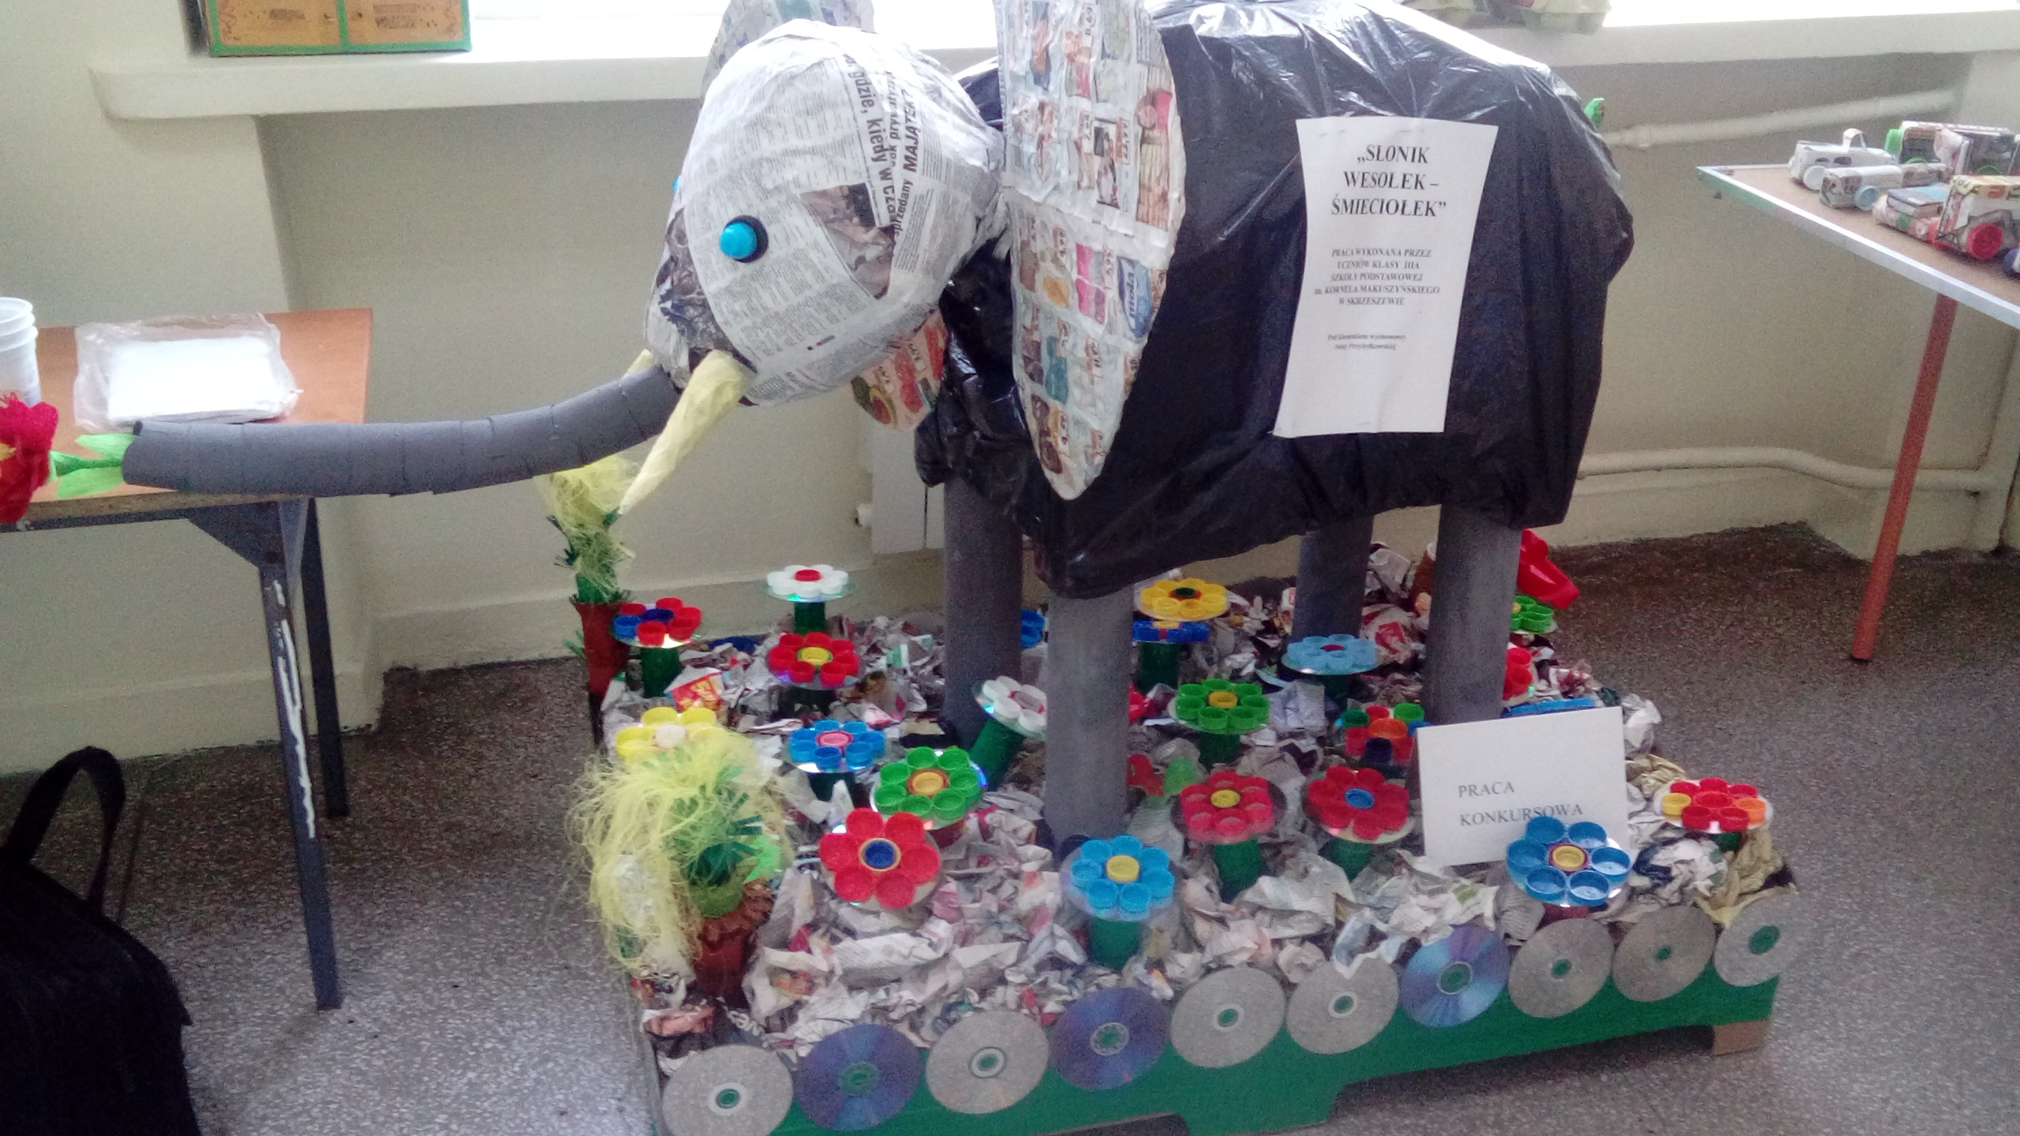
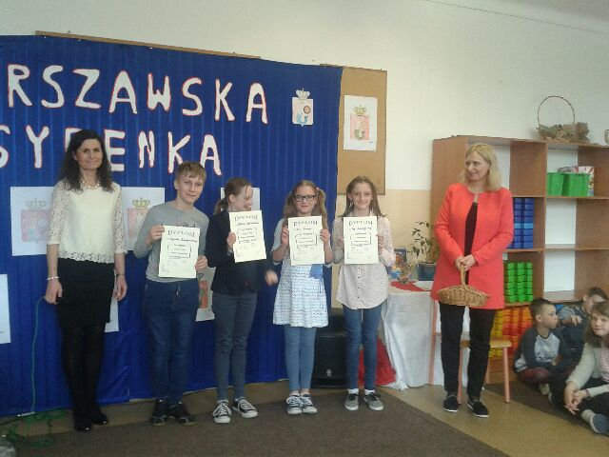
Other art activities
Fairy tale therapy – workshops
Warszawska syrenka – reciting contest
The art of discussing – school debate
Foreign language singing contest
Ecology workshops – the art of recycling
Notes:
Other art activities
Fairy tale therapy – workshops
Warszawska syrenka – reciting contest
The art of discussing – school debate
Foreign language singing contest
Ecology workshops – the art of recycling

Slide 16
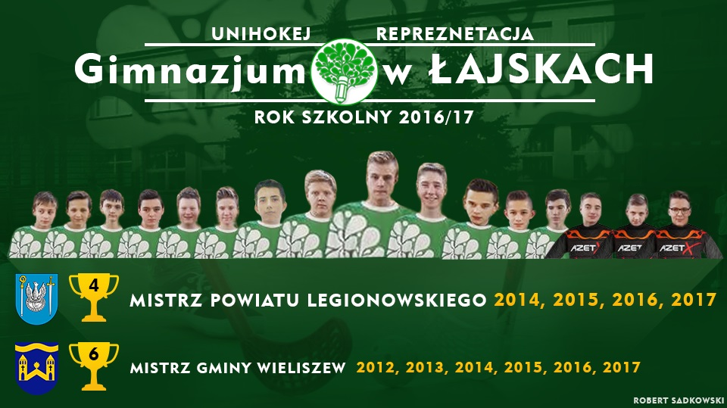
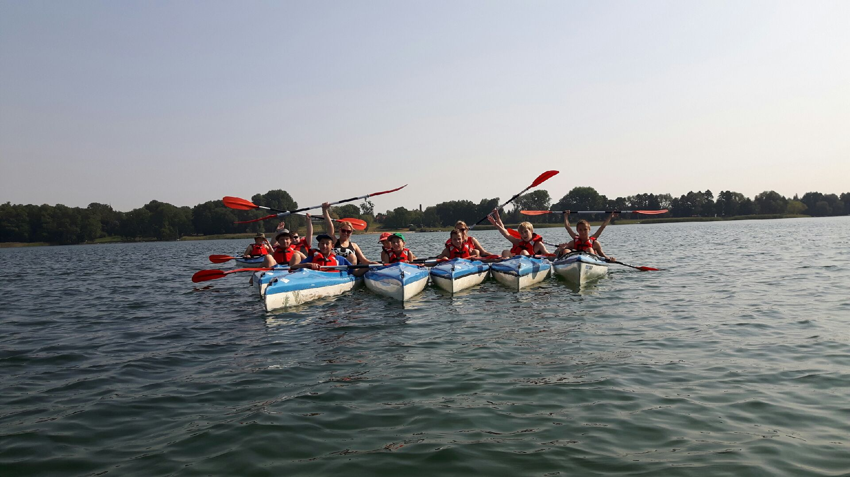
Our sports champions
Current champions in:
Table tennis
Unihockey
Cross-country running
Other sport activities:
Winter Sports Camp February 2017
Summer camps ☺
Notes:
Our sports champions
Current champions in:
Table tennis
Unihockey
Cross-country running
Other sport activities:
Winter Sports Camp February 2017
Summer camps ☺

Slide 17
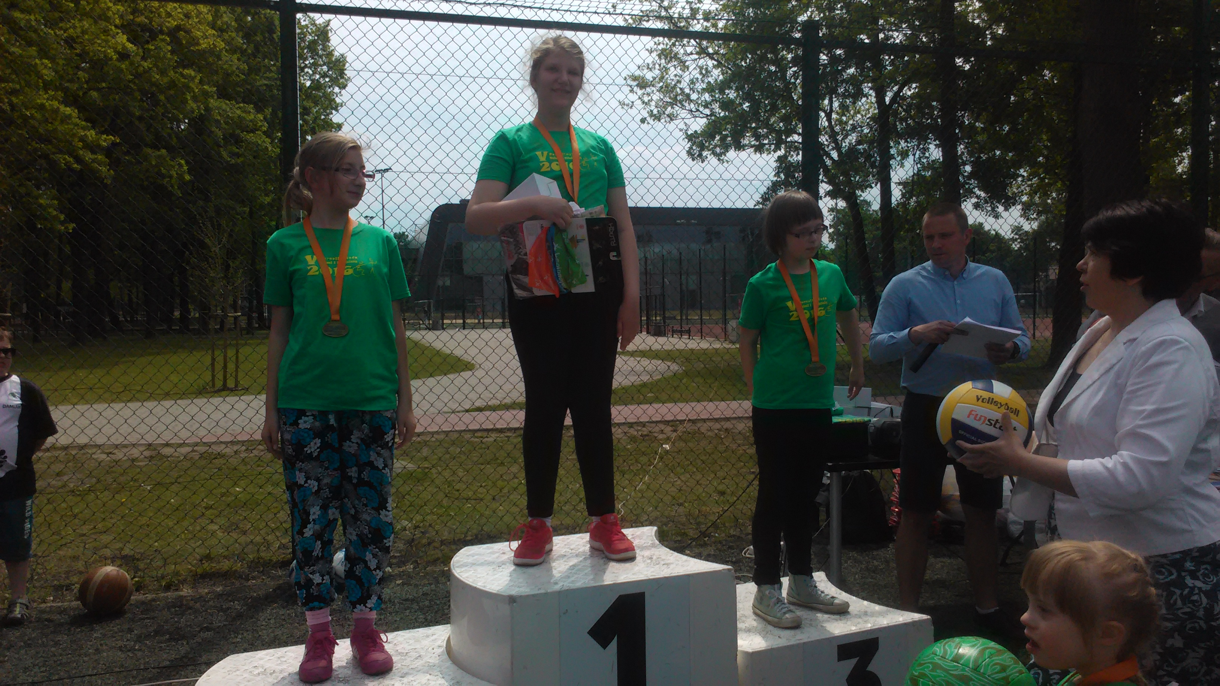
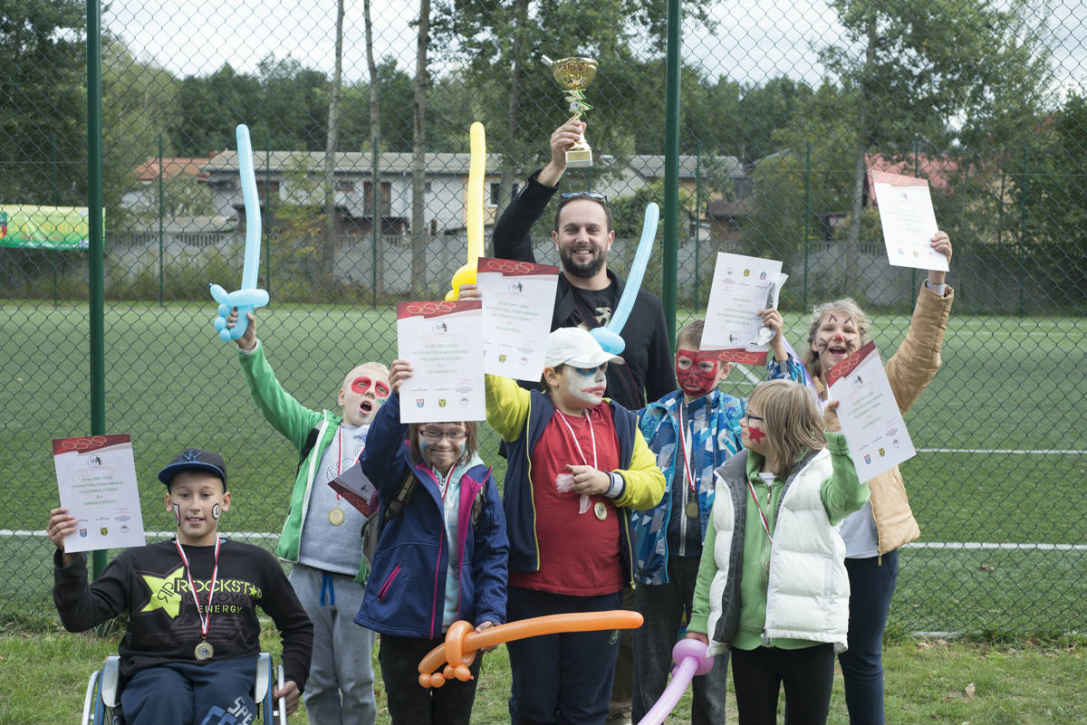
Paralympic games
May 2016 – fifth edition of Paralympics for children and teenagers from Legionowo province. Our students had great fun and showed their commitment ☺
Notes:
Paralympic games
May 2016 – fifth edition of Paralympics for children and teenagers from Legionowo province. Our students had great fun and showed their commitment ☺

Slide 18
Collaboration
Notes:
Collaboration

Slide 19
Cooperation with institutions and schools
Psychological and Pedagogical Counselling Centre (PPP)
Commune Wieliszew
Social Welfare Centre (OPS)
District centre of social integration (CIS)
Centre for Education Development (ORE)
Educational Research Institute (IBE)
The State Fund for Rehabilitation of Disabled Persons (PFRON)
Ravimed
Other schools – trainings and internships
Notes:
Cooperation with institutions and schools
Psychological and Pedagogical Counselling Centre (PPP)
Commune Wieliszew
Social Welfare Centre (OPS)
District centre of social integration (CIS)
Centre for Education Development (ORE)
Educational Research Institute (IBE)
The State Fund for Rehabilitation of Disabled Persons (PFRON)
Ravimed
Other schools – trainings and internships

Slide 20
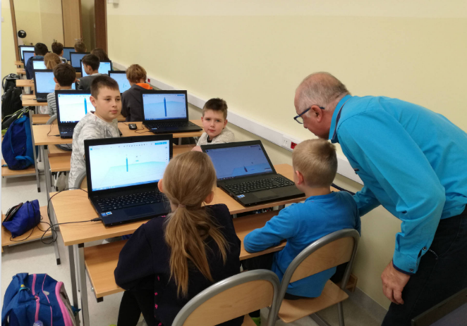
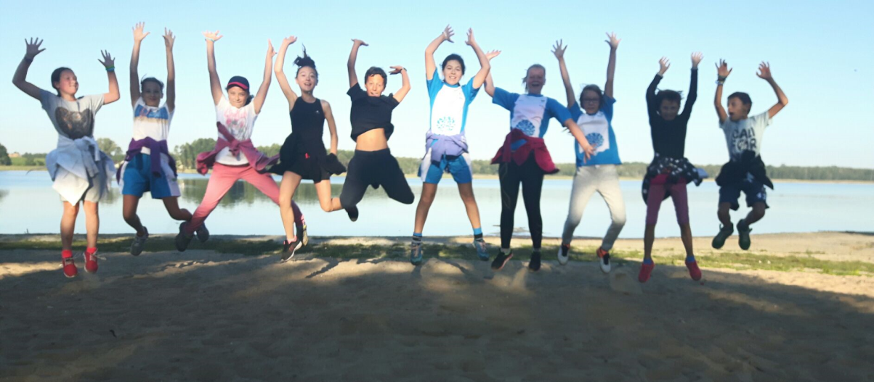
Continuation of participating in many projects
PNWM – (Polish-German Youth Cooperation)
Sports classes
Safe+
Milk, vegetables and fruits in school
Gotta get engineering
Erasmus+
Notes:
Continuation of participating in many projects
PNWM – (Polish-German Youth Cooperation)
Sports classes
Safe+
Milk, vegetables and fruits in school
Gotta get engineering
Erasmus+
Gotta get engineering – free program that introduces a fully-supported, engineering curriculum for elementary schools which uses 3D printers and basic engineering sets to integrate engineering design and 3D printing technology with core academic knowledge of: Science, Maths, ICT, Technology

Slide 21
Cooperation with Parents’ Board
Constant cooperation between school and parents, working together for school and all learners, listening to parents’ ideas
Parents of children with SEN (special educational needs) have got daily contact with the child assistants and their teachers
Notes:
Cooperation with Parents’ Board
Constant cooperation between school and parents, working together for school and all learners, listening to parents’ ideas
Parents of children with SEN (special educational needs) have got daily contact with the child assistants and their teachers
project "green surrounding around school”
Santa Claus presents on December 6th
’Hero of our school’ (finding the best student who achieved the greatest reputation among peers and faculty of our school)
Parents of children with SEN (special educational needs) have got daily contact with the child assistants and their teachers
School debate Oxford debate "Everyone is an egoist” – theory of the debate in practice

Slide 22
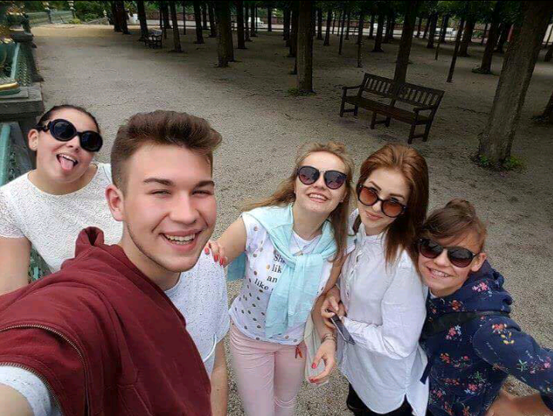
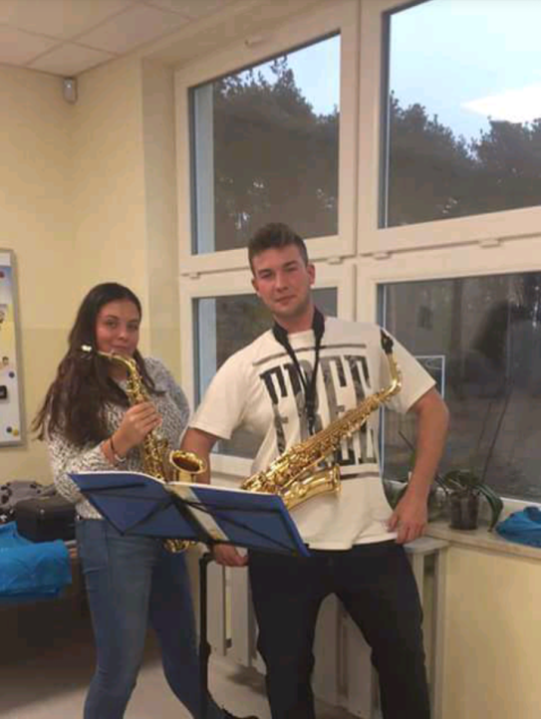
Cooperation with graduates
Students meet with graduates to play together in School Orchestra once a week
Students are open to pro-social attitudes working in the orchestral sections
School Orchestra is a unique structure where young musicians create positive attitudes, learn teamwork, common responsibility for the work of the whole team
Orchestra is learning by doing – students learn from each other
Notes:
Cooperation with graduates
Students meet with graduates to play together in School Orchestra once a week
Students are open to pro-social attitudes working in the orchestral sections
School Orchestra is a unique structure where young musicians create positive attitudes, learn teamwork, common responsibility for the work of the whole team
Orchestra is learning by doing – students learn from each other

Slide 23
Special Pedagogics Academy in Warsaw – partnership
Creating projects and curriculum for students and teachers in inclusive education
Taking common implementation of the work of scientific research and projects, including those co-financed by the European Union
Creating modular improvement courses
Creating and implementing new curriculums and improving those carried out by the University
Creating common research teams
Sharing teaching staff to carry out the practical or theoretical classes
Notes:
Special Pedagogics Academy in Warsaw – partnership
Creating projects and curriculum for students and teachers in inclusive education
Taking common implementation of the work of scientific research and projects, including those co-financed by the European Union
Creating modular improvement courses
Creating and implementing new curriculums and improving those carried out by the University
Creating common research teams
Sharing teaching staff to carry out the practical or theoretical classes

Slide 24
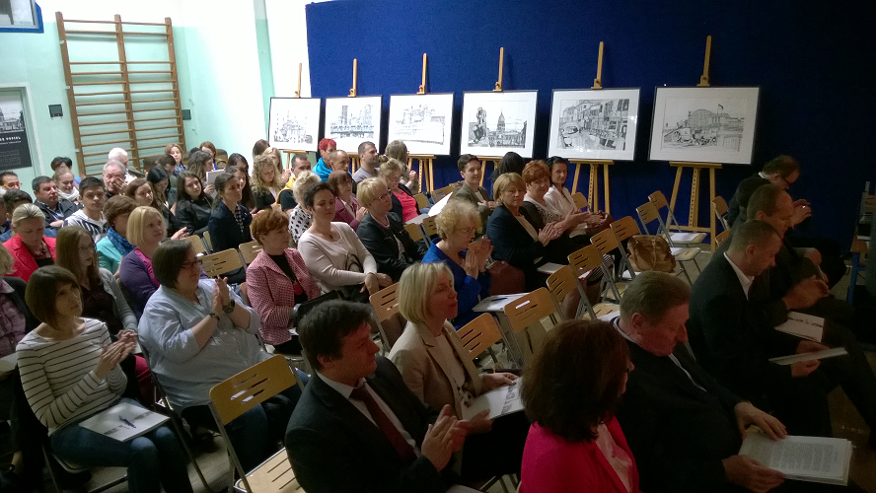
Special Pedagogics Academy in Warsaw – partnership – duties of the school in Łajski
Reviewing curriculum, including the purposes and effects of education and study plans in the context of the requirements of the labour market
Providing workshops in the school and mentoring the interns.
Notes:
Special Pedagogics Academy in Warsaw – partnership – duties of the school in Łajski
Reviewing curriculum, including the purposes and effects of education and study plans in the context of the requirements of the labour market
Providing workshops in the school and mentoring the interns.

Slide 25
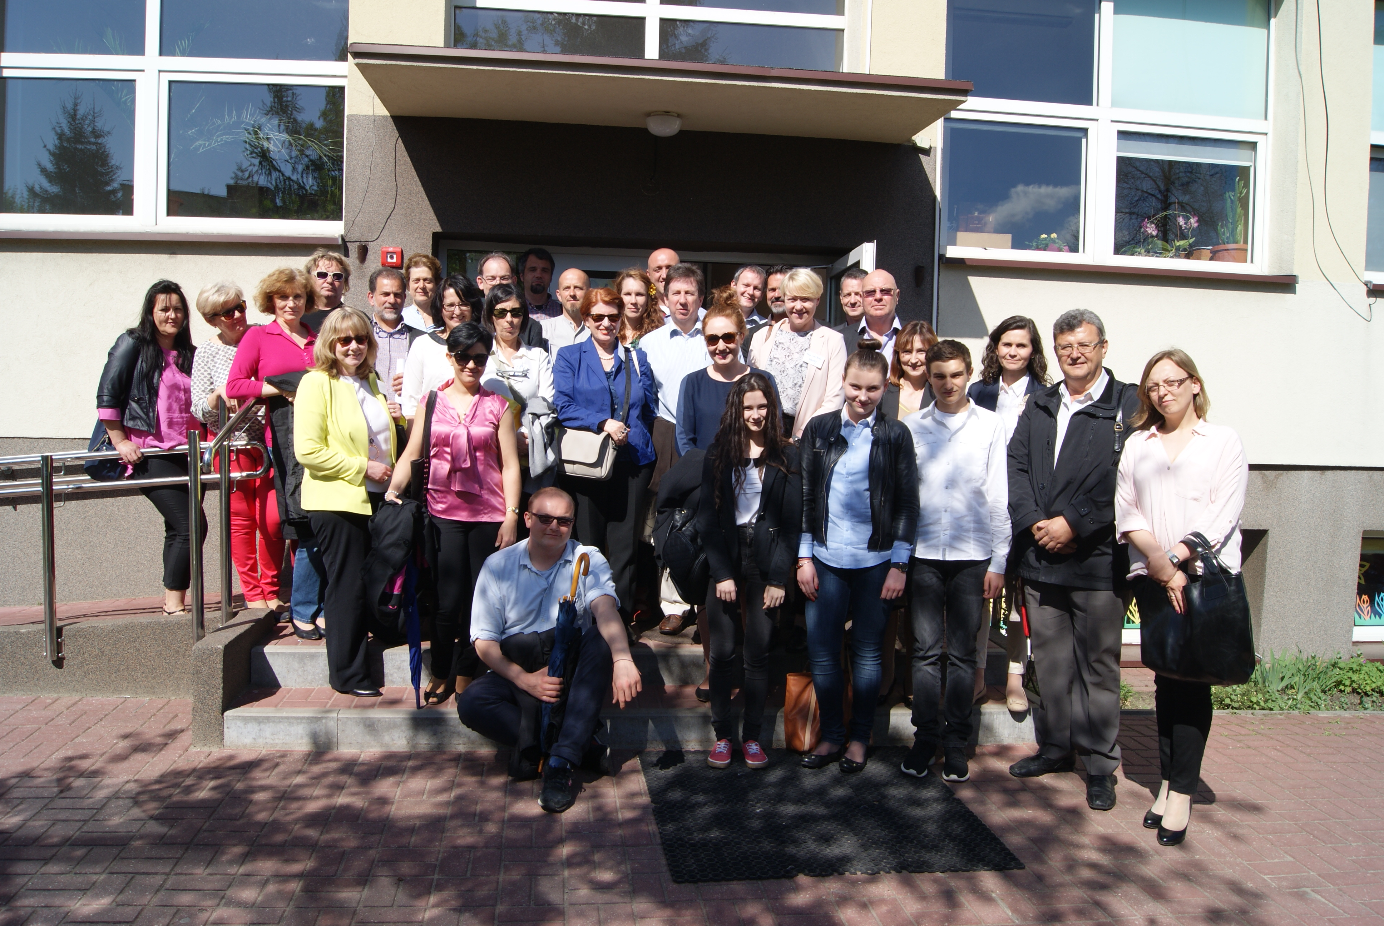
The school as good practice
The school in Łajski, Poland has been involved in the project since 2014 for the school-based project visits and research:
good practice as the source of knowledge and development
changes in the Polish legislation
education is an on-going process
‘Say what you do well and learn more’
‘Enjoy what you do in life’
Notes:
The school as good practice
The school in Łajski, Poland has been involved in the project since 2014 for the school-based project visits and research:
good practice as the source of knowledge and development
changes in the Polish legislation
education is an on-going process
‘Say what you do well and learn more’
‘Enjoy what you do in life’

Slide 26
‘An ordinary school’ video
Watch the ‘An ordinary school’ video on the Agency’s YouTube channel
Notes:
‘An ordinary school’ video
Watch the ‘An ordinary school’ video on the Agency’s YouTube channel (www.youtube.com/watch?v=6210-dQ3COE&index=3&list=PLWKpdDXcn5-5nf715yXXULP11vNQig8M3)

Slide 27
Thank you for your attention!
Notes:
Thank you for your attention!

