Slide 1
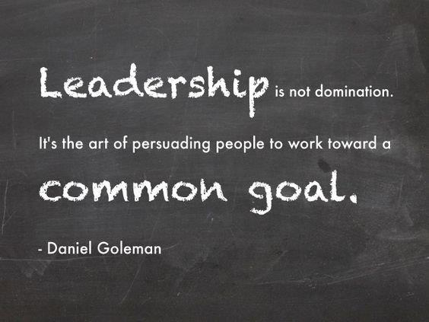
Leadership
Notes:
'Leadership is not domination. It's the art of persuading people to work toward a common goal.' - Daniel Goleman

Slide 2
Leadership of Culture
What messages are we delivering?
Beyond transmission of vision & values
Move away from focus on inclusion per se
Ensuring outcomes based on equity for all learners
Notes:
Leadership of Culture
What messages are we delivering?
Beyond transmission of vision & values
Move away from focus on inclusion per se
Ensuring outcomes based on equity for all learners
We had been challenged by the project we thought we were quite good on inclusion – a highly inclusive school. We were starting to have evidence of raising achievement for all
Looked at what are the messages we are delivering

Slide 3
So What… (1)
More teachers having a better understanding of equity and starting to think more inclusively and grasp the notion of raising achievement for all
Increased evidence of improved outcomes for all
Notes:
So What… (1)
More teachers having a better understanding of equity and starting to think more inclusively and grasp the notion of raising achievement for all
Increased evidence of improved outcomes for all

Slide 4
Sports journalism
Watch the video on Sports Journalism and Football Studies at Calderglen
Notes:
Sports journalism
Watch the video on Sports Journalism and Football Studies at Calderglen (https://youtu.be/gqSl8FAwUiU)

Slide 5
Flexible Learning Pathways
Quality opportunities for teachers
Training for teachers
Empower teachers
Develop the emotional intelligence of teachers
Notes:
Flexible Learning Pathways
Quality opportunities for teachers
Training for teachers
Empower teachers
Develop the emotional intelligence of teachers
Created/ allowed opportunities for teachers to engage and motivate them – teaches at CERN – impact
Photography course – qualifications
Barcelona – digital technology
South Africa

Slide 6
So What… (2)
Diverse learning and skills development opportunities for young people e.g. Inter Disciplinary Learning
A refreshed flexible curriculum leading to relevant pathways
More engaged young people, more inspired teachers through increased creativity and innovative approaches
Increased accreditation, qualifications and skills development – more young people ready for the workplace or further training or further study
Notes:
So What… (2)
Diverse learning and skills development opportunities for young people e.g. Inter Disciplinary Learning
A refreshed flexible curriculum leading to relevant pathways
More engaged young people, more inspired teachers through increased creativity and innovative approaches
Increased accreditation, qualifications and skills development – more young people ready for the workplace or further training or further study

Slide 7
Flying Car
Watch the video of the flying car designed by learners from Calderglen High School
Notes:
Flying Car
Watch the video of the flying car designed by learners from Calderglen High School

Slide 8
Mobilisation of a (Global) Community
Engaging with the whole school community
Extending the range of partnerships to deliver better outcomes for all
Thinking globally as well as locally and nationally
Notes:
Mobilisation of a (Global) Community
Engaging with the whole school community
Extending the range of partnerships to deliver better outcomes for all
Thinking globally as well as locally and nationally

Slide 9
So What… (3)
Watch the video on Working in Partnership
Notes:
So What… (3)
Watch the video on Working in Partnership (https://youtu.be/dIpctah4f4Y)

Slide 10
Pupil leadership opportunities
Watch the Lab Skills video
Notes:
Pupil leadership opportunities
Watch the Lab Skills video (https://youtu.be/tZ9Eqj259pg)

