Slide 1
Ferreira de Castro’s Schools Grouping
An inclusive cluster of schools with good results in achievement
Notes:
Ferreira de Castro’s Schools Grouping
An inclusive cluster of schools with good results in achievement

Slide 2
About the schools grouping
The Agrupamento de Escolas (Schools Grouping) Ferreira de Castro is a schools cluster that includes five different schools located in the suburban area of Mem Martins, Sintra, 20 km away from Lisbon.
Middle and lower class communities, many of the students’ families have severe financial difficulties, due to unemployment.
Algueirão – Mem Martins is a community with 80,000 inhabitants, and a density of 2,500 inhabitants per square km. Therefore, there is overcrowding in our schools.
Notes:
About the schools grouping
The Agrupamento de Escolas (Schools Grouping) Ferreira de Castro is a schools cluster that includes five different schools located in the suburban area of Mem Martins, Sintra, 20 km away from Lisbon.
Middle and lower class communities, many of the students’ families have severe financial difficulties, due to unemployment.
Algueirão – Mem Martins is a community with 80,000 inhabitants, and a density of 2,500 inhabitants per square km. Therefore, there is overcrowding in our schools.

Slide 3
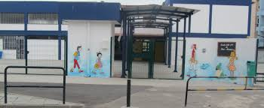
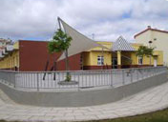
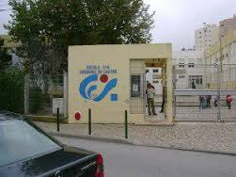
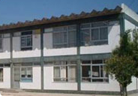
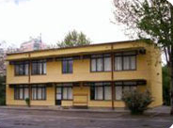
School images
E. B. nº 1 de Mem Martins
E. B. de Mem Martins
Main school
Escola Básica de 2º e 3º Ciclos
Ferreira de Castro
E. B. de Ouressa
Jardim de Infância de
Mem Martins
Notes:
School images
Photos of the schools in the schools grouping

Slide 4
School statistics
1,330 students
254 children
Lower secondary school: 10 to 15 years
Primary school: 6 to 10 years
810 students
Pre-school: 4 to 6 years
187
169
204
45 %
Notes:
School statistics
Lower secondary school: 10 to 15 years
1,330 students
Primary school: 6 to 10 years
810 students
Pre-school: 4 to 6 years
254 children
187 teachers
169 international students
45% subsidised students
204 learners with special needs

Slide 5
Educational Project
the education of all students, giving them full training and contributing to its construction as conscious citizens of their own rights and responsibilities, promoting their inclusion.
Notes:
Educational Project
the education of all students, giving them full training and contributing to its construction as conscious citizens of their own rights and responsibilities, promoting their inclusion.

Slide 6
Aims / Strategic goals
F1 - Significantly improve the qualifications and working conditions of all elements of the school community;
F2 - Build the autonomy of the group of schools under a shared management, with an effective articulation of the various agencies and services;
F3 - Fully train students by increasing levels of success and fostering an academic and technological solid formation;
F4 - Making the group of schools an institution with its own identity, intervenient and accepted full-fledged in the community.
Notes:
Aims / Strategic goals
F1 - Significantly improve the qualifications and working conditions of all elements of the school community;
F2 - Build the autonomy of the group of schools under a shared management, with an effective articulation of the various agencies and services;
F3 - Fully train students by increasing levels of success and fostering an academic and technological solid formation;
F4 - Making the group of schools an institution with its own identity, intervenient and accepted full-fledged in the community.

Slide 7
Priority School. Why?
The social contexts in which schools operate can be constituted as enhancers of risk factors for failure in the normal education system, verifying that in territories social and economically degraded educational success is often lower than the national, and violence, indiscipline, abandonment, failure at school and child labour are some examples of how this degradation is manifested.
Notes:
Priority School. Why?
The social contexts in which schools operate can be constituted as enhancers of risk factors for failure in the normal education system, verifying that in territories social and economically degraded educational success is often lower than the national, and violence, indiscipline, abandonment, failure at school and child labour are some examples of how this degradation is manifested.

Slide 8
Priority School. Why? (2)
The Educational Territories of Priority Intervention Program, which promotes educational policies territorialization according to priority criteria and positive discrimination, contains a set of general objectives converging with individual objectives of personal fulfilment.
This way the principle of positive discrimination was introduced in the allocation of resources to schools.
Notes:
Priority School. Why? (2)
The Educational Territories of Priority Intervention Program, which promotes educational policies territorialization according to priority criteria and positive discrimination, contains a set of general objectives converging with individual objectives of personal fulfilment.
This way the principle of positive discrimination was introduced in the allocation of resources to schools.

Slide 9
Inclusion. How?
our group of schools:
reflects the community as a whole, and doesn’t reject, exclude or select students;
is accessible to all, physically (without architectural barriers) and educationally (through curriculum, support and communication methods);
works with, not against;
practices democracy and equity.
Notes:
Inclusion. How?
our group of schools:
reflects the community as a whole, and doesn’t reject, exclude or select students;
is accessible to all, physically (without architectural barriers) and educationally (through curriculum, support and communication methods);
works with, not against;
practices democracy and equity.

Slide 10
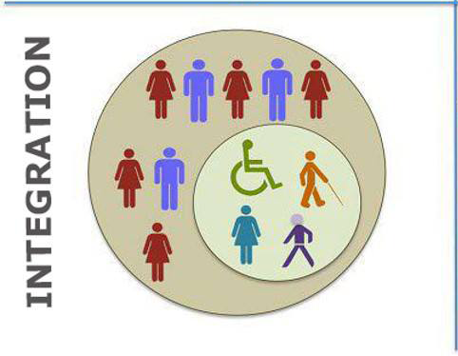
Inclusion. How? (2)
From Scholar Integration / Special Education | To Scholar inclusion/ Inclusive Education
From Special Educational Needs | To Education for all
From additional measures to respond to special students | To the response to the educational needs for all children and young
From the child-centred perspective | To the perspective-centred curriculum
From focus on student | To focus on class
From the programme for students | To strategies for teachers
Notes:
Inclusion. How? (2)
Table with two columns. The first column is titled 'From Scholar Integration/Special Education', the second is titled 'To Scholar inclusion/inclusive education'.
From Special Educational Needs: To Education for all;
From additional measures to respond to special students: to the response to the educational needs for all children and young people;
From the child-centred perspective: to the perspective-centred curriculum;
From focus on student: to focus on class;
From the programme for students: to strategies for teachers.

Slide 11
Practice (1)
Strengthening the fundamental disciplines – For students of the first four years, is intended to strengthen and improve learning in the disciplines of Portuguese and Mathematics as fundamental structuring in junior high school. Would be of three types: a) individualized and/or small group support; b) Second teacher in the classroom; c) study support.
Maths intervention plan - create groups of students on the basis of the levels of learning throughout the year, with assistance where possible, in the classroom and/or at Maths Lab; optimization of school study support; links between cycles (1st, 2nd and 3rd cycles) to different disciplines, Portuguese, Visual Education and Technological education.
Notes:
Practice (1)
Strengthening the fundamental disciplines – For students of the first four years, is intended to strengthen and improve learning in the disciplines of Portuguese and Mathematics as fundamental structuring in junior high school. Would be of three types: a) individualized and/or small group support; b) Second teacher in the classroom; c) study support.
Maths intervention plan - create groups of students on the basis of the levels of learning throughout the year, with assistance where possible, in the classroom and/or at Maths Lab; optimization of school study support; links between cycles (1st, 2nd and 3rd cycles) to different disciplines, Portuguese, Visual Education and Technological education.

Slide 12
Practice (2)
Reading and writing - This action aims to, in a first approach, improve learning of reading and writing skills of students at the end of the second and third cycles and will support the streamlining of tasks leading to the improvement of the learning of students, through differentiated pedagogy in the classroom and a second teacher in one of the classes.
X-class - The constitution of the class X is based on the existence of students with low levels of educational attainment, at risk of retention and lack of motivation for school activities. These classes have two teachers working together in some subjects to prevent retention and potentiate learning.
Notes:
Practice (2)
Reading and writing - This action aims to, in a first approach, improve learning of reading and writing skills of students at the end of the second and third cycles and will support the streamlining of tasks leading to the improvement of the learning of students, through differentiated pedagogy in the classroom and a second teacher in one of the classes.
X-class - The constitution of the class X is based on the existence of students with low levels of educational attainment, at risk of retention and lack of motivation for school activities. These classes have two teachers working together in some subjects to prevent retention and potentiate learning.

Slide 13
Practice (3)
Pedagogical intervision - Observation of classes with the supervision cycle application to share and reflect on practices, (and) pedagogy and school methodologies in order to improve the teaching-learning process. Pedagogical meetings between teaching cycles, allowing the articulation between cycles. Pedagogical conversations: informal moments of sharing and reflection on different topics and pedagogical experiences. Collaborative mural of reflection and sharing: dissemination of practices, strategies and methodologies. Training the teachers that wish to attend.
The Bridge - With this project we intend to intervene with students who show inappropriate behaviours, inside or outside the classroom, through two ways: use of mediation office and opening of mentoring processes.
Notes:
Practice (3)
Pedagogical intervision - Observation of classes with the supervision cycle application to share and reflect on practices, (and) pedagogy and school methodologies in order to improve the teaching-learning process. Pedagogical meetings between teaching cycles, allowing the articulation between cycles. Pedagogical conversations: informal moments of sharing and reflection on different topics and pedagogical experiences. Collaborative mural of reflection and sharing: dissemination of practices, strategies and methodologies. Training the teachers that wish to attend.
The Bridge - With this project we intend to intervene with students who show inappropriate behaviours, inside or outside the classroom, through two ways: use of mediation office and opening of mentoring processes.

Slide 14
Practice (4)
Affections - Diagnosis, prevention and intervention on absenteeism and early school disruption in the schools grouping, throughout the school year.
Animate the “Know Be and Know to Be” - This action targets the students, and the recreational space is the location chosen for its implementation. Develops daily activities in order to enhance the personal and social development of the students, and at the same time contributes to the prevention of indiscipline outside the classroom. The organizer acts primarily on streamlining the recreational space, seeking to involve them in activities/projects playful character journals and training, identifying and intervening on potential disruptive behaviours and/or risk.
Notes:
Practice (4)
Affections - Diagnosis, prevention and intervention on absenteeism and early school disruption in the schools grouping, throughout the school year.
Animate the “Know Be and Know to Be” - This action targets the students, and the recreational space is the location chosen for its implementation. Develops daily activities in order to enhance the personal and social development of the students, and at the same time contributes to the prevention of indiscipline outside the classroom. The organizer acts primarily on streamlining the recreational space, seeking to involve them in activities/projects playful character journals and training, identifying and intervening on potential disruptive behaviours and/or risk.

Slide 15
What we have learned: Key points
Learning environment
Emphasis on teaching and learning
Teaching with intention
High expectations
Positive reinforcement
Monitoring the progress
Family-school partnership
Leadership
Vision and shared goals
Learning organization
Monitoring, (self)regulation and improvement of the work in the classroom
Notes:
What we have learned: Key points
Learning environment
Emphasis on teaching and learning
Teaching with intention
High expectations
Positive reinforcement
Monitoring the progress
Family-school partnership
Leadership
Vision and shared goals
Learning organization
Monitoring, (self)regulation and improvement of the work in the classroom

Slide 16
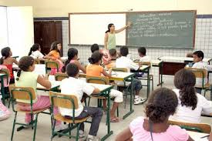
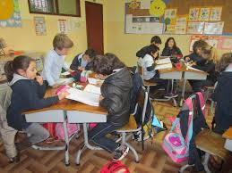
Learning environment
Learning environment
Nice atmosphere, of trust and openness
Ordered and secure
Risk-taking is encouraged - innovation
Climate of collaboration and mutual aid
Notes:
Learning environment
The diagram shows key features of the learning environment – a nice atmosphere of trust and openness; climate of collaboration and mutual aid; risk-taking and innovation and an ordered and secure classroom/school

Slide 17
Emphasis on teaching and learning
Emphasis on teaching and learning
Maximize learning
Identification of essential content
Focus on learning
Pedagogical Differentiation
Strategies of diversification
Notes:
Emphasis on teaching and learning
The diagram shows how the school emphasizes teaching and learning:
Identification of essential content
Focus on maximizing learning
Pedagogical differentiation
Strategies of diversification

Slide 18
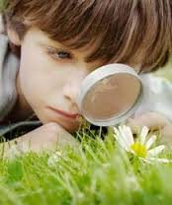
Teaching with intention (1)
Teaching with intention
Clear definition of the objectives of learning (essential and secondary)
Disclosure (negotiation) learning objectives with the students
Establish "bridges" with previous knowledge of students with knowledge of other curricular areas and with the daily life of the students -give meaning to learning.
Notes:
Teaching with intention (1)
The diagram shows how the school teachers with intention:
Clear definition of learning objectives – essential and secondary
Disclosure (negotiation) learning objectives with the students
Establish "bridges" with previous knowledge of students with knowledge of other curricular areas and with the daily life of the students -give meaning to learning.

Slide 19
Teaching with intention (2)
High expectations
Transmission of confidence and encouragement – no student should be left behind
Aspirations and shared success criteria – establishment of commitments
Teachers with high expectations of their students convey that attitude (intentionally or not) and in general these students get better results than those of teachers whose expectations are low.
Notes:
Teaching with intention (2)
The slide shows the need for high expectations:
Teachers with high expectations of their students convey that attitude (intentionally or not) and in general these students get better results than those of teachers whose expectations are low.
Transmission of confidence and encouragement – no student should be left behind
High aspirations and shared success criteria – establishment of commitments

Slide 20
Positive reinforcement
Positive reinforcement
Provide quality feedback.
Use of various forms of recognition of merit, behaviours and attitudes.
Involve parents in positive reinforcement
Notes:
Positive reinforcement
The diagram shows the actions taken to provide positive reinforcement;
Provide quality feedback
Use of various forms of recognition of merit, behaviours and attitudes.
Involve parents in positive reinforcement
Positive reinforcement statements: Excellent, Great improvement, Good job!, Perfect! 100%, Very creative!, You did it!

Slide 21
Monitoring of progress
Monitoring of progress
Systematic collection of information about the students’ learning – formative evaluation
Use of various assessment tools and techniques
Involvement of students in the evaluation – self, straight and co-evaluation (use of headings)
Monitoring of the success criteria established with the students
Notes:
Monitoring of progress
The diagram sets out how progress is monitored:
Systematic collection of information about the students’ learning – formative evaluation
Use of various assessment tools and techniques
Involvement of students in the evaluation – self, straight and co-evaluation (use of headings)
Monitoring of success criteria with students

Slide 22
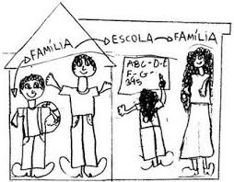
Family-school partnership
Learning increases when the schools encourage parents to stimulate the intellectual development of children
Submit concrete suggestions of things that parents can do to help the children
Parents need to hear success stories of their children
Family-school partnership
Notes:
Family-school partnership
The diagram shows aspects of family-school partnership:
Learning increases when the schools encourage parents to stimulate the intellectual development of children
Submit concrete suggestions of things that parents can do to help the children
Parents need to hear success stories of their children

Slide 23
Leadership
Leadership
Decision-making by workgroups
Shared workgroups - planning and execution of activities
Commits all in decision-making
Constant (inter-) communication – updated information
Shared responsibility for results achieved
Notes:
Leadership
The diagram highlights key aspects of leadership:
Shared work groups - planning and execution of activities
Decision making by workgroups
Commits in all decision making
Constant (inter-) communication – updated information
Shared responsibility for results achieved

Slide 24
Vision and shared goals
“We” instead of “I”
Organization of work for the goals and objectives of the school
Shared vision
Predominance of forms of collaborative work
Vision and shared goals
Notes:
Vision and shared goals
The diagram shows what contributes to school vision and shared goals:
Shared vision
We instead of I
Organization of work for goals and objectives of the school
Predominance of forms of collaborative work

Slide 25
Learning organisation
Identification and sharing of good practice models - note pairs’ lessons
Systematic reflections on the teaching and learning
Learning Organization
Learning teachers
Training that responds to the identified needs
Notes:
Learning organisation
The diagram explains work towards becoming a learning organization:
Systematic reflections on teaching and learning
Training that responds to identified needs
Identification and sharing of good practice models - note pairs’ lessons
Learning teachers

Slide 26
Monitoring, (self-)regulation and improvement of the work in the classroom
SUPERVISION
REFLECTION
COOPERATIVE WORK
Notes:
Monitoring, (self-)regulation and improvement of the work in the classroom
The diagram shows that monitoring, self-regulation and improvement work in the classroom consists of inter-related aspects of cooperative work, reflection and supervision

Slide 27
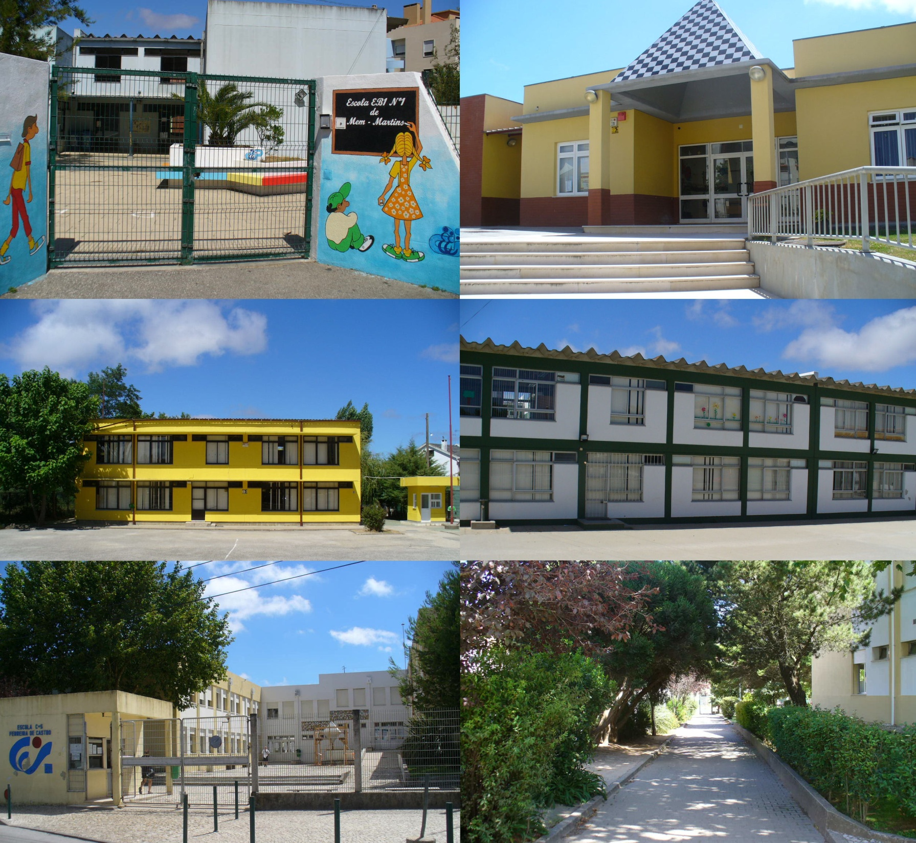
School images (2)
Notes:
School images (2)
Photos of the school

