Slide 1
DEVELOPING PARTNERSHIP WITH UNIVERSITIES SESSION: COLLABORATION
Lidia Kazberuk
and
Representatives of the Parents’ Board
6 April 2017
Notes:
DEVELOPING PARTNERSHIP WITH UNIVERSITIES SESSION: COLLABORATION
Lidia Kazberuk
and
Representatives of the Parents’ Board
6 April 2017

Slide 2
Co-operation with institutions and schools
Psychological and Pedagogical Counselling Centre (PPP)
Commune Wieliszew
Social Welfare Centre (OPS)
District Centre of Social Integration (CIS)
Centre for Education Development (ORE)
Educational Research Institute (IBE)
The State Fund For Rehabilitation of Disabled Persons (PFRON)
Ravimed
Other schools – trainings and internships
Notes:
Co-operation with institutions and schools
Psychological and Pedagogical Counselling Centre (PPP)
Commune Wieliszew
Social Welfare Centre (OPS)
District Centre of Social Integration (CIS)
Centre for Education Development (ORE)
Educational Research Institute (IBE)
The State Fund For Rehabilitation of Disabled Persons (PFRON)
Ravimed
Other schools – trainings and internships

Slide 3
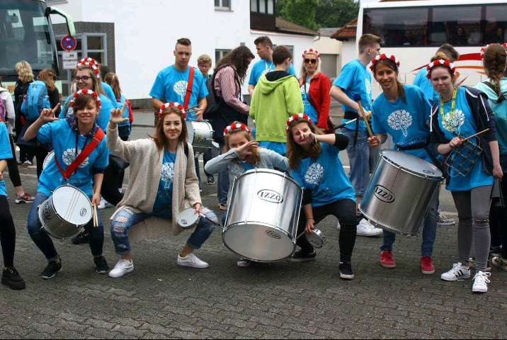
Continuation of participating in many projects (1)
PNWM – (Polish–German Youth Co-operation)
The project focuses on youth co-operation, meeting once a year in Poland or Germany and playing in the symphonic orchestra consisted of two orchestras – Polish and German
Notes:
Continuation of participating in many projects (1)
PNWM – (Polish–German Youth Co-operation)
The project focuses on youth co-operation, meeting once a year in Poland or Germany and playing in the symphonic orchestra consisted of two orchestras – Polish and German

Slide 4
Continuation of participating in many projects (2)
Safe+: the government project in which we got financial support to buy new instruments and to organise Meeting with Arts for providing safety, co-operation, and agreement in school and the whole commune.
Milk, vegetables and fruits in school: we have been involved in the project for five years. Students receive milk, vegetables and fruits for free during their school breaks.
Notes:
Continuation of participating in many projects (2)
Safe+: the government project in which we got financial support to buy new instruments and to organise Meeting with Arts for providing safety, co-operation, and agreement in school and the whole commune.
Milk, vegetables and fruits in school: we have been involved in the project for five years. Students receive milk, vegetables and fruits for free during their school breaks.

Slide 5
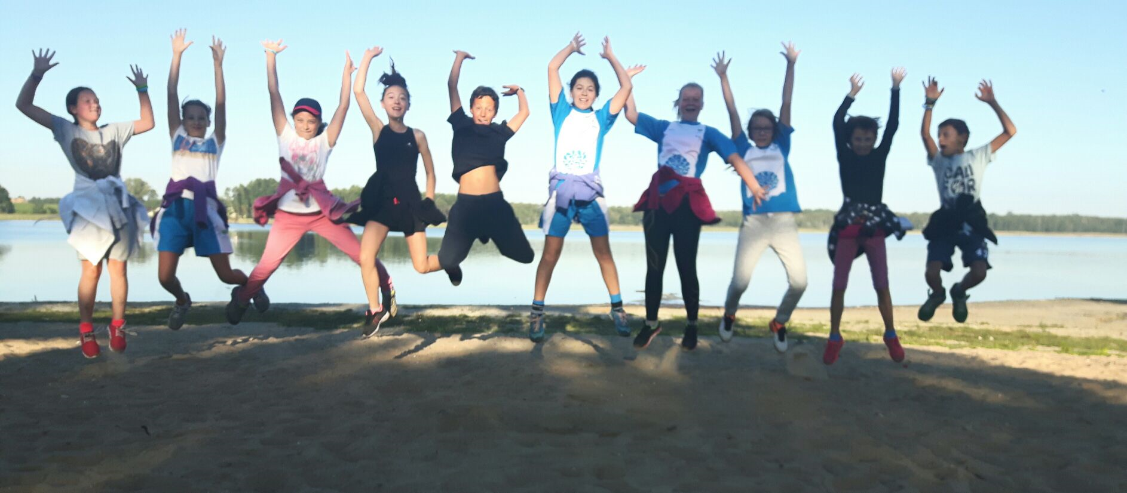
Continuation of participating in many projects (3)
Sports classes: additional classes include ice-skating during winter, swimming and physiotherapy
Notes:
Continuation of participating in many projects (3)
Sports classes: additional classes include ice-skating during winter, swimming and physiotherapy

Slide 6
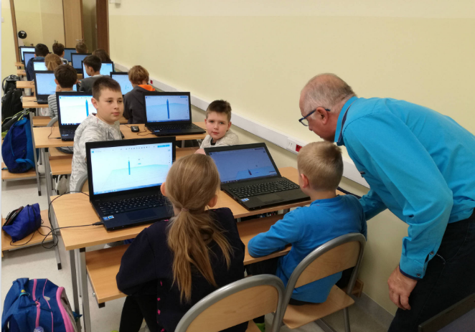
Continuation of participating in many projects (4)
Gotta Get Engineering – free programme that introduces a fully supported engineering curriculum for elementary schools. It uses 3D printers and basic engineering sets to integrate engineering design and 3D printing technology with core academic knowledge of:
Science
Maths
ICT
Technology
Notes:
Continuation of participating in many projects (4)
Gotta Get Engineering – free programme that introduces a fully supported engineering curriculum for elementary schools. It uses 3D printers and basic engineering sets to integrate engineering design and 3D printing technology with core academic knowledge of:
Science
Maths
ICT
Technology

Slide 7
European project
Area: YOUTH
Action 2: Co-operation for innovation and exchange of good practices
Strategic partnerships: international co-operation of organisations and institutions involved in youth and non-formal education
Aim: long-term impact on the methods of work with young people – so that they will have higher competences and find the adult world easier
2017–2019
Notes:
European project
Area: YOUTH
Action 2: Co-operation for innovation and exchange of good practices
Strategic partnerships: international co-operation of organisations and institutions involved in youth and non-formal education
Aim: long-term impact on the methods of work with young people – so that they will have higher competences and find the adult world easier
2017–2019

Slide 8
Co-operation with Parents’ Board (1)
Constant co-operation between school and parents, working together for school and all learners, listening to parents’ ideas:
Project ‘green surrounding around school’
Santa Claus presents on 6 December
Notes:
Co-operation with Parents’ Board (1)
Constant co-operation between school and parents, working together for school and all learners, listening to parents’ ideas:
Project ‘green surrounding around school’
Santa Claus presents on 6 December

Slide 9
Co-operation with Parents’ Board (2)
‘Hero of our school’ (finding the best student who achieved the greatest reputation among peers and faculty of our school)
Parents of children with SEN (special educational needs) have got daily contact with the child’s assistants and teachers
School debate Oxford debate ‘Everyone is an egoist’ – theory of the debate in practice
Notes:
Co-operation with Parents’ Board (2)
‘Hero of our school’ (finding the best student who achieved the greatest reputation among peers and faculty of our school)
Parents of children with SEN (special educational needs) have got daily contact with the child’s assistants and teachers
School debate Oxford debate ‘Everyone is an egoist’ – theory of the debate in practice

Slide 10
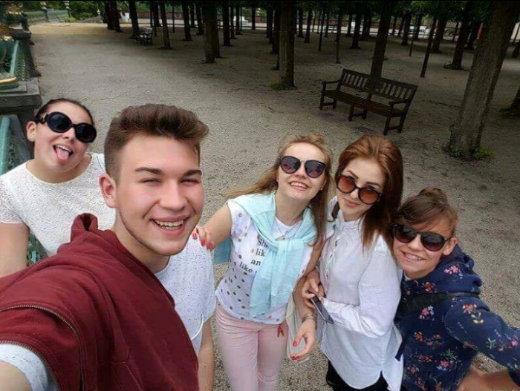
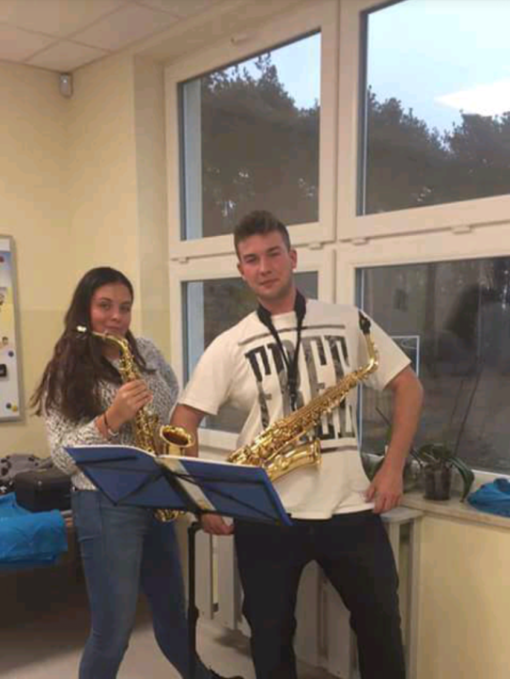
Co-operation with graduates
Students meet with graduates to play together in the School Orchestra once a week.
Students are open to pro-social attitudes working in the orchestral sections.
The School Orchestra is a unique structure where young musicians create positive attitudes, learn teamwork and common responsibility for the work of the whole team.
The Orchestra is learning by doing – students learn from each other.
Notes:
Co-operation with graduates
Students meet with graduates to play together in the School Orchestra once a week.
Students are open to pro-social attitudes working in the orchestral sections.
The School Orchestra is a unique structure where young musicians create positive attitudes, learn teamwork and common responsibility for the work of the whole team.
The Orchestra is learning by doing – students learn from each other.

Slide 11
Partnership with universities – interns
Interns from different Universities:
University of Warsaw
Cardinal Stefan Wyszyński University in Warsaw
Józef Piłsudski University of Physical Education in Warsaw
Christian Theological Academy in Warsaw
University of Humanities and Economics in Lodz
Notes:
Partnership with universities – interns
Interns from different Universities:
University of Warsaw
Cardinal Stefan Wyszyński University in Warsaw
Józef Piłsudski University of Physical Education in Warsaw
Christian Theological Academy in Warsaw
University of Humanities and Economics in Lodz

Slide 12
Special Pedagogics Academy in Warsaw
Established in 1922
7,000 students
Focuses on training of teachers and teacher assistants to children, adolescents and adults with intellectual difficulties, hearing, speech or sight impediment, motor impairment, physical disabilities, as well as emotional and behavioural disorders
Pedagogical courses prepare for working both at school (a school pedagogue) and other special education centres
Notes:
Special Pedagogics Academy in Warsaw
Established in 1922
7,000 students
Focuses on training of teachers and teacher assistants to children, adolescents and adults with intellectual difficulties, hearing, speech or sight impediment, motor impairment, physical disabilities, as well as emotional and behavioural disorders
Pedagogical courses prepare for working both at school (a school pedagogue) and other special education centres

Slide 13
Special Pedagogics Academy in Warsaw – partnership
Creating projects and curriculum for students and teachers in inclusive education
Taking common implementation of the work of scientific research and projects, including those co-financed by the European Union
Creating modular improvement courses
Creating and implementing new curriculums and improving those carried out by the University
Creating common research teams
Sharing teaching staff to carry out practical or theoretical classes
Notes:
Special Pedagogics Academy in Warsaw – partnership
Creating projects and curriculum for students and teachers in inclusive education
Taking common implementation of the work of scientific research and projects, including those co-financed by the European Union
Creating modular improvement courses
Creating and implementing new curriculums and improving those carried out by the University
Creating common research teams
Sharing teaching staff to carry out practical or theoretical classes

Slide 14
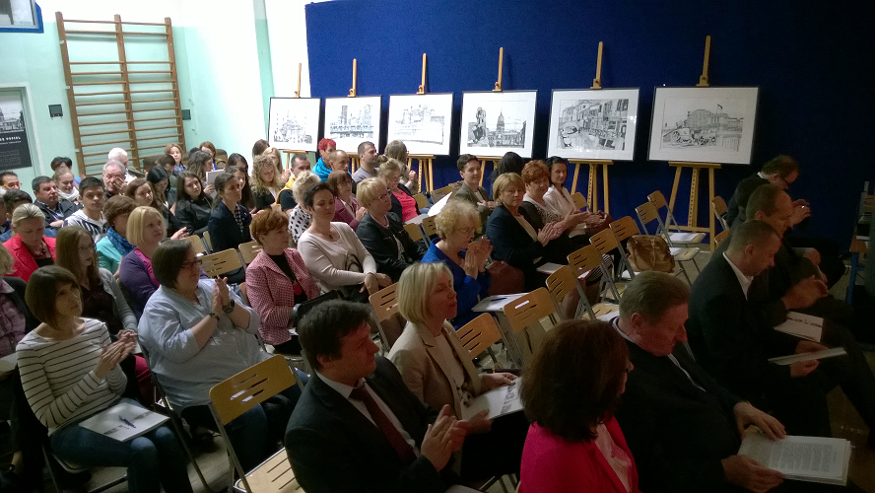
Special Pedagogics Academy in Warsaw – partnership – duties of the school in Łajski
Reviewing the curriculum, including the purposes and effects of education and study plans in the context of the requirements of the labour market.
Providing workshops in the school and mentoring the interns.
Notes:
Special Pedagogics Academy in Warsaw – partnership – duties of the school in Łajski
Reviewing the curriculum, including the purposes and effects of education and study plans in the context of the requirements of the labour market.
Providing workshops in the school and mentoring the interns.

Slide 15
Thank you for your attention!
Notes:
Thank you for your attention!

