Slide 1
Growth Mindset: Permeating our teaching
By David Marsden
The Calderglen Faculty of Mathematics and Numeracy
Notes:
Growth Mindset: Permeating our teaching
By David Marsden
The Calderglen Faculty of Mathematics and Numeracy

Slide 2
Growth Mindset: Permeating our teaching (1)
Our Challenge
Senior Phase
Broad General Education (BGE)
Parents and Carers
Evidence
Notes:
Growth Mindset: Permeating our teaching (1)
Our Challenge
Senior Phase
Broad General Education (BGE)
Parents and Carers
Evidence

Slide 3
Growth Mindset: Permeating our teaching (2)
Our Challenge
Senior Phase
Broad General Education (BGE)
Parents and Carers
Evidence
Notes:
Growth Mindset: Permeating our teaching (2)
Our Challenge
Senior Phase
Broad General Education (BGE)
Parents and Carers
Evidence

Slide 4
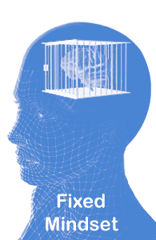
Growth Mindset: Our Challenge (1)
Mathematics can be a polarizing subject.
“I’m not good at maths.”
“I’ve never been good at maths.”
“He/She has always been good at maths.”
Notes:
Growth Mindset: Our Challenge (1)
Mathematics can be a polarizing subject.
“I’m not good at maths.”
“I’ve never been good at maths.”
“He/She has always been good at maths.”

Slide 5
Growth Mindset: Our Challenge (2)
Mathematics can be a polarizing subject.
“I’m a natural at maths.”
“I’ve always been good at maths.”
“I don’t need to work hard to do well in maths.”
Notes:
Growth Mindset: Our Challenge (2)
Mathematics can be a polarizing subject.
“I’m a natural at maths.”
“I’ve always been good at maths.”
“I don’t need to work hard to do well in maths.”

Slide 6
Growth Mindset: Our Challenge (3)
The power of yet!
Notes:
Growth Mindset: Our Challenge (3)
The power of yet!

Slide 7
Growth Mindset: Our Challenge (4)
“Picture your brain forming new connections as you meet the challenge and learn. Keep on going.”
Carol S. Dweck, Mindset: The New Psychology of Success
Notes:
Growth Mindset: Our Challenge (4)
“Picture your brain forming new connections as you meet the challenge and learn. Keep on going.”
Carol S. Dweck, Mindset: The New Psychology of Success

Slide 8
Growth Mindset: Permeating our teaching (3)
Our Challenge
Senior Phase
Broad General Education (BGE)
Parents and Carers
Evidence
Notes:
Growth Mindset: Permeating our teaching (3)
Our Challenge
Senior Phase
Broad General Education (BGE)
Parents and Carers
Evidence

Slide 9
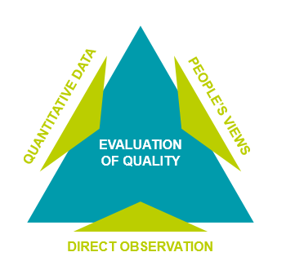
Growth Mindset: Senior Phase
How Good is Our School? (4th edition)
Notes:
Growth Mindset: Senior Phase
The diagram is taken from Education Scotland’s self-evaluation document How Good is our School? (4th edition). It shows three processes that contribute to the evaluation of quality: people’s views, direct observation and quantitative data.

Slide 10
Growth Mindset: Permeating our teaching (4)
Our Challenge
Senior Phase
Broad General Education (BGE)
Parents and Carers
Evidence
Notes:
Growth Mindset: Permeating our teaching (4)
Our Challenge
Senior Phase
Broad General Education (BGE)
Parents and Carers
Evidence

Slide 11
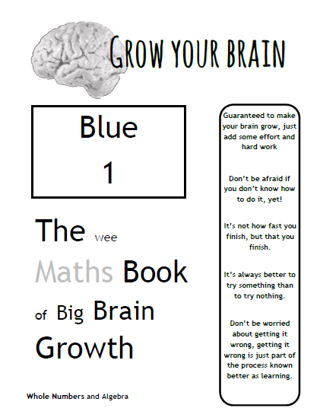
Growth Mindset: Broad General Education (1)
Notes:
Growth Mindset: Broad General Education (1)
Image of a page from The wee Maths Book of Big Brain Growth produced by Calderglen

Slide 12
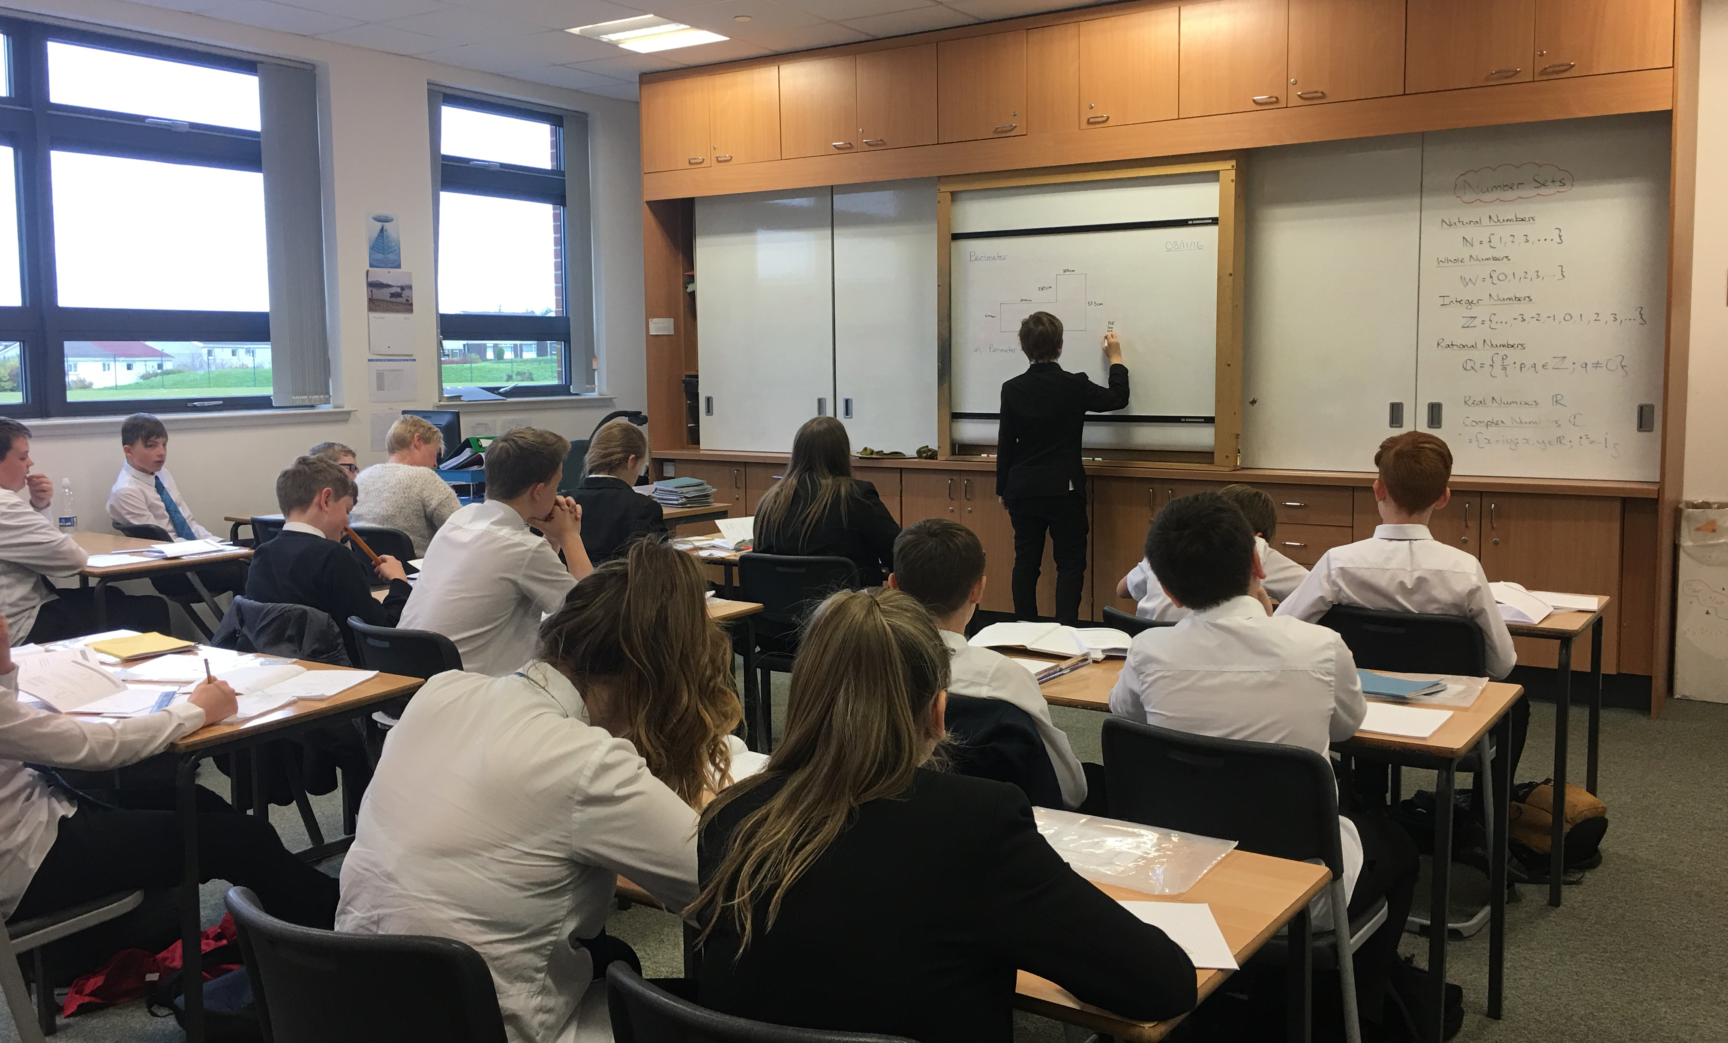
Growth Mindset: Broad General Education (2)
Notes:
Growth Mindset: Broad General Education (2)
Photo of maths class

Slide 13
Growth Mindset: Permeating our teaching (5)
Our Challenge
Senior Phase
Broad General Education (BGE)
Parents and Carers
Evidence
Notes:
Growth Mindset: Permeating our teaching (5)
Our Challenge
Senior Phase
Broad General Education (BGE)
Parents and Carers
Evidence

Slide 14
Growth Mindset: Parents and Carers (1)
Parents and carers can unintentionally hinder or halt their children’s progress.
“I was never good at maths at school.”
“I can’t help them with their maths.”
“Everything’s changed since I was at school.”
Notes:
Growth Mindset: Parents and Carers (1)
Parents and carers can unintentionally hinder or halt their children’s progress.
“I was never good at maths at school.”
“I can’t help them with their maths.”
“Everything’s changed since I was at school.”

Slide 15
Growth Mindset: Parents and Carers (2)
Parents’ Evenings
Reports
Feedback from assessments
Correspondence through letters and emails
Parents’ Information Evenings
“Tips for Parents and Carers” booklet
Notes:
Growth Mindset: Parents and Carers (2)
Parents’ Evenings
Reports
Feedback from assessments
Correspondence through letters and emails
Parents’ Information Evenings
“Tips for Parents and Carers” booklet

Slide 16
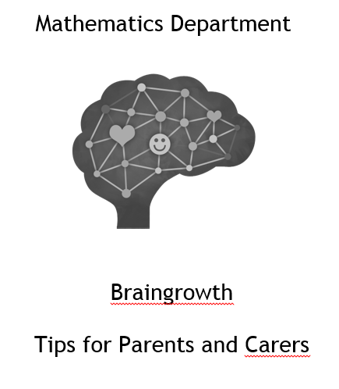
Growth Mindset: Parents and Carers (3)
Notes:
Growth Mindset: Parents and Carers (3)
Cover of Mathematics Department booklet 'Braingrowth: Tips for Parents and Carers'

Slide 17
Growth Mindset: Parents and Carers (4)
Reflective learners try to learn from mistakes
Ask your child to give you examples of a time they learned from a mistake they had made.
Talk to your child on a regular basis about being a resilient and reflective learner
Notes:
Growth Mindset: Parents and Carers (4)
Talk to your child on a regular basis about being a resilient and reflective learner
Reflective learners try to learn from mistakes
Ask your child to give you examples of a time they learned from a mistake they had made.

Slide 18
Growth Mindset: Permeating our teaching (6)
Our Challenge
Senior Phase
Broad General Education (BGE)
Parents and Carers
Evidence
Notes:
Growth Mindset: Permeating our teaching (6)
Our Challenge
Senior Phase
Broad General Education (BGE)
Parents and Carers
Evidence

Slide 19
Growth Mindset: Evidence (1)
Notes:
Growth Mindset: Evidence (1)
Smiling learners in a classroom

Slide 20
Growth Mindset: Evidence (2)
“It’s all about perseverance!”
“I am a resilient learner!”
“I don’t love maths but I recognise the challenge and it’s opened doors for me.”
Notes:
Growth Mindset: Evidence (2)
“It’s all about perseverance!”
“I am a resilient learner!”
“I don’t love maths but I recognise the challenge and it’s opened doors for me.”

Slide 21
Growth Mindset: Evidence (3)
“Through studying mathematics at Calderglen, I have developed a Growth Mindset… it has helped me with my other subjects and in general life.”
Notes:
Growth Mindset: Evidence (3)
“Through studying mathematics at Calderglen, I have developed a Growth Mindset… it has helped me with my other subjects and in general life.”

Slide 22
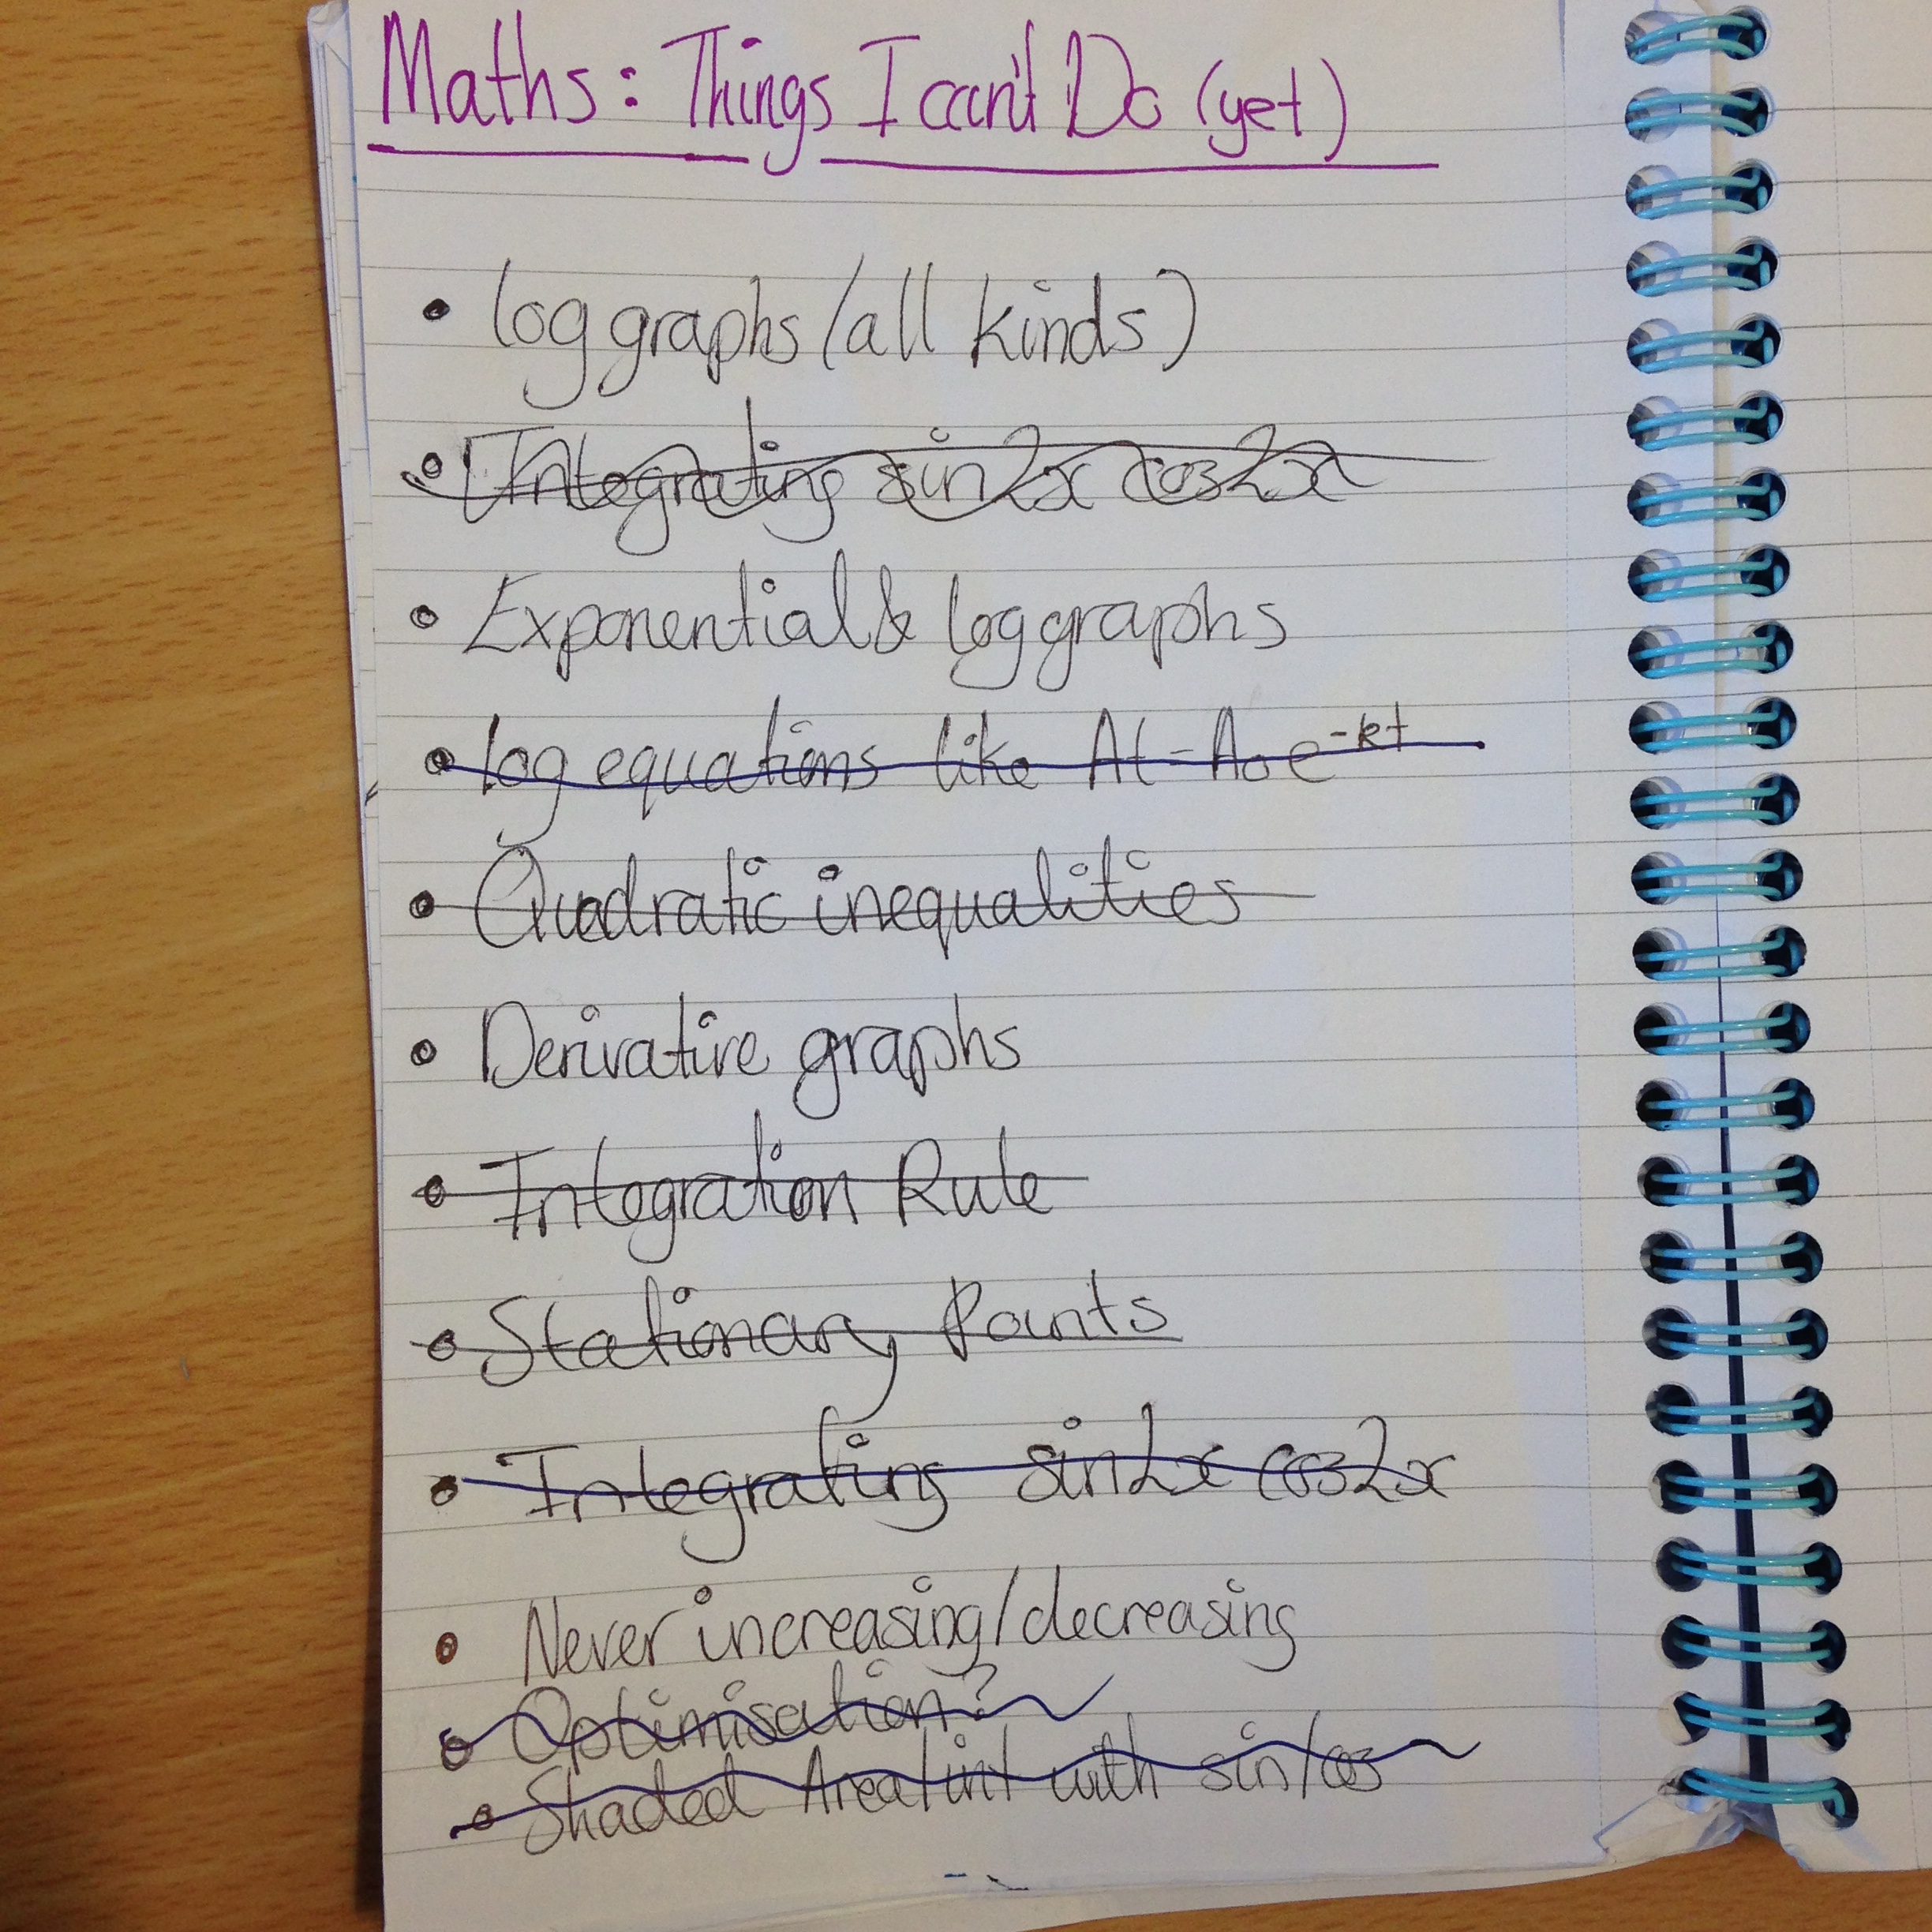
Growth Mindset: Evidence (4)
Notes:
Growth Mindset: Evidence (4)
A learner's list entitled: 'Maths: Things I can't do (yet).

Slide 23
Growth Mindset: Evidence (5)
“I learned that intelligence is not about immediately understanding but about working hard to find your own ways to understand.”
Notes:
Growth Mindset: Evidence (5)
“I learned that intelligence is not about immediately understanding but about working hard to find your own ways to understand.”

