Slide 1
Inclusive Education and Raising Achievement: the project conceptual framework
Notes:
Inclusive Education and Raising Achievement: the project conceptual framework

Slide 2
Overview of presentation
Project overview
The RA journey – how our thinking has developed in the key project concepts
Inclusive education and raising achievement
Project ‘theory of change’
Emerging outcomes – examples of learning community development
Notes:
Overview of presentation
Project overview
The RA journey – how our thinking has developed in the key project concepts
Inclusive education and raising achievement
Project ‘theory of change’
Emerging outcomes – examples of learning community development

Slide 3
Raising Achievement: Project key questions
What pedagogical strategies and teaching approaches best support learning and are effective in raising the achievement (academic and social) of all learners?
How can school leaders best support:
The development, implementation and monitoring of inputs and processes for raising achievement?
The participation of learners, parents/carers in the learning process?
The ‘measurement’ of all forms of achievement and analysis of outcomes to inform further development?
Notes:
Raising Achievement: Project started in 2014 to look at these key questions
What pedagogical strategies and teaching approaches best support learning and are effective in raising the achievement (academic and social) of all learners?
How can school leaders best support:
The development, implementation and monitoring of inputs and processes for raising achievement?
The participation of learners, parents/carers in the learning process?
The ‘measurement’ of all forms of achievement and analysis of outcomes to inform further development?
A further fundamental part of the project was a third theme - COLLABORATION which was a both another strategy for RA plus a key part of our PROJECT METHODOLOGY– we’ll talk a lot more about this during the next 2 days

Slide 4
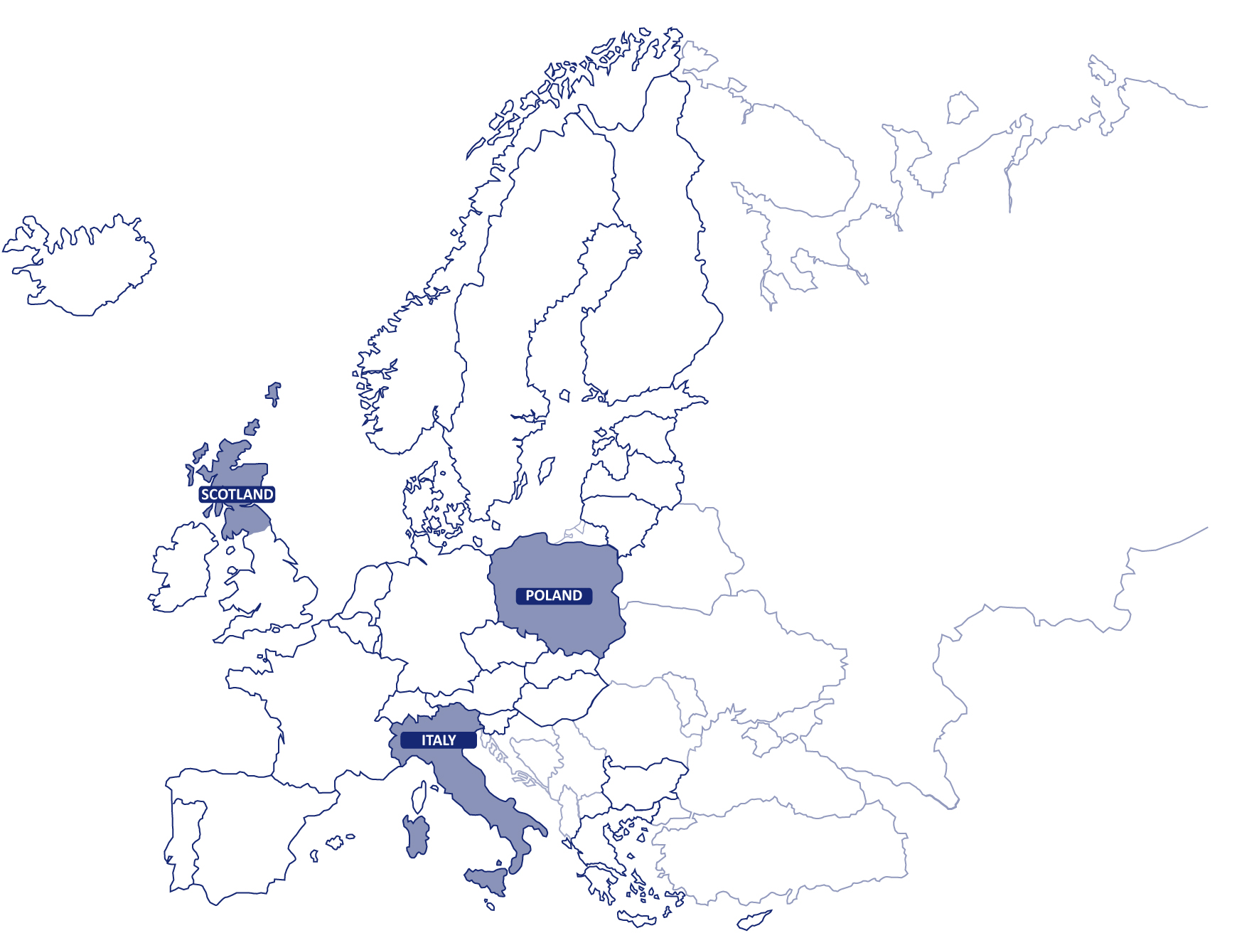
The LCs
Calderglen mainstream school and Sanderson special school, East Kilbride
Group of Schools in Łajski, Commune of Wieliszew
Istituto Tecnico Agrario Sereni (I.T.A. Sereni) & Istituto Comprensivo Antonio Rosmini, Rome Lazio region
Notes:
3 LCs selected to work with us on the project –
Italy: Istituto Tecnico Agrario Sereni (I.T.A. Sereni) & Istituto Comprensivo Antonio Rosmini, Rome Lazio region
Scotland: Calderglen mainstream school and Sanderson special school, East Kilbride
Poland: Group of Schools in Łajski, Commune of Wieliszew
The LCs will describe their learning journeys in final plenary tomorrow. This presentation will focus on the Agency teams’ learning journey and the ways in which our thinking has developed - from original conceptual framework – developed from past projects and research – through the project practical activities.

Slide 5
Raising Achievement – a journey
RA4AL (2012)
Rather than revisiting definitions … or justifying a move to more inclusive approaches, policy makers, school leaders and teachers should collaborate to:
Ensure equity – providing access to education that is not compromised by poverty, social class, gender, race or disability;
Work efficiently – maximising outcomes in cost-effective ways;
Achieve excellence – through a holistic education that will improve the lives of all young people
Organisation of Provision (2013)
Moving from individual support (compensatory) to increasing capacity of all schools to support all learners (proactive)
Notes:
Raising Achievement – a journey
RA4AL (2012)
Rather than revisiting definitions … or justifying a move to more inclusive approaches, policy makers, school leaders and teachers should collaborate to:
Ensure equity – providing access to education that is not compromised by poverty, social class, gender, race or disability;
Work efficiently – maximising outcomes in cost-effective ways;
Achieve excellence – through a holistic education that will improve the lives of all young people
Organisation of Provision (2013)
Moving from individual support (compensatory) to increasing capacity of all schools to support all learners (proactive)
The RA project built on earlier Agency work – in particular the RA4AL one year project and the OoP project. These key quotes provided some starting points for our learning journey -
RA4AL (2012)
Rather than revisiting definitions …or justifying a move to more inclusive approaches, policy makers, school leaders and teachers should collaborate to:
Ensure equity – providing access to education that is not compromised by poverty, social class, gender, race or disability;
Work efficiently – maximising outcomes in cost-effective ways;
Achieve excellence – through a holistic education that will improve the lives of all young people
So really moving towards a much wider understanding of inclusion as being about all learners not only those with SEN/disabilities
In the Organisation of Provision to support IE project (2013) we highlighted the need to
move from individual support (compensatory) to taking a more proactive approach by increasing capacity of all schools to support all learners

Slide 6
Conceptual framework for RA of all learners
Need for culture change and different pedagogical approaches – diversity as ‘pedagogical asset’
Focus moving from individual needs to increasing capacity/capability to personalise learning for all – proactive (rather than remedial or compensatory)
Teachers taking responsibility for all learners – adapting curriculum, teaching, support
Leaders organising in a proactive way to support the development of teacher competences to raise achievement of all learners
Notes:
Conceptual framework for RA of all learners
Need for culture change and different pedagogical approaches – diversity as ‘pedagogical asset’
Focus moving from individual needs to increasing capacity/capability to personalise learning for all – proactive (rather than remedial or compensatory)
Teachers taking responsibility for all learners – adapting curriculum, teaching, support
Leaders organising in a proactive way to support the development of teacher competences to raise achievement of all learners
So from these ideas, we developed the conceptual frame for the current RA work. This included recognising the need for:
culture change and different pedagogical approaches – diversity as ‘pedagogical asset’
Focus moving from individual needs to increasing capacity/capability to personalise learning for all – proactive (rather than remedial or compensatory)
Teachers taking responsibility for all learners – adapting curriculum, teaching, support
Leaders organising in a proactive way to support the development of teacher competences to raise achievement of all learners

Slide 7
Development through collaborative practice
shared vision and values
collective responsibility
respectful and trusting relationships and…
…sharing knowledge and experience through networks that connect with others on own system level and on other levels (regionally, nationally and internationally)
Notes:
Development through collaborative practice
shared vision and values
collective responsibility
respectful and trusting relationships and…
…sharing knowledge and experience through networks that connect with others on own system level and on other levels (regionally, nationally and internationally)
A key premise - from the literature and from Agency work e.g. TE4I. RA4AL. OoP, Inclusive early childhood education - importance of collaboration for inclusive practice – and this is also true for RA.
We felt that development through collaborative practice is necessary to support
shared vision and values
collective responsibility
respectful and trusting relationships and…
…sharing knowledge and experience through networks that connect with others on own system level and on other levels (regionally, nationally and internationally)
So we see collaboration as critical at all system levels – from working between Ministries, between system levels to working across countries – essence of the Agency!
In the conceptual framework we recognised the key role played by learning communities which we defined as: ‘collaboration of education stakeholders around clusters of schools involving school and community personnel, together with researchers, local area leaders and policy makers’

Slide 8
RA ‘networks’
Notes:
RA ‘networks’
To explain in a little more detail - this diagram represents the collaboration and networking we had in mind for the RA project. This shows 3 levels of collaboration:
Level 1: Within the learning communities (between schools, colleges, universities, community employers, etc.).
Level 2: Between the 3 learning communities.
Level 3: With project experts (mostly head teachers and researchers from all Agency member countries) who formed an international learning community.
As well as face to face meetings, we have had a project online forum to support networking within LCs, between LCs and between LCs and all project participants
…collaboration therefore really was a project methodology as well as key part of LC practice in raising achievement.

Slide 9
Developing thinking…
Moving from…
inclusion as concerned with learners who experience disadvantage to a view of high quality education for all
a view of achievement linked to formal accreditation to a broader view of achievement as authentic learning/competences for life and work – and in areas such as sport, arts, music, etc.
‘adapting’ what is planned for the majority to providing a ‘menu’ of different opportunities to support personalisation
Notes:
Developing thinking…
Moving from…
inclusion as concerned with learners who experience disadvantage to a view of high quality education for all
a view of achievement linked to formal accreditation to a broader view of achievement as authentic learning/competences for life and work – and in areas such as sport, arts, music, etc.
‘adapting’ what is planned for the majority to providing a ‘menu’ of different opportunities to support personalisation
So from the drafting of the conceptual framework at the start of the project, our thinking – and that of our LCs - has continued to develop from seeing:
inclusion as concerned with learners who experience disadvantage to a view of high quality education for all
a view of achievement linked to formal accreditation to a broader view of achievement as authentic learning/competences for life and work – and in areas such as sport, arts, music, etc.
‘adapting’ what is planned for the majority to providing a ‘menu’ of different opportunities to support personalisation
In particular the view of personalisation has developed as involving learners in their own learning so that they are responsible for making connections with their own interests. (Bray and McCluskey 2014). Personalisation differs from individualisation and differentiation which both tend to be teacher led. However, it must be said that even within the frame of personalised learning there is still need for guidance and quality teaching - but learners take a more active and leading role.

Slide 10
Inclusion
‘Inclusion’ is used and understood in a variety of ways and contexts:
Inclusion as the placement of learners with disabilities in mainstream classrooms
Inclusion as meeting the social/academic needs of learners with disabilities
Inclusion as meeting the social/academic needs of all learners
Inclusion as the creation of communities
(Göransson & Nilholm 2014)
Notes:
Inclusion
‘Inclusion’ is used and understood in a variety of ways and contexts:
Inclusion as the placement of learners with disabilities in mainstream classrooms
Inclusion as meeting the social/academic needs of learners with disabilities
Inclusion as meeting the social/academic needs of all learners
Inclusion as the creation of communities
(Göransson & Nilholm 2014)
Our learning increased with the first output – literature review. This made ref to the work of Göransson and Nilholm who outlined different understandings of inclusion – from placement of learners with disabilities –through meeting social and academic needs to the creation of communities. It is important to stress here that while the project focused on RA and was not about inclusion in itself… it was very much about creating communities. This understanding of inclusion then seemed to bring together these two key parts of the project – that making everyone feel valued and feel a sense of belonging gives learners and staff alike the feeling of security which allows learning to take place…

Slide 11
Inclusive Education and Raising Achievement
Inclusive education as an organising principle or ‘mega strategy’:
Diversity in the classroom increases capability and provides:
more equitable opportunities for all learners to participate, to raise their achievement and experience success
more authentic outcomes for life (including personal and social) through flexible organisation, curriculum and assessment and learner-centred teaching.
Notes:
Inclusive Education and Raising Achievement
Inclusive education as an organising principle or ‘mega strategy’:
Diversity in the classroom increases capability and provides:
more equitable opportunities for all learners to participate, to raise their achievement and experience success
more authentic outcomes for life (including personal and social) through flexible organisation, curriculum and assessment and learner-centred teaching.
So to continue this thinking – an important part of this relationship between inclusion and RA –is recognising inclusion as an organising principle underpinning all policy and practice - in effect as a ‘mega strategy for RA (Mitchell)
As well as enhancing learning through security and belonging – educating all learners together in diverse classrooms also provides more equitable opportunities for all learners to participate and experience success and potentially achieve more authentic outcomes for life through flexible organisation, curriculum, assessment and learner-centred teaching. Such inclusive practice can also extend to informal and non formal learning in school and in the community beyond – with opportunities for all learners

Slide 12
Who will be the better driver?
Notes:
Who will be the better driver?
A quiet country road with no traffic vs. A busy junction with five lanes of traffic
And just to reinforce the point about increasing school capacity by including all learners, we found this analogy helpful. If I learn to drive on a quiet road with no problems – I’ll probably do fine – maybe getting the hang of the practice pretty well but – in the absence of any challenges my improvement is likely to be limited. If I drive on a busy road and encounter many different situations and experiences – it may be a touch stressful, especially at first – but I will develop a different skill set and be equipped to deal with many more challenges – the same might be said of teaching…

Slide 13
Equality vs. Equity
Notes:
Equality vs. Equity
We also felt that these images helped to convey one of our key messages about equity…
In the first image, it is assumed that everyone will benefit from ‘common’ /the same support. This illustrates equal opportunities – but the little guy still cant see the game!
In the second image, individuals receive different support to give them equitable access to the game. This illustrates equitable opportunity provided by different sized boxes - everyone can see.
However, in the third image, all three can see the game without support or accommodation as the cause of the inequity has been addressed and the barrier to equitable opportunity has been removed (following the principle of universal design).
Maybe we should think about a fourth image where there is no fence at all!

Slide 14
Project ‘Theory of Change’…
Pedagogy: from traditional approaches to flexible teaching and support, assessment for learning, relevant curriculum – increasing teacher confidence in taking responsibility for ALL
Leadership: from reactive to constructive/proactive support for staff and learners
Collaboration: from individual/small group stakeholder work to trust and effective co-working for whole LC
Achievement – from focus on academic/accredited outcomes to authentic learning for life and work, active learner engagement
Notes:
Project ‘Theory of Change’…
In the early stages of the project we developed a ‘theory of change’ – a vision of how it could it be - what changes would we want to see in the key themes?:
Pedagogy: from traditional approaches to flexible teaching and support, assessment for learning, relevant curriculum – increasing teacher confidence in taking responsibility for ALL learners
Leadership: from reactive - often crisis management’ in busy schools to constructive/proactive support for staff and learners
Collaboration: from individual/small group stakeholder work to trust and effective co-working for the whole LC – also the development of shared language and shared understanding of key ideas, aims and direction of travel
Achievement – from focus on academic/accredited outcomes to authentic learning for life and work, active learner engagement
Here it is important to stress the difference between good/best practice (particular context/particular reason/to develop a particular aspect) and successful educational actions – apply to any context, imp attainment, inclusion, community participation and social cohesion. This idea is based on the work of the very successful INCLUDE-ED project 2006-2011) and is helpful in the context of our project in particular when sharing the work of the learning communities.

Slide 15
Project self-review
Pedagogy for all learners
Support for learning
Leadership roles and approaches
Learner well-being and participation
Curriculum development
Partnerships and collaborative working
Systems of support
Notes:
A Self-review tool was developed as part of the project to record some of these ‘harder to measure ‘areas where we hoped to see change over the life of the project. These particular areas are also areas of importance for RA in inclusive setting. The Self-review which will be available as a project output - was carried out by LCs in May 2015 at the start of practical work phase and will be repeated following this meeting. The self-review focused on: Pedagogy for all learners
Support for learning
Leadership roles and approaches
Learner well-being and participation
Curriculum development
Partnerships and collaborative working
Systems of support
It is fair to say that there have been developments in all of our learning communities – they have worked incredibly hard - on top of their day jobs – to undertake additional work for the project. You will hear much more from them tomorrow but I will now hand over to Anthi who will give you a summary of the key developments.

Slide 16
Examples of LC development – pedagogy
Development of staff mentoring for diversity
‘Growth’ mindset – all stakeholders
Greater staff awareness of attainment gap, potential disengagement
Collaborative teaching – co-operative learning – use of ICT
Learners taking the lead – increasing their learning capacity (and that of others)
Assessment for learning
Notes:
Examples of LC development – pedagogy
Development of staff mentoring for diversity
‘Growth’ mindset – all stakeholders
Greater staff awareness of attainment gap, potential disengagement
Collaborative teaching – co-operative learning – use of ICT
Learners taking the lead – increasing their learning capacity (and that of others)
Assessment for learning
Overcoming poverty of expectations

Slide 17
Examples – leadership (1)
Curriculum – more authentic learning for life and work – wider opportunities for accreditation, careers guidance – valued outcomes
Distribution of tasks – flatter structure, leadership opportunities for all
Culture of reflection and learning innovation – research evidence (external sources)
Notes:
Examples – leadership
Curriculum – more authentic learning for life and work – wider opportunities for accreditation, careers guidance – valued outcomes
Distribution of tasks – flatter structure, leadership opportunities for all
Culture of reflection and learning innovation – research evidence (external sources)

Slide 18
Examples – leadership (2)
Updating resources – effective/targeted use of funds
Vision – improvement through inclusive lens
Culture of trust/openness – collective responsibility – no blame game
Success of every child drives policy and practice (equity – use of data)
Notes:
Examples – leadership
Updating resources – effective/targeted use of funds
Vision – improvement through inclusive lens
Culture of trust/openness – collective responsibility – no blame game
Success of every child drives policy and practice (equity – use of data)

Slide 19
Examples – collaboration
Community involvement – strong links to parents and families, other schools/colleges, sporting, musical and artistic activities
Local employers/other partners – extending curriculum opportunities, increasing relevance
Links to universities/research institutes, etc. – bringing in new knowledge
Links to international networks – sharing knowledge/experiences
Notes:
Examples – collaboration
Community involvement – strong links to parents and families, other schools/colleges, sporting, musical and artistic activities
Local employers/other partners – extending curriculum opportunities, increasing relevance
Links to universities/research institutes, etc. – bringing in new knowledge
Links to international networks – sharing knowledge/experiences

Slide 20
Conclusion
‘In the past, education was about teaching people something. Now, it’s about helping students develop a reliable compass and the navigation skills to find their own way through an increasingly uncertain, volatile and ambiguous world.’
Notes:
‘In the past, education was about teaching people something. Now, it’s about helping students develop a reliable compass and the navigation skills to find their own way through an increasingly uncertain, volatile and ambiguous world.’

