Slide 1
“RAISING THE ACHIEVEMENT OF ALL LEARNERS IN INCLUSIVE EDUCATION” International Conference Malta, 7th of April 2017
FEEDBACK FROM CONFERENCE
From key messages to project guidelines
Annalisa Morganti
(University of Perugia - Italy)
Notes:
“RAISING THE ACHIEVEMENT OF ALL LEARNERS IN INCLUSIVE EDUCATION” International Conference Malta, 7th of April 2017
FEEDBACK FROM CONFERENCE
From key messages to project guidelines
Annalisa Morganti
(University of Perugia - Italy)

Slide 2
THEORETICAL SHIFT
INCLUSION
Sharing “principle”
From disabled learners to all learners
From special needs to “human needs”
Human right and social justice
Organizing principle and “mega-strategy”
Notes:
THEORETICAL SHIFT
INCLUSION
Sharing “principle”
From disabled learners to all learners
From special needs to “human needs”
Human right and social justice
Organizing principle and “mega-strategy”

Slide 3
Diversity
“Diversity” is actually an a priori of our classroom so teachers, school heads and school staff, must be able to answer to this challenge.
Notes:
Diversity
“Diversity” is actually an a priori of our classroom so teachers, school heads and school staff, must be able to answer to this challenge.

Slide 4
The four pillars
Pedagogy
Leadership
Collaboration
Achievement
Notes:
The four pillars: Pedagogy, Leadership, Collaboration and Achievement make up the four quarters of a circle

Slide 5
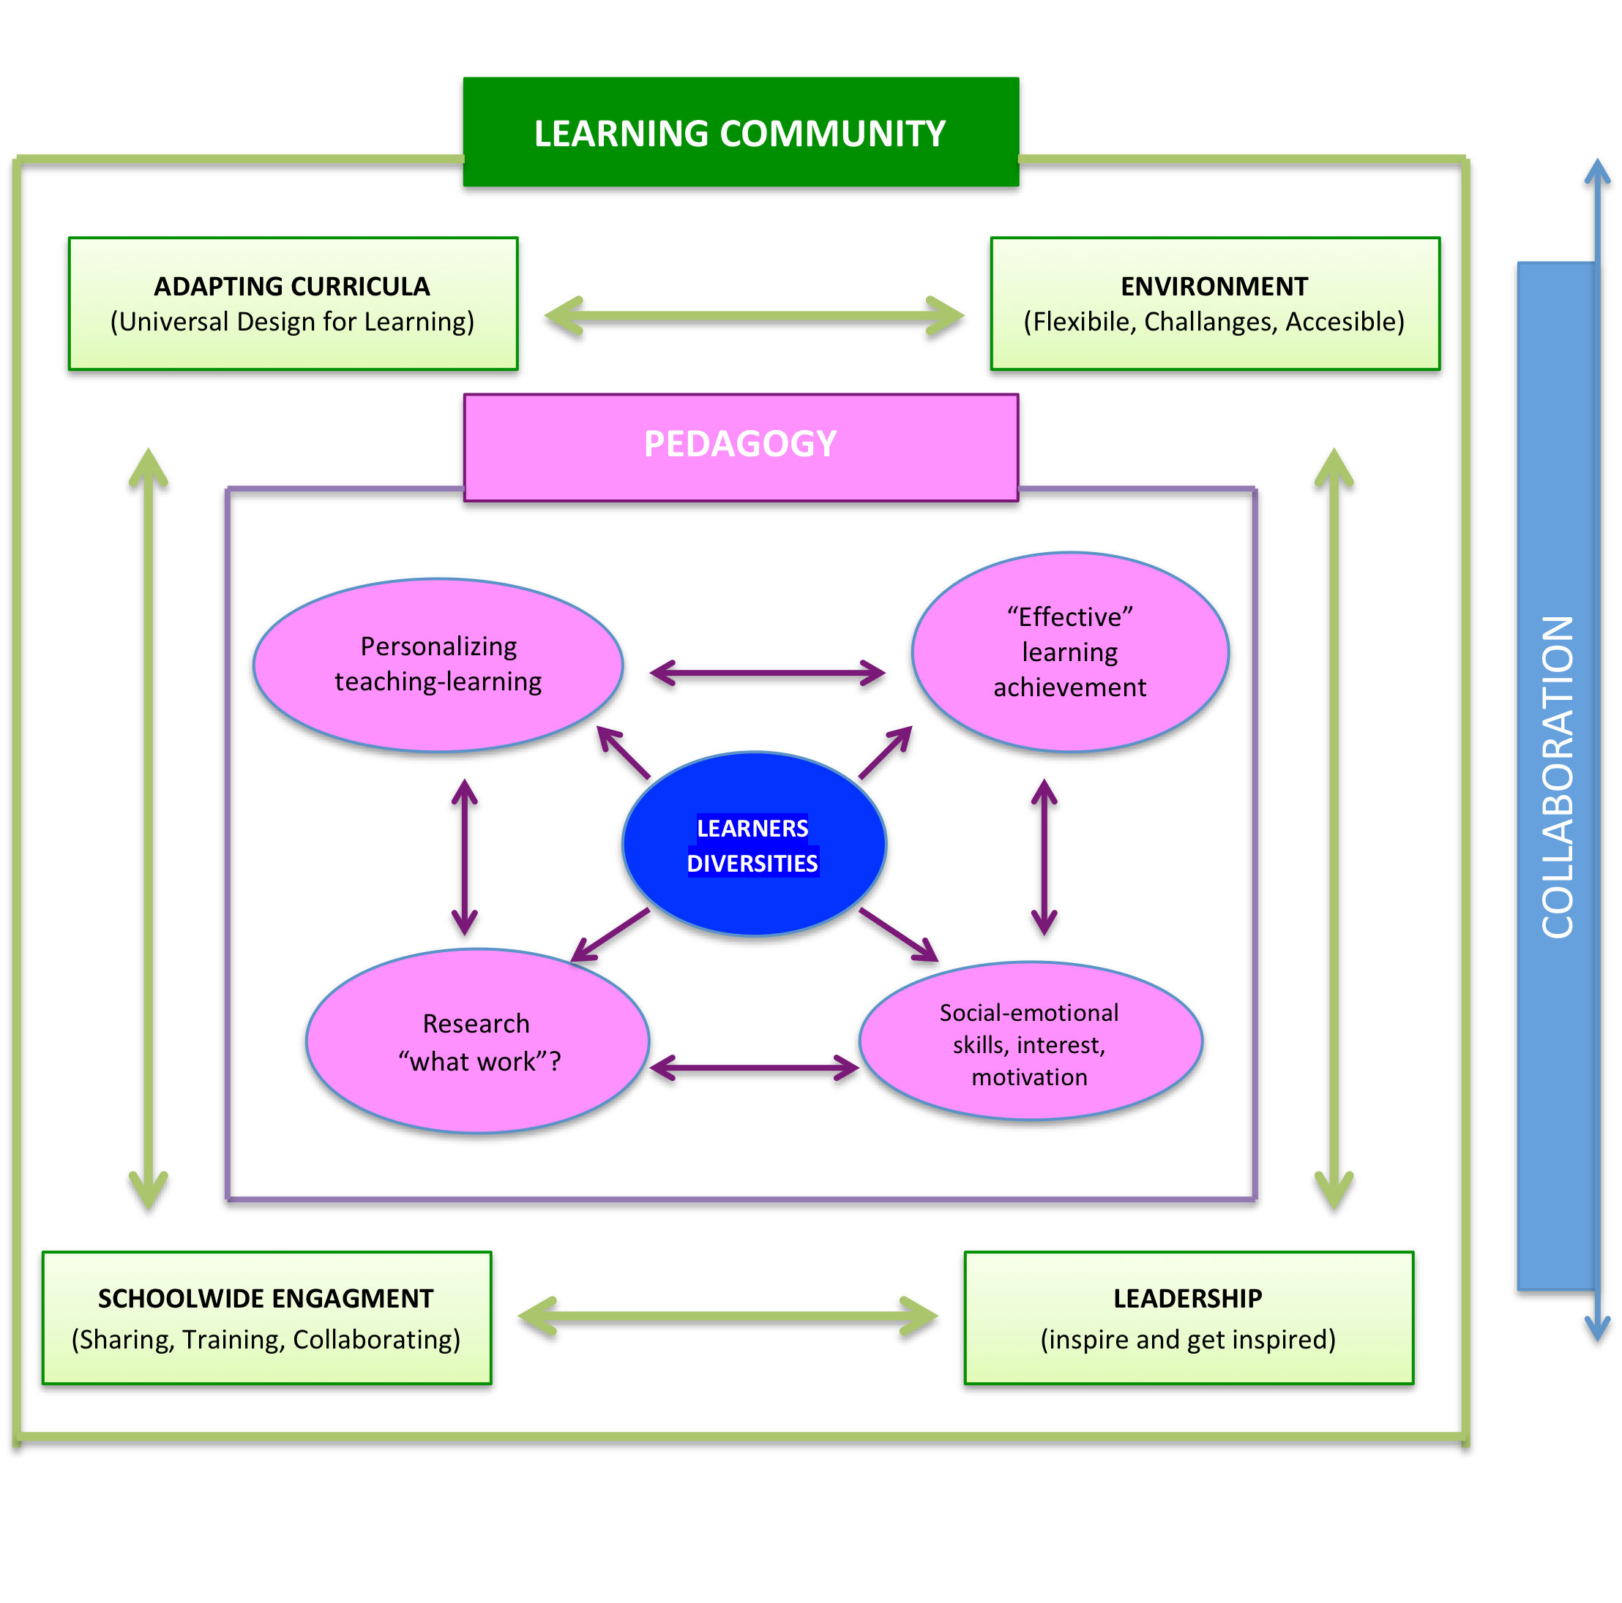
Collaborative work of the learning community
Notes:
Collaborative work of the learning community
The diagram shows the collaborative work of the learning community:
Inspiring leadership, flexible environment, adapted curricula and schoolwide engagement. This supports pedagogy for personalisation with attention to social-emotional skills, using research to meet learner diversity.

Slide 6
Role of Educators
As educators, we can do more than building inclusive Learning Communities; we must make them “tools for development” for all of those involved.
Notes:
Role of Educators
As educators, we can do more than building inclusive Learning Communities; we must make them “tools for development” for all of those involved.

Slide 7
Evidence Based Education: European Strategic Model for School Inclusion (2014-2017)
How to assess the inclusiveness of the school?
An inclusive school is also an efficient school?
How to improve the quality of inclusion?
Notes:
Evidence Based Education: European Strategic Model for School Inclusion (2014-2017)
How to assess the inclusiveness of the school?
An inclusive school is also an efficient school?
How to improve the quality of inclusion?

Slide 8
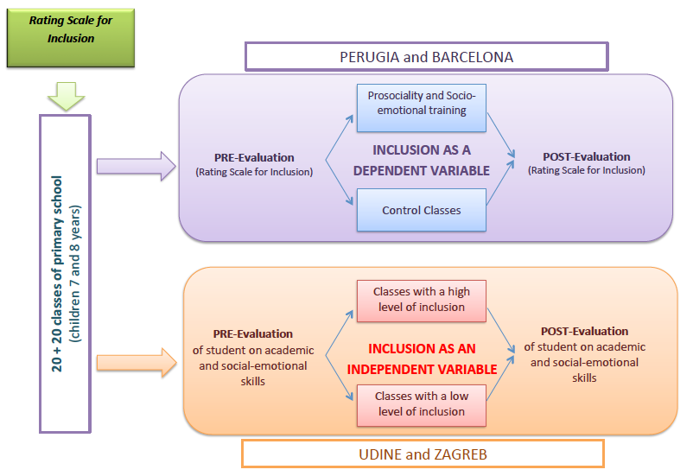
Experimental Plans
CONCLUDED
High level of inclusion classroom
IN PROGRESS
Assessment of pupils’ academic, social and emotional abilities
Low level of inclusion classroom
2,500 pupils
Notes:
Experimental Plans
The diagram outlines plans from the project Universities Perugia, Barcelona, Udine and Zagreb to develop the Rating Scale for Inclusion and the focus on prosocial and socio-emotional learning.
The diagram outlines plans from the project by the Universities of Perugia, Barcelona, Udine and Zagreb to develop the Rating Scale for Inclusion and the focus on prosocial and socio-emotional learning.
2,500 pupils are involved, in the form of 20 + 20 classes of primary school (children aged 7 and 8 years). The first component has concluded. It consisted of pre-evaluation (rating scale for inclusion); inclusion as a dependent variable (prosociality and socio-emotional training; control classes); post-evaluation (rating scale for inclusion). The second component is in progress. Arrows link textboxes reading 'high level of inclusion classroom' and 'low level of inclusion classroom' to text that says Assessment of pupils’ academic, social and emotional abilities.

Slide 9
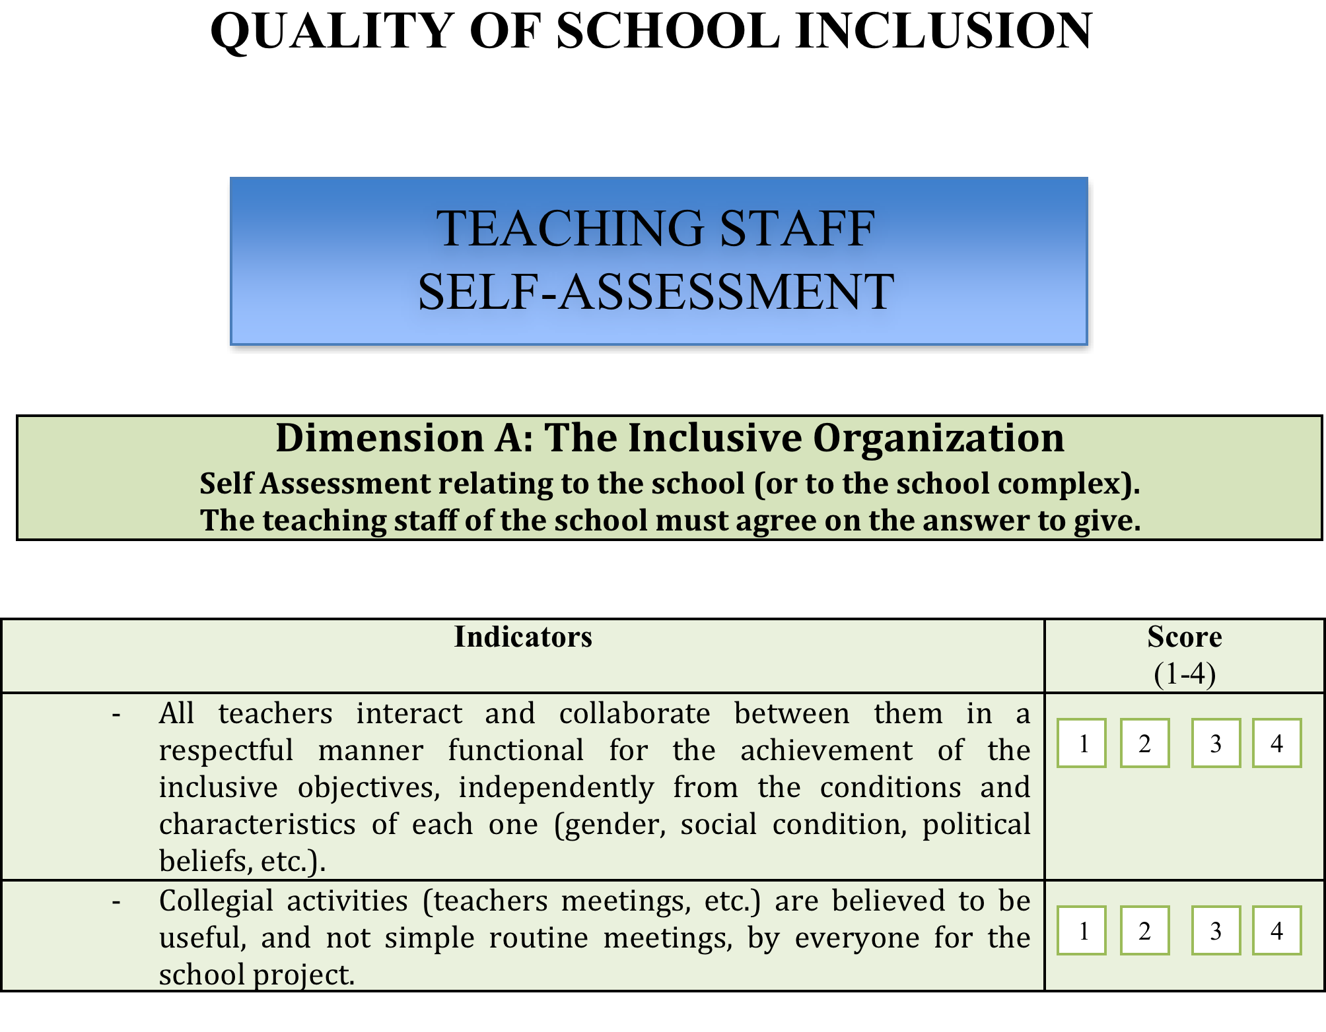
“Inclusive Process Assessment Scale”
(Cottini, Fedeli, Morganti, Pascoletti, Signorelli, Zanon, Zoletto, 2016)
Notes:
“Inclusive Process Assessment Scale”
(Cottini, Fedeli, Morganti, Pascoletti, Signorelli, Zanon, Zoletto, 2016)
Teaching Staff Self-Assessment.
Dimension A: The Inclusive Organization. Self-Assessment relating to the school (or to the school complex). The teaching staff of the school must agree on the answer to give.
The table shows the Indicators in the left hand column, and the right hand column is for teachers to give a score from 1-4.
Indicators:
- All teachers interact and collaborate between them in a respectful manner functional for the achievement of the inclusive objectives, independently from the conditions and characteristics of each one (gender, social condition, political beliefs, etc.).
- Collegial activities (teachers' meetings, etc.) are believed to be useful and not simple routine meetings, by everyone for the school project.

Slide 10
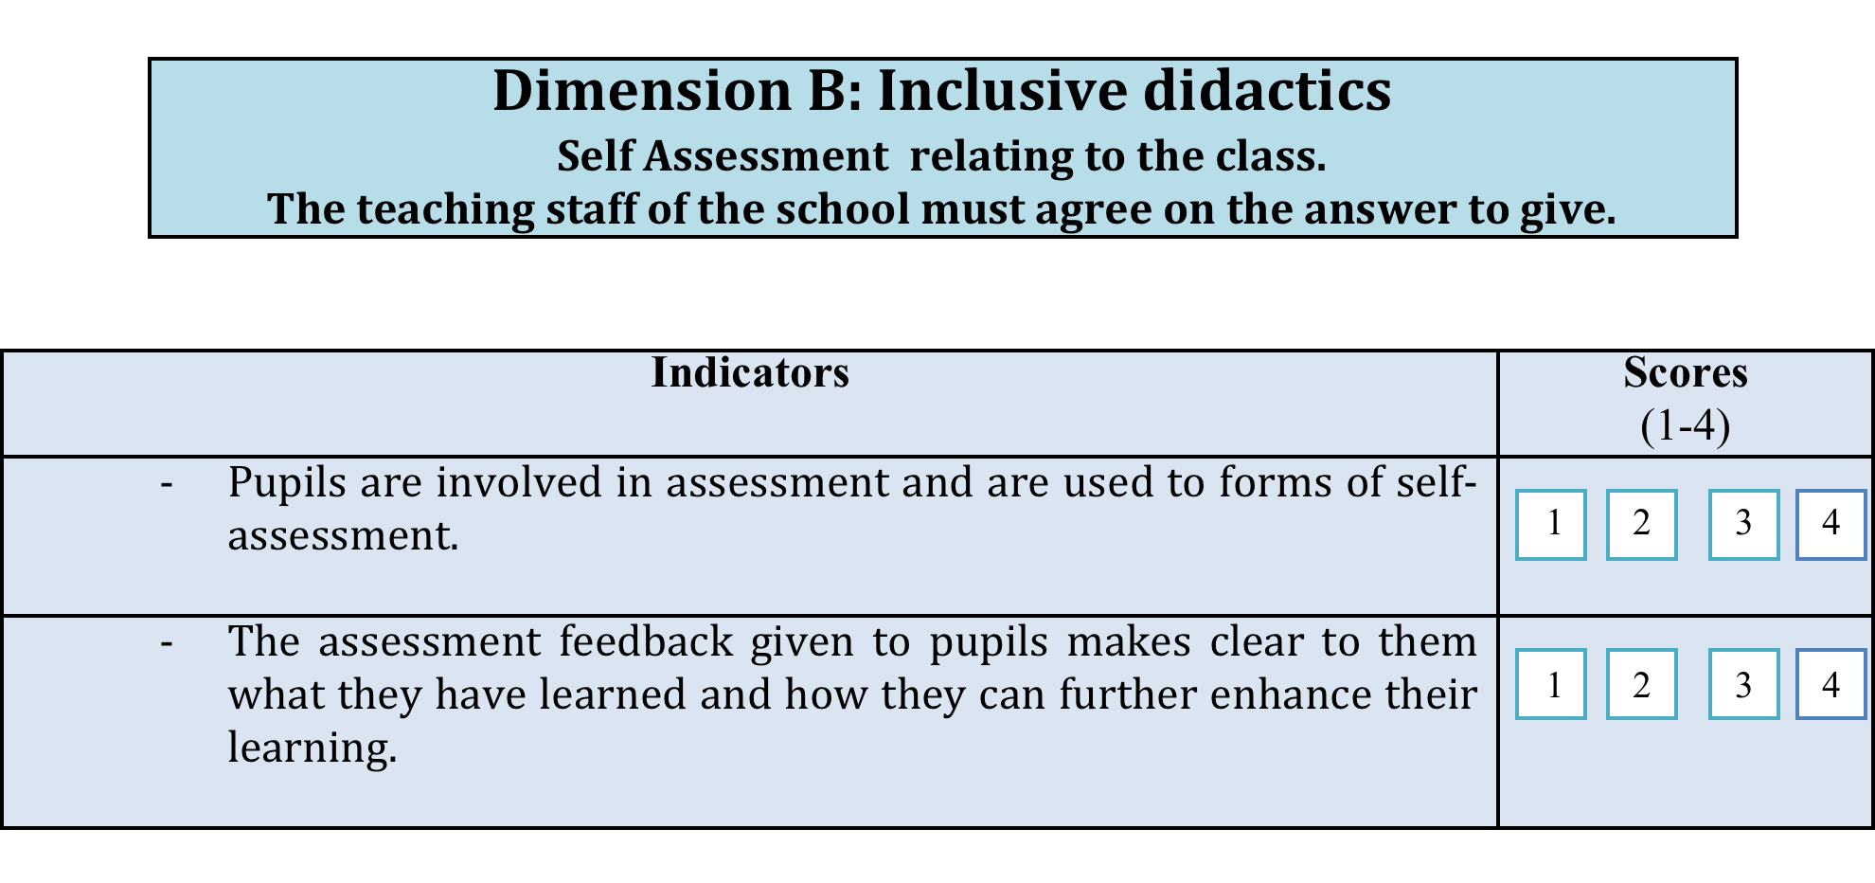
Erasmus+ Evidence Based Education. European Strategic Model for School Inclusion (EBE-EUSMOSI) – 2014-1-IT02-KA201-003578
Notes:
Erasmus+ Evidence Based Education. European Strategic Model for School Inclusion (EBE-EUSMOSI) – 2014-1-IT02-KA201-003578
Dimension B: Inclusive didactics. Self-Assessment relating to the class. The teaching staff must agree on the answer to give.
The table shows the Indicators in the left hand column, and the right hand column is for teachers to give a score from 1-4.
Indicators:
- Pupils are involved in assessment and are used to forms of self-assessment.
The assessment feedback given to pupils makes clear to them what they have learned and how they can further enhance their learning.
Objective indicators for the quality of inclusion
1. How many training and discussion meetings have been organised during the school year on topics concerning inclusion that have seen the participation of the school staff?
- None
- 1 to 2
- 3 to 5
- More than 5.
Please write the meetings' names:

Slide 11
INNOVATING TEACHING AND LEARNING PRACTICES
“The PROSEL Curriculum”
(Prosociality & Social Emotional Learning)
Notes:
INNOVATING TEACHING AND LEARNING PRACTICES
“The PROSEL Curriculum”
(Prosociality & Social Emotional Learning)

Slide 12
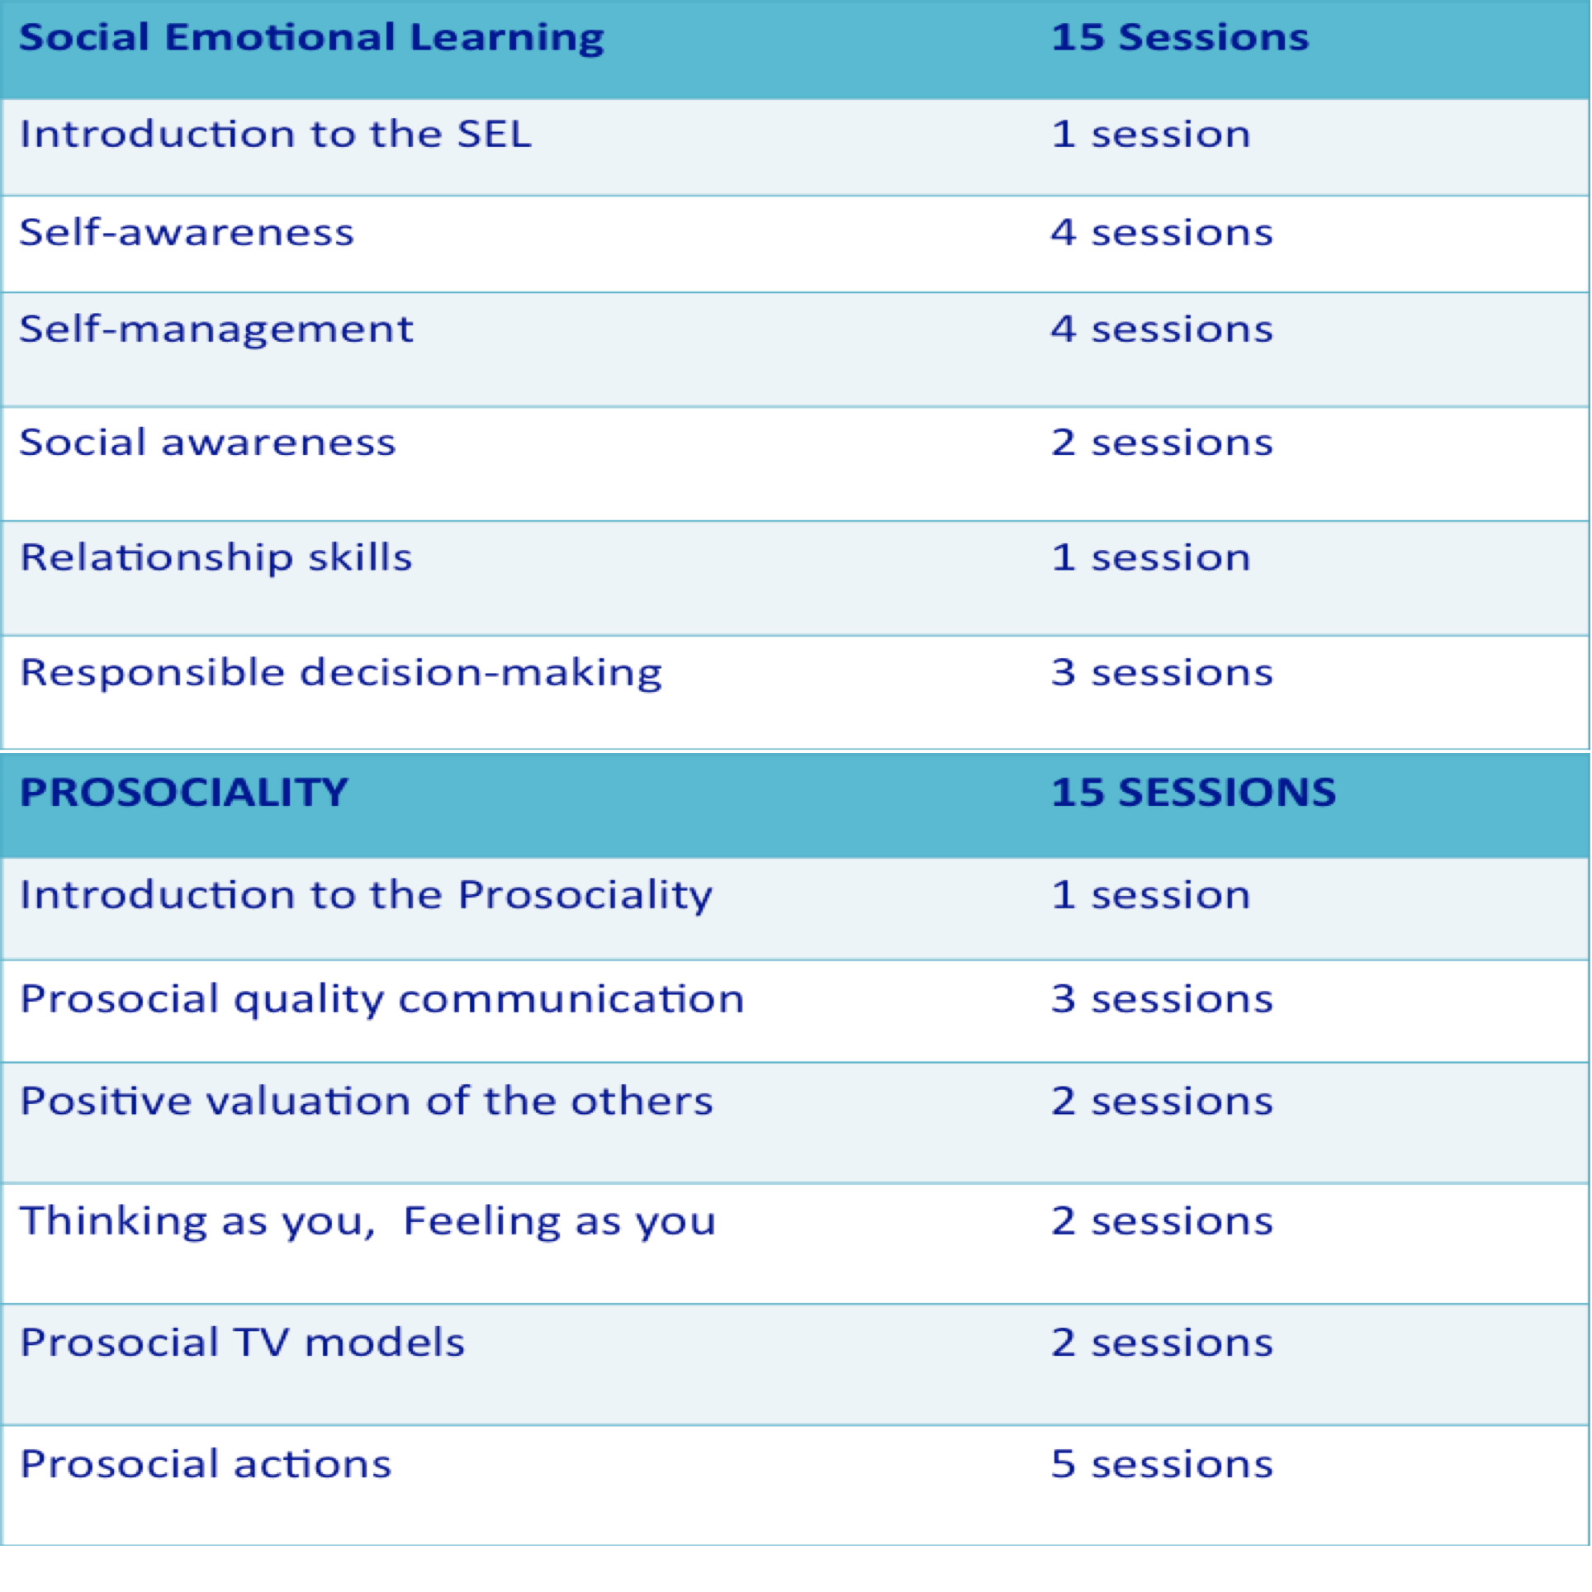
PROSEL Curriculum
Notes:
PROSEL Curriculum
Social Emotional Learning - 15 sessions:
- Introduction to the SEL: 1 session
- Self-awareness: 4 sessions
- Self-management: 4 sessions
- Social awareness: 2 sessions
- Relationship skills: 1 session
- Responsible decision-making: 3 sessions.
Prosociality - 15 sessions:
- Introduction to Prosociality: 1 session
- Prosocial quality communication: 3 sessions
- Positive valuation of others: 2 sessions
- Thinking as you, feeling as you: 2 sessions
- Prosocial TV models: 2 sessions
- Prosocial actions: 5 sessions

Slide 13
The PROSEL Curriculum: first outcomes
Students direct assessment: from 7,5 to 10;
Surprising maturity for their age for the easy and adequate learning of all the concepts presented during the activities;
The single word PROSEL identified relevant ideas and emotions which demonstrated micro-cognitive changes in the students;
Teachers felt not just as “passing on” knowledge to their students; they felt changed in their social, emotional and prosocial competencies.
Notes:
The PROSEL Curriculum: first outcomes
Students direct assessment: from 7,5 to 10;
Surprising maturity for their age for the easy and adequate learning of all the concepts presented during the activities;
The single word PROSEL identified relevant ideas and emotions which demonstrated micro-cognitive changes in the students;
Teachers felt not just as “passing on” knowledge to their students; they felt changed in their social, emotional and prosocial competencies.

Slide 14
Research
EFFICACY RESEARCH
EFFECTIVENESS RESEARCH
Notes:
Research
EBE-EUSMOSI: efficacy research
Raising the Achievement of All Learners in Inclusive Education project: effectiveness research

Slide 15
WHAT’S NEXT?
Notes:
WHAT’S NEXT?

Slide 16
An Evidence-based Education Model in Inclusive Education
(Cottini, & Morganti, 2015; 2016)
IMPLEMENTATION
How can we make it work?
Is it working?
EFFECTIVENESS
When does it work?
EFFICACY
What does it work?
Notes:
An Evidence-based Education Model in Inclusive Education
(Cottini, & Morganti, 2015; 2016)
IMPLEMENTATION
How can we make it work?
Is it working?
EFFECTIVENESS
When does it work?
EFFICACY
What does it work?

Slide 17
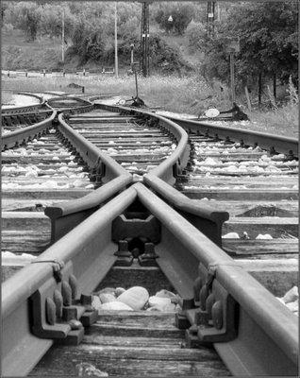
NEW ROADS TO GUIDE INNOVATION OF INCLUSIVE EDUCATION
Notes:
NEW ROADS TO GUIDE INNOVATION OF INCLUSIVE EDUCATION

Slide 18
Let’s start together. Now!
Thank you
Notes:
Let’s start together. Now!
Thank you

