Slide 1
Engaging Parents
Professor Sonia Blandford, CEO
April 2017
Notes:
Engaging Parents
Professor Sonia Blandford, CEO
April 2017

Slide 2
Working with schools…
Leadership
Teaching & Learning
Parent & Carer Engagement
The Whole Child
Wider outcomes & opportunities
Notes:
Working with schools…
Leadership, Teaching and learning, Parent and carer engagement, The whole child: Wider outcomes and opportunities
Introduce the Achievement for All programme - history, what it is, etc.

Slide 3
What works? Parents as Partners
Notes:
What works? Parents as Partners

Slide 4
Engaging parents
A key factor in the development of a school ‘learning’ community is the extent to which parents are engaged in their children’s learning.
Parental engagement in children’s learning has a very distinct and far-reaching effect on their outcomes.
Recent research across OECD countries and economies showed the greater confidence and motivation of children whose parents had high expectations for their learning and achievement.
(Schleicher, 2014)

Slide 5
Importance of Parental Engagement
Charles Desforges:
The best programmes train academic AND parenting skills:
Notes:
Importance of Parental Engagement
Charles Desforges:
Pupil age: 7, Parent effects: 0.29, School effects: 0.05;
Pupil age: 11, Parent effects: 0.27, School effects: 0.21;
Pupil age: 16, Parent effects: 0.14, School effects: 0.51.
The best programmes train academic AND parenting skills:
Best effects: Parents helped to read to child, Effect size: 0.18;
Best effects: Parents helped to listen to child read, Effect size: 0.51;
Best effects: Parents helped to teach specific reading skills, Effect size: 1.15.

Slide 6
The Achievement for All structured conversation model…
is an integral element within the wider Achievement for All programme.
has been a key success for schools in raising the aspirations and achievement of disadvantaged and vulnerable learners
Notes:
The Achievement for All structured conversation model…
is an integral element within the wider Achievement for All programme.
has been a key success for schools in raising the aspirations and achievement of disadvantaged and vulnerable learners

Slide 7
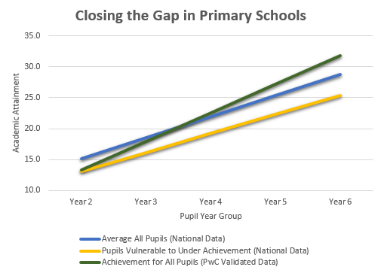
Impact: Evidence (Primary) (PwC, 2016)
Notes:
Impact: Evidence (Primary) (PwC, 2016)
The graph shows the more rapid progress for the Achievement for All pupils in comparison to two other groups of pupils (Average All Pupils and Pupils Vulnerable to Underachievement)

Slide 8
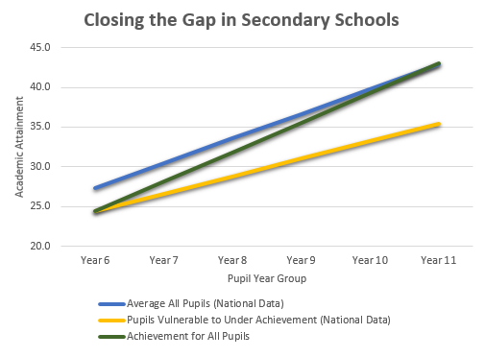
Impact: Evidence (Secondary) (PwC, 2016)
Notes:
Impact: Evidence (Secondary) (PwC, 2016)
The graph shows the more rapid progress for the Achievement for All pupils in comparison to two other groups of pupils (Average All Pupils and Pupils Vulnerable to Underachievement)

Slide 9
Engaging parents: What the teachers say
“Pupils are being listened to and have opportunity to express their aspirations more clearly. They are given more one-to-one time with their teacher.”
“Our culture of engagement and aspiration has improved, and so lessons are more focused and behaviour is better, which also benefits other pupils”
“Achievement for All has helped us focus on aspirational outcomes. Planning for SEND children is now more parent- and pupil-centred.”
Notes:
Engaging parents: What the teachers say
“Pupils are being listened to and have opportunity to express their aspirations more clearly. They are given more one-to-one time with their teacher.”
“Our culture of engagement and aspiration has improved, and so lessons are more focused and behaviour is better, which also benefits other pupils”
“Achievement for All has helped us focus on aspirational outcomes. Planning for SEND children is now more parent- and pupil-centred.”

Slide 10
Engaging parents: What the parents say
“Knowing a teacher can see the same problem with my child as I do and we both try and solve and help my child together.”
“M has been gaining confidence over the course of our involvement in Achievement for All. As a result of this, we’re now seeing academic improvements, particularly in reading and writing.”
“My child has been encouraged to improve academically without being made to feel that he’s bad at everything.”
Notes:
Engaging parents: What the parents say
“Knowing a teacher can see the same problem with my child as I do and we both try and solve and help my child together.”
“M has been gaining confidence over the course of our involvement in Achievement for All. As a result of this, we’re now seeing academic improvements, particularly in reading and writing.”
“My child has been encouraged to improve academically without being made to feel that he’s bad at everything.”

Slide 11
Engaging parents: What the pupils say
“Getting my parents involved with my work has been good. That’s a big thing for me.”
Notes:
Engaging parents: What the pupils say
“Getting my parents involved with my work has been good. That’s a big thing for me.”

Slide 12
Thank you
Professor Sonia Blandford, CEO
Achievement for All
Achievement for All is a registered charity. No. 1142154.
Registered in England and Wales as Achievement for All (3As) Ltd. No. 07528857
Notes:
Thank you
Professor Sonia Blandford, CEO
Achievement for All
Achievement for All is a registered charity. No. 1142154.
Registered in England and Wales as Achievement for All (3As) Ltd. No. 07528857

