Slide 1
Versatile support for learning
through the Incredible Years program and HyMy-lessons for social and emotional skills
Finland, Vantaa, Vierumäki School, Principal Elina Kuosmanen
Country experts Mari-Pauliina Vainikainen and Merja Koivisto
Notes:
Versatile support for learning
through the Incredible Years program and HyMy-lessons for social and emotional skills
Finland, Vantaa, Vierumäki School, Principal Elina Kuosmanen
Country experts Mari-Pauliina Vainikainen and Merja Koivisto

Slide 2
It is common knowledge
outside of academic journals that motivation, tenacity, trustworthiness, and perseverance are important traits for success in life. It is thus surprising that academic discussions of skill and skill formation almost exclusively focus of cognitive ability and ignore noncognitive skills.
Heckman & Rubinstein, 2001
But the times have changed…
Notes:
It is common knowledge
outside of academic journals that motivation, tenacity, trustworthiness, and perseverance are important traits for success in life. It is thus surprising that academic discussions of skill and skill formation almost exclusively focus of cognitive ability and ignore noncognitive skills.
Heckman & Rubinstein, 2001
But the times have changed…

Slide 3
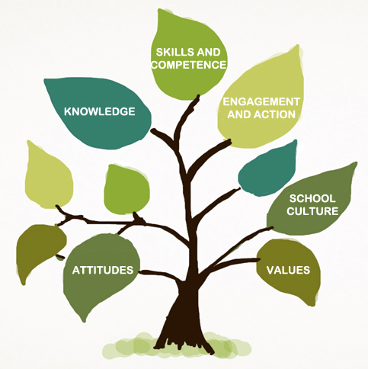
School as learning community
Strengthening pupils’ positive and realistic self-image as learners
Emphasis on unhurried pace and peace
Interaction and empowerment wellbeing and safety in daily life
Notes:
School as learning community
Strengthening pupils’ positive and realistic self-image as learners
Emphasis on unhurried pace and peace
Interaction and empowerment wellbeing and safety in daily life
[Image: Tree with Attitudes, Knowledge, Skills and Competence, Engagement and Action, School Culture and Values written on the leaves]

Slide 4
If you are not prepared to look at your pupils’ strengths,
don’t touch their weaknesses.
Reuven Feuerstein
Notes:
If you are not prepared to look at your pupils’ strengths, don’t touch their weaknesses.
Reuven Feuerstein

Slide 5
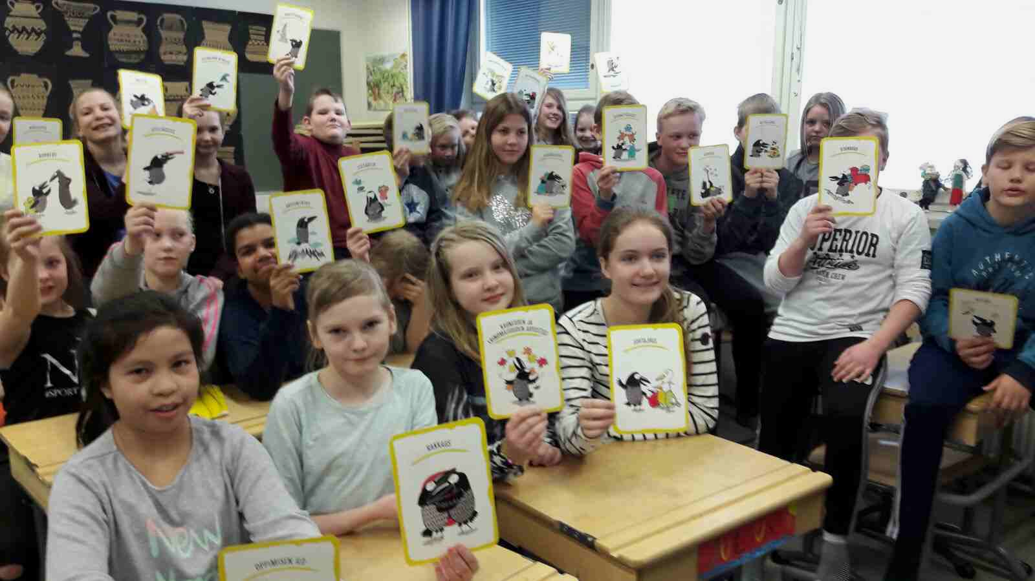
HyMy (=Smile)
Learning emotional skills in Vierumäki school
Vierumäki school environment
Notes:
HyMy (=Smile)
Learning emotional skills in Vierumäki school
Vierumäki school environment

Slide 6
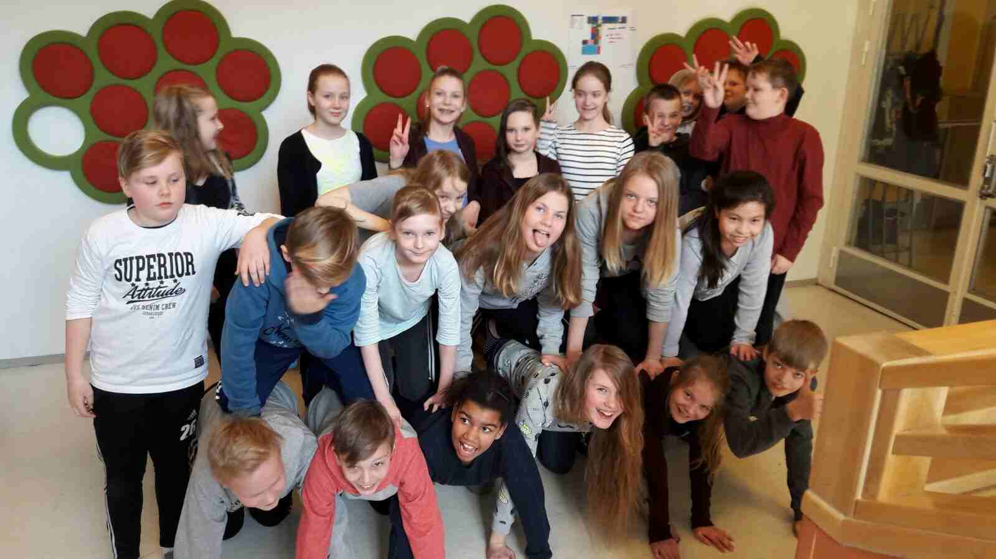
HyMy lesson once a week Every Tuesday 9-10 am HyMy-lesson.
It is easy to teach reading and math but why so difficult social and emotional skills!
During this school year we use the material “Huomaa hyvä” by Kaisa Vuorinen.
Important to remember: Playing is learning!
HyMy theme of month and “HyMy-radio”, like Kick off for every month
FEBRUARY Justice: Teamwork, Fairness and Leadership
MARCH Temperance: Forgiveness, Humility, Prudence, Self-regulation
VERSO is one part of our HyMy-work. The aim is teach children to understand their rights as well as learn social skills by mediation. School mediation is seen as learning situation where children learn not only to manage conflicts but also to use their right of participating and being heard.
Verso
Notes:
HyMy lesson once a week Every Tuesday 9-10 am HyMy-lesson.
It is easy to teach reading and math but why so difficult social and emotional skills!
During this school year we use the material “Huomaa hyvä” by Kaisa Vuorinen.
Important to remember: Playing is learning!
HyMy theme of month and “HyMy-radio”, like Kick off for every month
FEBRUARY Justice: Teamwork, Fairness and Leadership
MARCH Temperance: Forgiveness, Humility, Prudence, Self-regulation
VERSO is one part of our HyMy-work. The aim is teach children to understand their rights as well as learn social skills by mediation. School mediation is seen as learning situation where children learn not only to manage conflicts but also to use their right of participating and being heard.
Verso

Slide 7
VIA Classification of Character Strengths and Virtues
Via Survey
Notes:
VIA Classification of Character Strengths and Virtues
The Character Strengths of a Flourishing Life include:
- Wisdom (Creativity, Curiosity, Judgment, Love of Learning, Perspective)
- Courage (Bravery, Perseverance, Honesty, Zest)
- Humanity (Love, Kindness, Social Intelligence)
- Justice (Teamwork, Fairness, Leadership)
- Temperance (Forgiveness, Humility, Prudence, Self-Regulation)
Transcendence (Appreciation of Beauty and Excellence, Gratitude, Hope, Humor, Spirituality)
VIA Institute on Character (where the world finds strength)
www.viacharacter.org

Slide 8
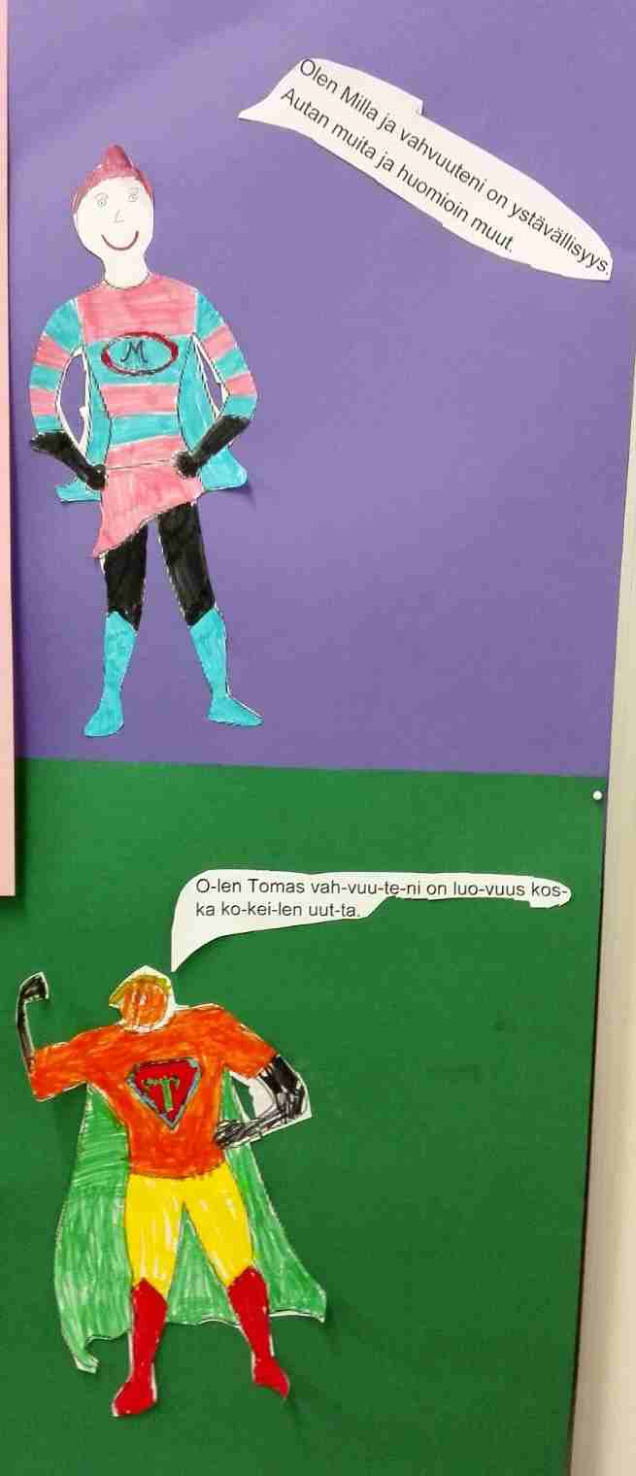
HyMy – adults’ attitude and positive solution orientation
It is not always possible to change how pupils react.
Teachers must and can change and vary the way they work.
All our teachers and school assistants have studied the program of Incredible Years www.incredibleyears.com/
Teachers have the ability to see farther and help pupils to succeed.
Notes:
HyMy – adults’ attitude and positive solution orientation
It is not always possible to change how pupils react.
Teachers must and can change and vary the way they work.
All our teachers and school assistants have studied the program of Incredible Years www.incredibleyears.com/
Teachers have the ability to see farther and help pupils to succeed.
Solution-oriented working method: An arrow points from left to right, with points numbered 1 to 5 moving along the arrow.
Point 1. Noticed the need for developing operating culture.
Point 2. Figuring out development issues and how to promote the issues together.
Point 3. Figuring out together a variety of creative ways to promote operating culture.
Point 4. Test and evaluate together the impact of change.
Point 5. Change in operating culture is done together - good change requires the commitment of all.

Slide 9
HyMy- not only one lesson a week
Feeling good weeks (video), Feeling Good Morning Cafe for parents and other phenomenon phased periods
After school meal 1st and 2nd graders play every day together, older pupils are “godparents”
We have lot of sports and exercises outside
Pupils can influence and participate, even the youngest ones
No special classes but precise structures to support pupils
(1st graders video learning co-operation)
Notes:
HyMy- not only one lesson a week
Feeling good weeks (video), Feeling good Morning Cafe for parents and other phenomenon phased periods
After school meal 1st and 2nd graders play every day together, older pupils are “godparents”
We have lot of sports and exercises outside
Pupils can influence and participate, even the youngest ones
No special classes but precise structures to support pupils
(1st graders video learning co-operation)

Slide 10
“It's easier to build strong children than to repair broken men”
-Frederick Douglass
Notes:
“It's easier to build strong children than to repair broken men”
-Frederick Douglass

Slide 11
More information →
Notes:
More information

Slide 12
“Contrary to what most of us believe, happiness does not simply happen to us. It's something that we make happen”
Mihaly Csikszentmihalyi, co-founder of positive psychology
Notes:
“Contrary to what most of us believe, happiness does not simply happen to us. It's something that we make happen”
Mihaly Csikszentmihalyi, co-founder of positive psychology

Slide 13
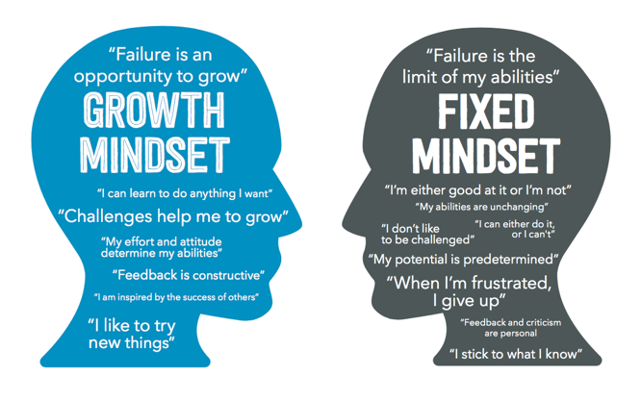
Growth Mindset vs Fixed Mindset
Notes:
Growth Mindset vs Fixed Mindset
Two silhouette heads with writing on face each other. The head on the left says:
Growth Mindset: 'Failure is an opportunity to grow', 'I can learn to do anything I want', 'Challenges help me to grow', 'My effort and attitude determine my abilities', 'Feedback is constructive', 'I am inspired by the success of others', 'I like to try new things'.
The head on the right says:
Fixed Mindset: 'Failure is the limit of my abilities', 'I'm either good at it or I'm not', 'My abilities are unchanging', 'I don't like to be challenged', 'I can either do it or I can't', 'My potential is predetermined', 'When I'm frustrated I give up', 'Feedback and criticism are personal', 'I stick to what I know'.

